Slide 1
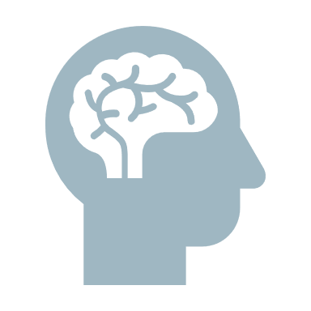
NEUROHACKING
Emmanuel NICAISE, MPsy, CISSP, CISM
11111100010
HACK.LU
Notes:
Hi everyone, I’m glad to be here and see so many people. When I thought about making a talk on neuro psychology in an hacking conference, I had the feeling that I would be as welcome as Mark Zuckerberg in a conference on Data Privacy. So far, it seems I was wrong.
While preparing this talk, I started realize that I was maybe a bit too optimistic. 45 minutes to explain why and how we can hack people… well, it’s a challenge. I know you’ve got lot of brain power there, but I’m not sure my bus has a bitrate high enough to transfer that amount of data. And also, I don’t think that giving you a 45 seconds explanation on a selection of the more than 200 cognitive biases identified so far will not lead to the biggest wave of people leaving a room that this conference has ever seen.
So I propose that we make a little journey all together in the discovery of your new target (you’re all hackers, right): the human. For t

Slide 2
QUIZZ
Knowing that the brain has an average of 86 billion neurons, how many connections between neurons (called synapses) can we find in the brain of an adult?
820 to 950 billion

100 to 500 trillion
1 quadrillion
HINT: average synapses per neurons: 7.000.
Notes:
FYI, as a comparison, a 8-core Core i7 Haswell-E has 2,6 billion circuits (but it’s like apples and oranges, so it means nothing)

Slide 3
HACK.LU HACKERS GROUP
MISSION:
Human Hacking
TARGET:
Bob and Alice
Background:
They are probably in a relationship as it seems they exchange a lot of messages
Phase 1:
Hardware Reverse Engineering

Slide 4
I won’t see cryptography the same way, now!
Alice
PICTURES
Bob

Slide 5
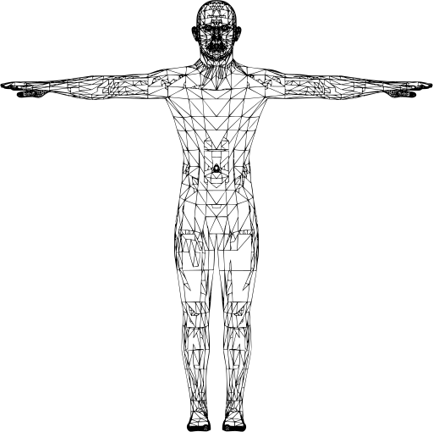
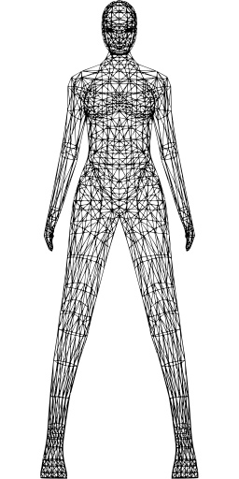
HW Version 1.0
SCHEMATICS
Notes:
These two guys are exchanging messages all the time

Slide 6
1 VLSI microprocessor, a lot a ASIC dedicated processors, 5 kb cache memory. NO MULTITASKING AVAILABLE
SPECIFICATIONS
2 HD Stereoscopic colours cameras with movements detection
2 HiFi microphone, with noise filtering
1 speaker (sometimes HiFi)
1 unlimited size fuzzy storage disk

Slide 7
 MULTITASKING
 TIME SHARING
BENCHMARK

PERFORMANCE
Yes, it’s true for woman too!
Number of // tasks

Slide 8
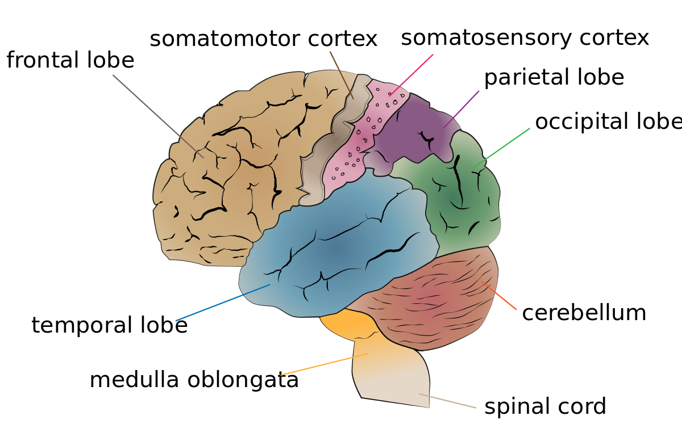
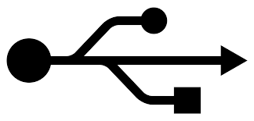
PROCESSOR’s ARCHITECTURE

Slide 9
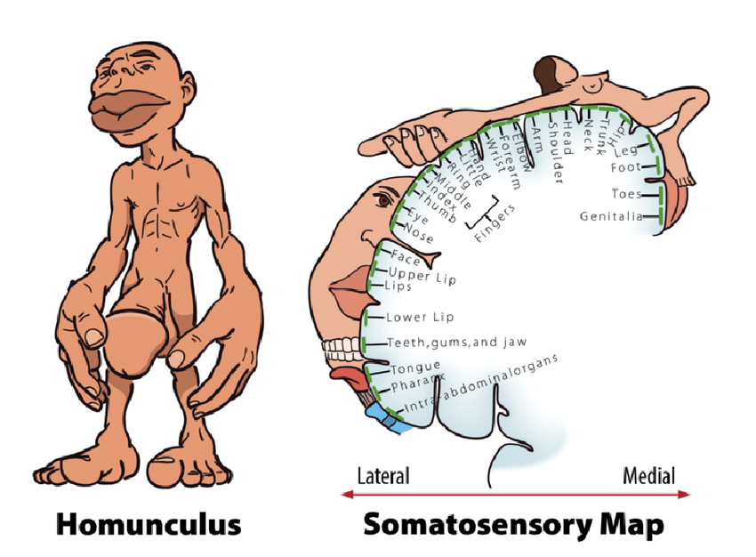
That’s really disproportionate… hands
SOMATOSENSORY CORTEX’s ARCHITECTURE

Slide 10
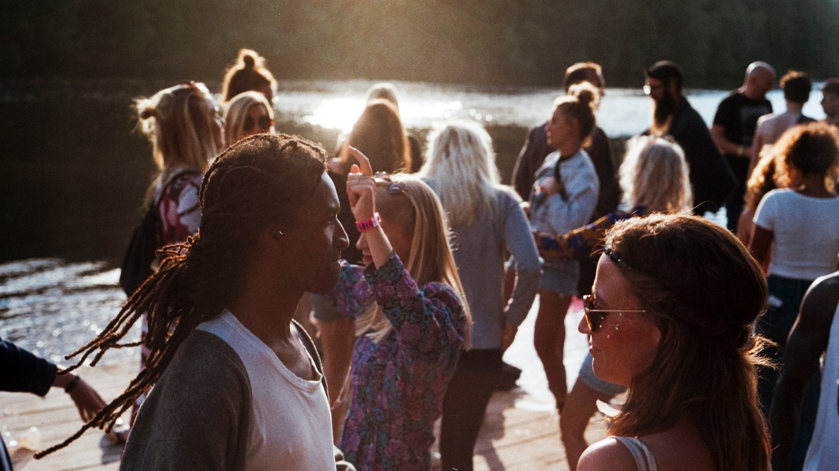
If you touch someone
(holding hand, touch the shoulder)
after you asked him to do something,
you increase the likelihood that
he will perform the action

Slide 11
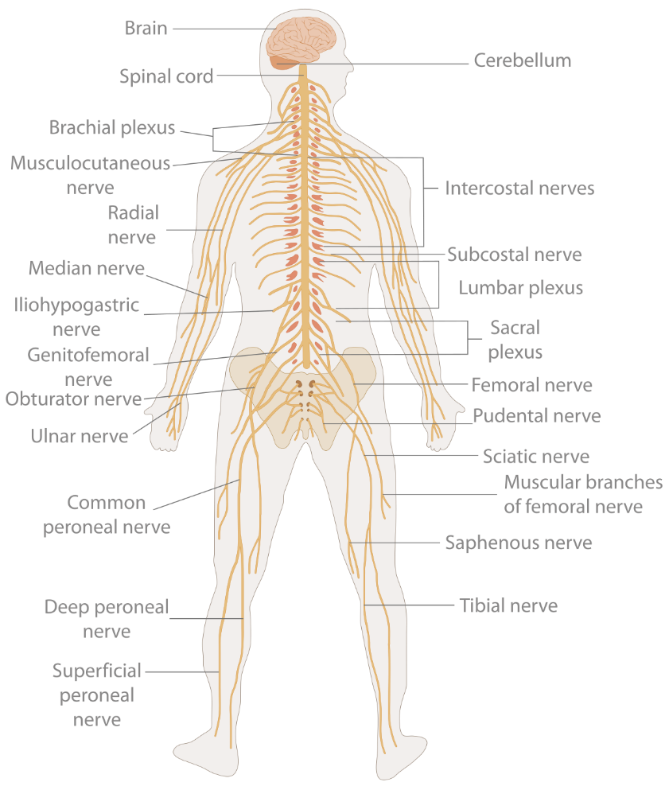
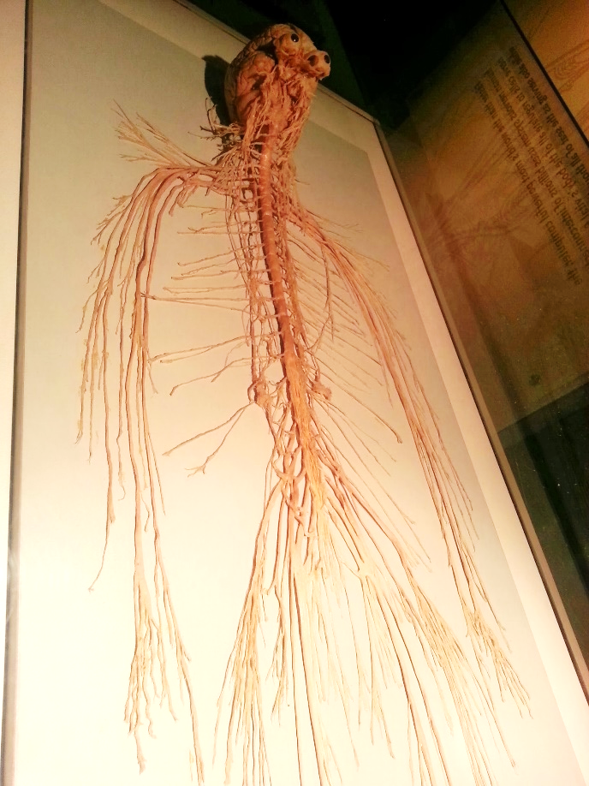
DATA BUS ARCHITECTURE

Slide 12
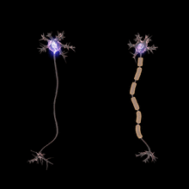
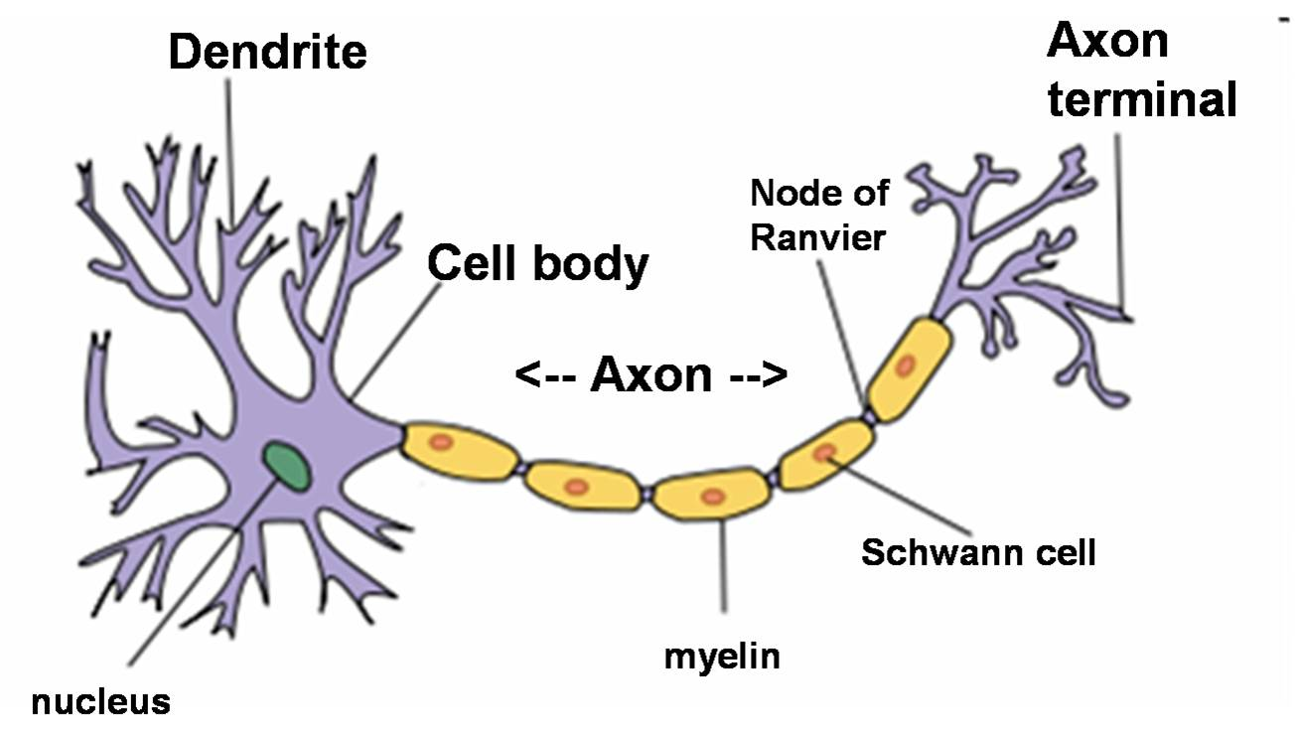
CABLING IN DETAIL

Slide 13
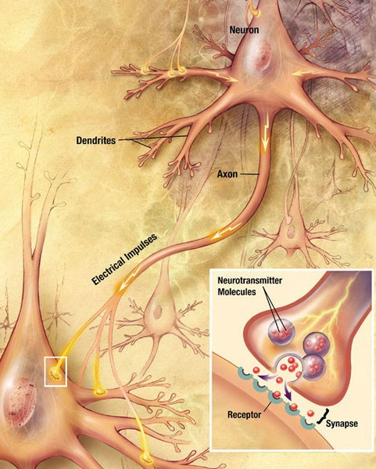
CONNECTORS IN DETAIL

Slide 14
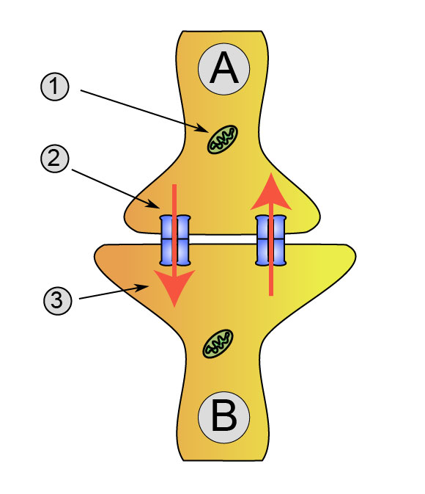
CHEMICAL
ELECTRICAL
CONNECTORS IN DETAIL
- Slower
+ More complex signal
+ more gain -> Long distance
- Simple signal
- Short distance
+ Faster

Slide 15
200+ type of neurotransmitters:
Glutamate (90% of the neurons in the brain)
Gamma-AminoButyric Acid (or GABA, 9%)
Dopamine
Serotonin
Oxytocin
Epinephrine (Adrenaline)
NEUROTRANSMITTERS

Slide 16
Neurotransmitters can be
(+) Excitatory (e.g. Glutamate)
(-) Inhibitory (e.g. GABA)
+
NEUROTRANSMITTERS
-
Activation threshold
+

Slide 17
Neurotransmitters can be
(+) Excitatory (e.g. Glutamate)
(-) Inhibitory (e.g. GABA)
+
NEUROTRANSMITTERS
-
-
Activation threshold
+

Slide 18
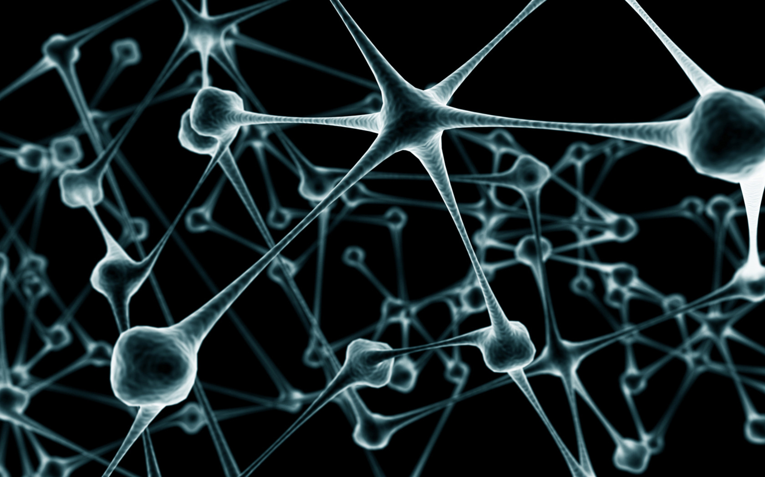
The brain’s communication mode is analogic. With 7.000 synaptic connections per neuron, nothing is never guaranteed

Slide 19
NEUROTRANSMITTERS
Stored in axons’ terminal
Are used in synapses
Affect neurons
HORMONES
Generated by glands and cells
Are used in the entire body
Travel through the bloodstream
Affect cells in the entire body
NEUROTRANSMITTERS vs. HORMONES
The same molecule can be used as
Neurotransmitter and Hormone

Slide 20
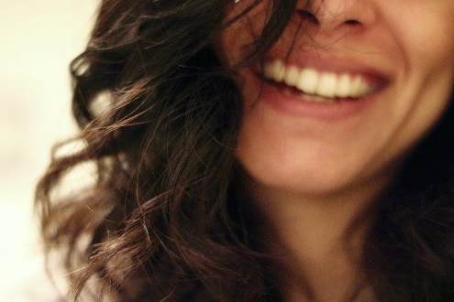
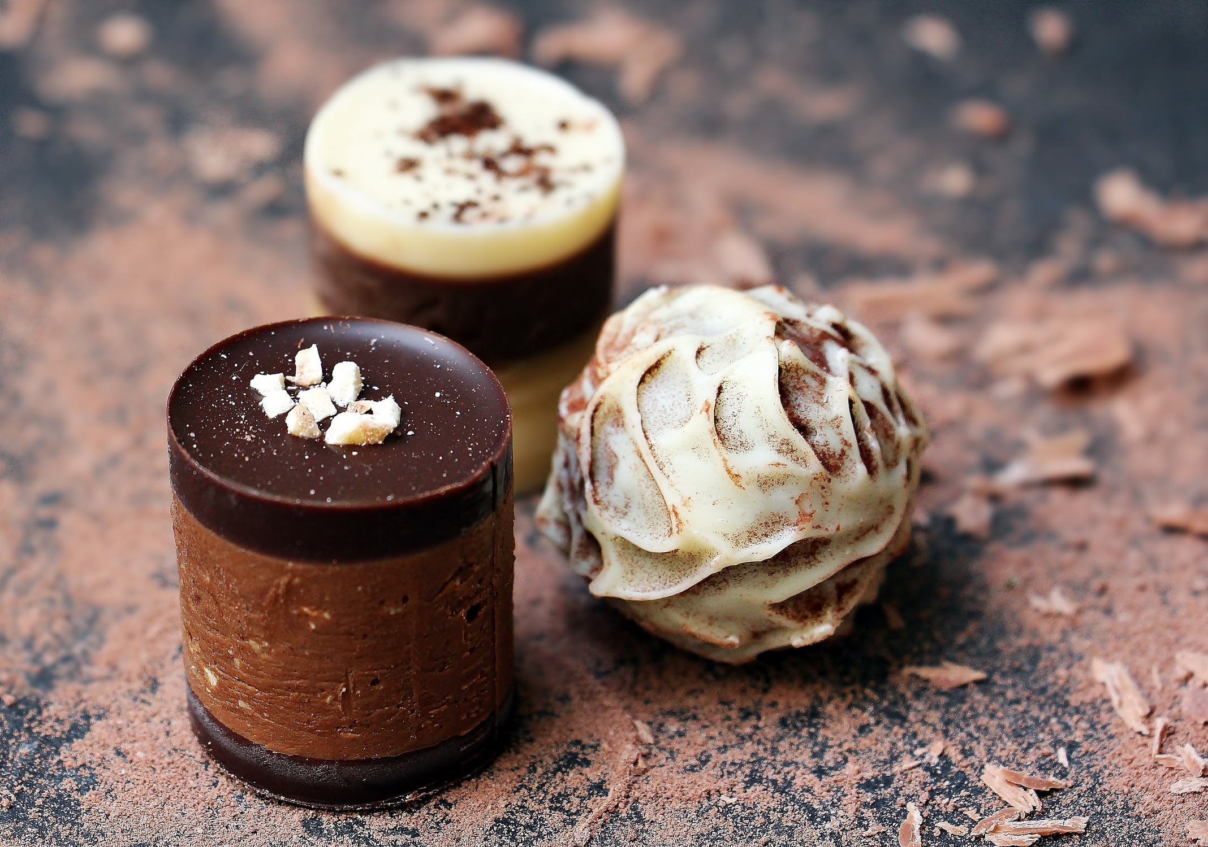
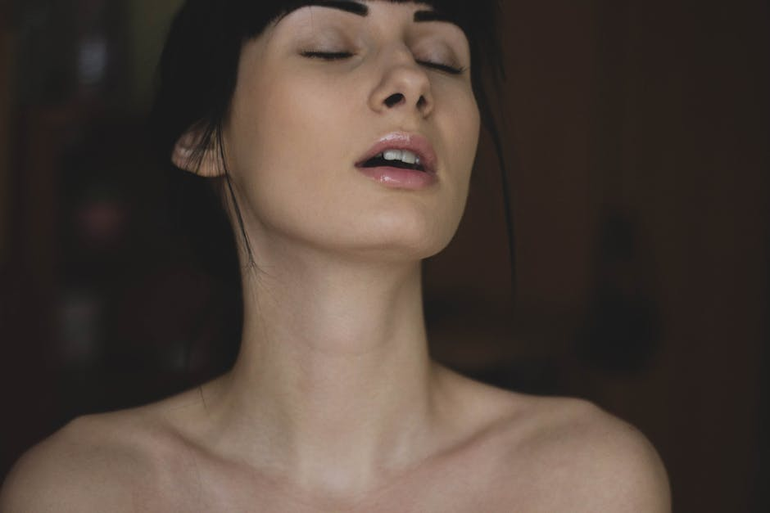
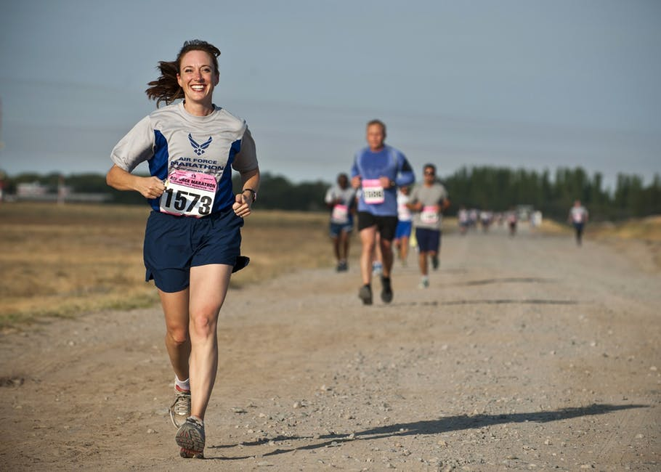
The REWARD SYSTEM is a group of neural structures influencing:
motivation,
desire,
pleasure,
craving for a reward,
associative learning
and positively-perceived emotions like joy or euphoria.
DOPAMINE, ENDORPHINE
REWARD SYSTEM
Notes:
Certain bundle of neurons using the same neurotransmitter creates pathway in our nervous system having specific psychological effects.

Slide 21
The reward system is activated by multiple stimuli.
Combine stimulus to increase the effect.
The sooner the reward follow the action, the greater the chances that the action will be repeated.

Slide 22
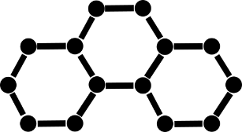
$$f\left(x\right)$$
NEUROTRANSMITTER
& HORMONES
BRAIN FUNCTIONS
EMOTIONS
Notes:
Some specific functions and tightly linked to some specific molecules

Slide 23
Who needs a scientific study to know that?
The brain’s is strongly influenced by some chemicals! Morphine, CO, THC, Alcohol, Sugar, fat,…

Slide 24
15 minutes to get to that! I Love science.
The best security can probably be defeated with a few beers.

Slide 25
Phase 2:
Software Reverse Engineering
Software Version 1.3047 – Fork 7.125.254.598
MAIN FUNCTIONS
FUNCTION #1: MAKE SENSE
FUNCTION #2: ANALYSE PATTERNS
Notes:
Certain bundle of neurons using the same neurotransmitter creates pathway in our nervous system having specific psychological effects.

Slide 26
PATTERNS RECOGNITION
?
Notes:
We tend to see rapidly patterns…

Slide 27
I really don’t like not finding the solution!
PATTERNS RECOGNITION
?
3
#
Z
Notes:
If you cannot make sense out of it, it makes you crazy.

Slide 28
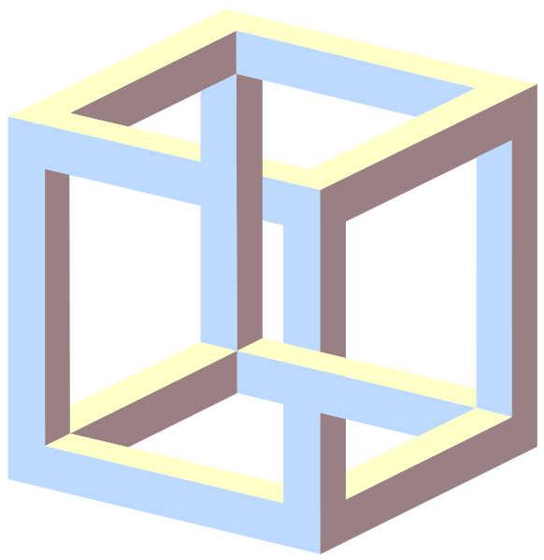
PATTERNS RECOGNITION FLAWS
Notes:
We can create sense where there is none… that an illusion.

Slide 29
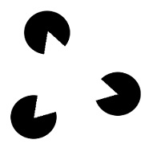
ILLUSIONS
Notes:
We see things where there is nothing… we fill the gaps

Slide 30
INCOMPLETE PATTERN MATCHING
Notes:
We see things where there is nothing… we fill the gaps… even with very few information

Slide 31
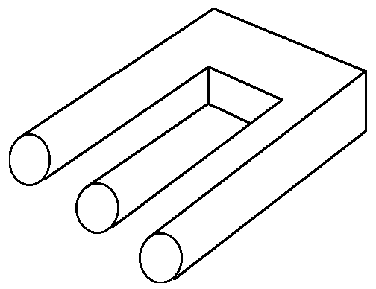
ILLUSIONS
Notes:
We desperately try to make sense of something that doesn’t, even if we know it doesn’t make sense

Slide 32
Inconsistency makes us stressed and vigilant.
If you want to make people do something, you must be coherent in your story, in your actions, to maintain vigilance at a low level.

Slide 33
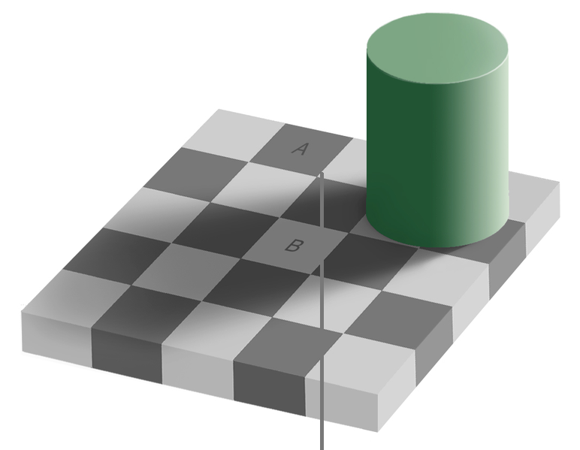
ILLUSIONS
Notes:
And our perception is influenced by the environment.
Check the colour of A, B and the line, they are identical if you can isolate them from the rest

Slide 34
AUTOMATED PATTERN MATCHING
Notes:
Some patterns are more easy to recognize, even with little information

Slide 35
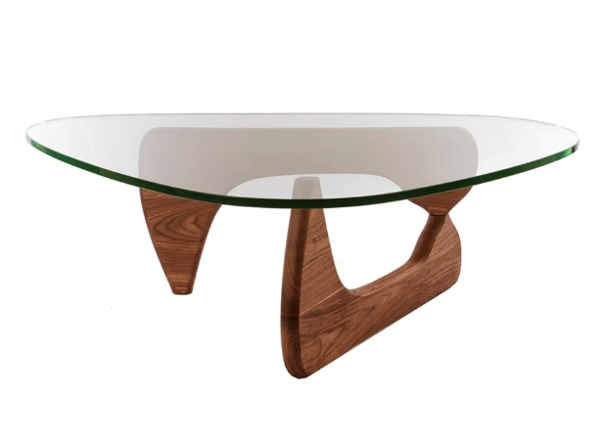
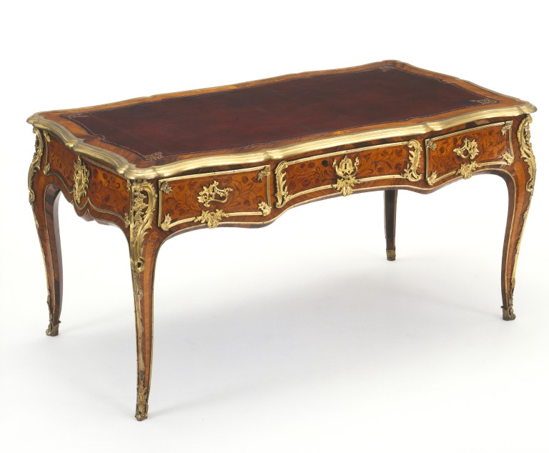
This is a table
CATEGORISATION
This is a table too
Notes:
We see things where there is nothing… we fill the gaps… even with very few information

Slide 36
TABLES
CATEGORISATION
Notes:
We see things where there is nothing… we fill the gaps… even with very few information

Slide 37
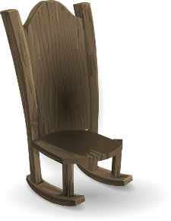
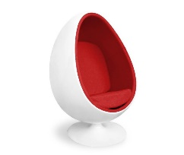
FURNITURES
CATEGORISATION
CHAIRS
TABLES
Notes:
We see things where there is nothing… we fill the gaps… even with very few information

Slide 38
TABLE = ?
PROTOTYPE & STEREOTYPES
Notes:
We see things where there is nothing… we fill the gaps… even with very few information

Slide 39
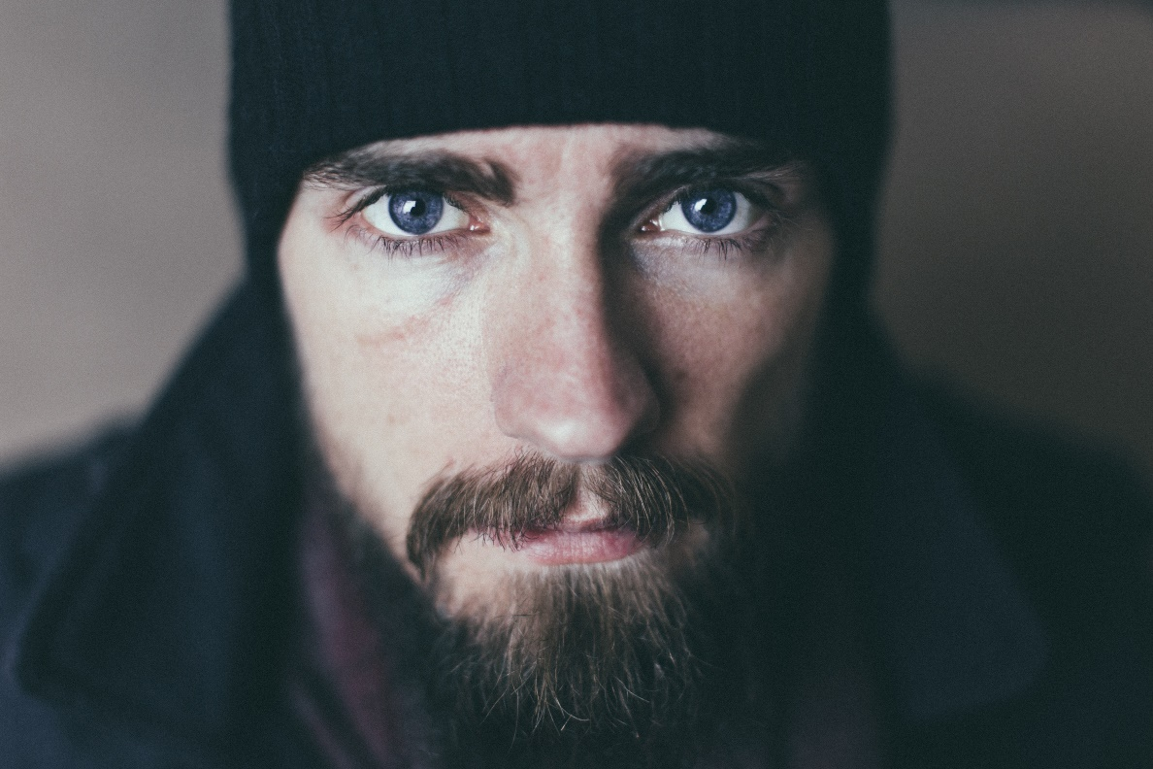
WHAT YOU SEE IS WHAT YOU USE
Notes:
Just take that picture

Slide 40
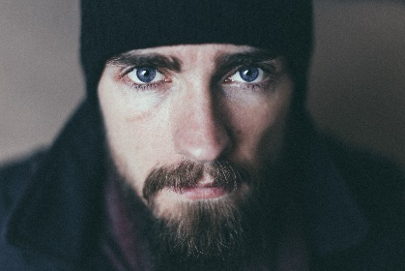
MAN
+
BEARD
WHAT YOU SEE IS WHAT YOU USE
+
CAUCASIAN
+
BLUE EYES
+
MARINE CAP
=
HARD WORKING, SOCIAL, TRUSTABLE?
Notes:
What do you see? A man with a beard, Caucasian, blue eyes wearing a marine cap. If I asked to give me a few personality traits, you could probably says Hardworking, Social and Trustable. Or who knows what else.

Slide 41
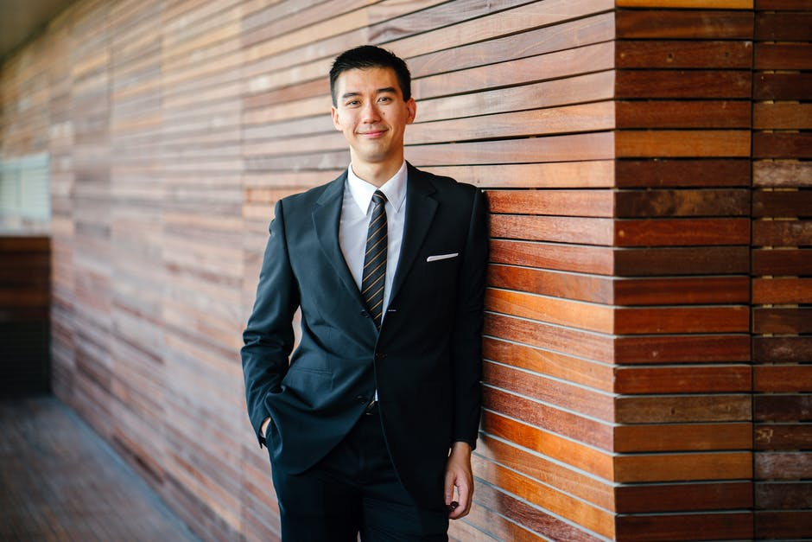
WHO SERVED TIME IN JAIL?
WHAT YOU SEE IS WHAT YOU USE
Notes:
Now, If I show you these two pictures and ask which one of them served time in jail, who will you pick? What would be the 3 characteristics you will use to describe this person?

Slide 42
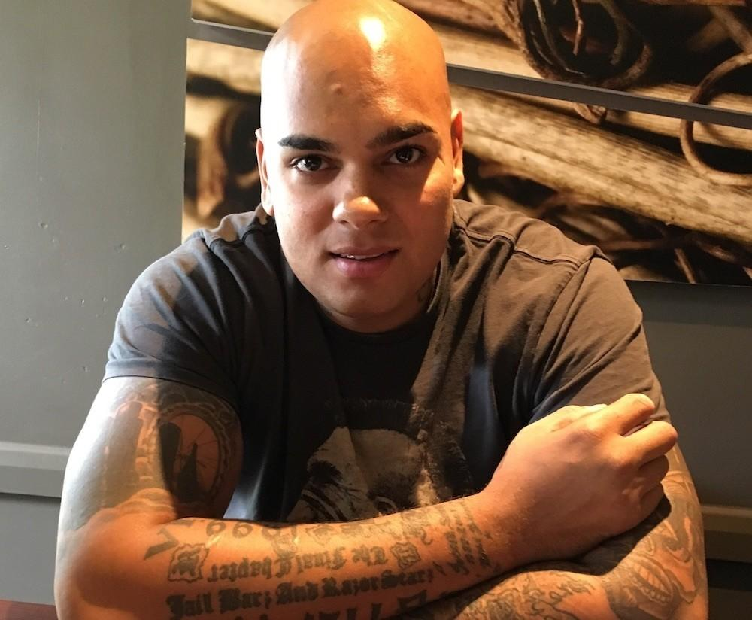
WHO SERVED TIME IN JAIL?
WHAT YOU SEE IS WHAT YOU USE
Notes:
And now, who do you pick?

Slide 43
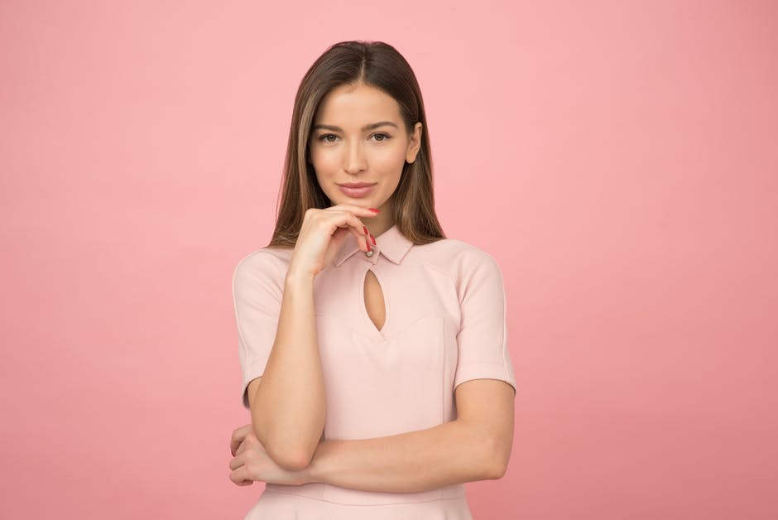
WHO SERVED TIME IN JAIL?
WHAT YOU SEE IS WHAT YOU USE
Notes:
Context will influence what we will project on people. It will define what we use to fill the gap in our construction of the reality

Slide 44
The context defines what is normal, what is acceptable
People will do anything if the context allows it.
Notes:
Think about how a war context change what people are ready to do. Or what you will do in a game context. You don’t behave the same way in an interview or while discussing with a friend. The framework, the context, defines what is possible.

Slide 45
HALO EFFECT
HALO EFFECT
The tendency for a person's positive or negative traits to "spill over" from one personality area to another in others' perceptions of them
Notes:
Context will influence what we will project on people. It will define what we use to fill the gap in our construction of the reality

Slide 46
HALO EFFECT
GOOD LOOKING
Perceived as SMARTER
SUITS
AUTHORITY POSITION
DIRTY CLOTHES
Perceived as LESS ORGANIZED
Notes:
Context will influence what we will project on people. It will define what we use to fill the gap in our construction of the reality

Slide 47
It can also “spill over” someone or something else, close to you
HALO EFFECT
Typical use of halo effect:
women and sports car
Notes:
Context will influence what we will project on people. It will define what we use to fill the gap in our construction of the reality

Slide 48
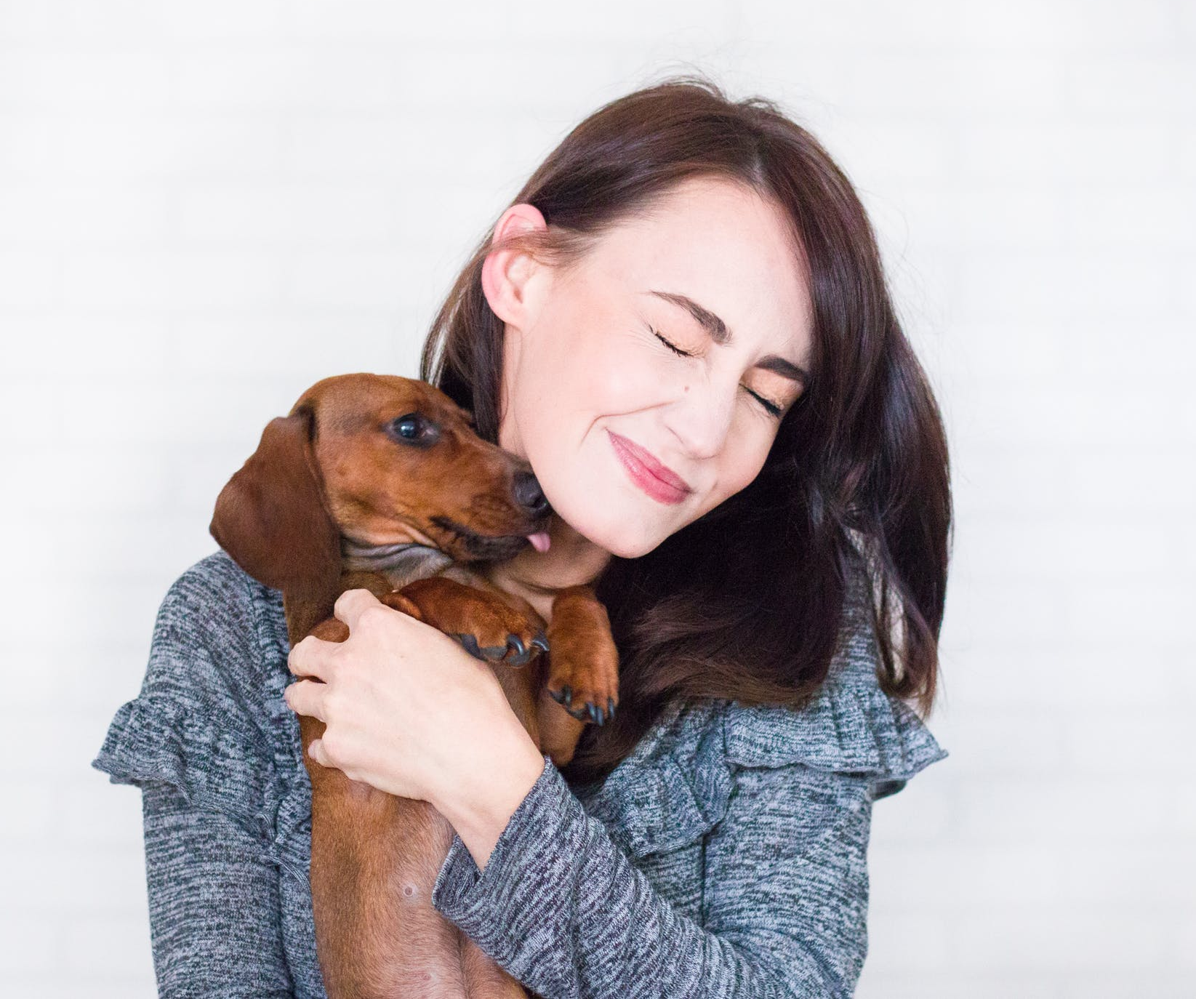
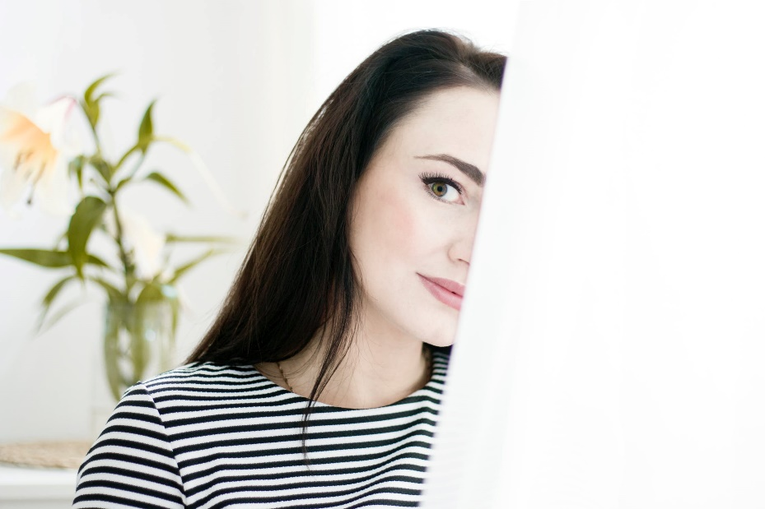
It can also “spill over” FROM someone or something close to you
HALO EFFECT
Notes:
Context will influence what we will project on people. It will define what we use to fill the gap in our construction of the reality

Slide 49
Little details linked to some stereotypes can make you appear to be anything you want.
A clean man with a beard, wearing a clean suit with a white shirt, smiling and handling a little cat in his arms will look more honest than a person in jeans wearing an Hard-Rock T-Shirt and holding a dirty bag.

Slide 50
FAST
STEREOTYPES are
FAST to process
ENERGY efficient
SPONTANEOUS
PREDICTIBLE / REPETITIVE
FAST & SLOW
SLOW
FREE WILL requires
TIME to process
Lot of mental ENERGY
EFFORT
Notes:
Our brain has 2 ways of working: Or it uses the fast systems, the ASIC processors in our brain, and it perform the tasks automatically, like stereotypes, using few resources and working fast, without having to think a lot about it, without effort.
Or it can use the main CPU, takes the time to process all the data, look for the missing one, take more balanced decisions, but it requires some will, an effort, a lot more time and energy.

Slide 51
Storing data in our brain is a rather simple and fast process.
FREE WILL
STORING DATA IS A FAST PROCESS
NEW DATA
TRIGGERS?
PHONOLOGIC TREATMENT
TRIGGERS?
NO
NO
STORED IN MEMORY (Flag: TRUE)
According to the Direct Processing Model, We tend to believe everything we are told except if our vigilance is triggered.
Notes:
Our brain has 2 ways of working: Or it uses the fast systems, the ASIC processors in our brain, and it perform the tasks automatically, like stereotypes, using few resources and working fast, without having to think a lot about it, without effort.
Or it can use the main CPU, takes the time to process all the data, look for the missing one, take more balanced decisions, but it requires some will, an effort, a lot more time and energy.

Slide 52
Who needs a scientific study to know that?
Keeping the brain in FAST mode makes it easier to manipulate, to predict! If we remain in an environment that fit the patterns we know and are used to, the Free will is not triggered and we tend to believe everything.

Slide 53
The frame influence the way we behave by forcing us to use the FAST paths
MODULATING FACTORS
TIME
AUTHORITY
EMOTIONS
HISTORY
Notes:
If we are pressed by time we tend to use more the FAST path (make sense) and rely on stereotypes. It’s a fear response. So, any other stressor that will trigger the same pathways will likely produce the same effect.
In case of presence of a recognized authority, we do as we are said to do and we do not questions. Milgram’s experiments are well known and have been repeated recently with different parameters. They still show that under the right circumstances, 95% of the people will do whatever we ask them to (event killing someone) if it is ordered by a superior (and he can provide a basis to lower the moral ground)

Slide 54
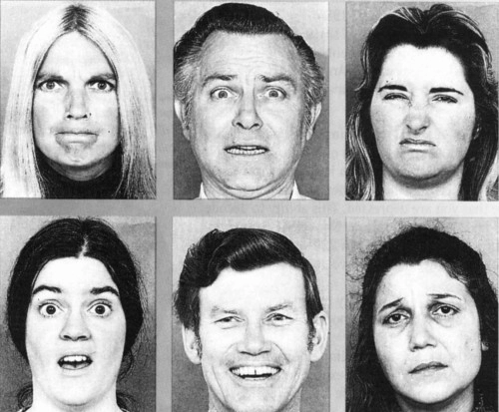
ANGER
FEAR
DISGUST
EMOTIONS
SURPRISE
JOY
SADNESS
Notes:
Emotions regulate, modulate all our decisions. Emotion can be easily induced just by a story, a picture of someone expressing this emotion (mirror neurons) or by a context. We tend to take more risk when we are happy.

Slide 55
If you want to motivate with rewards, look happy, smile
If you want to use authority, look angry (like directors)
If you want to use Altruism, look sad.

Slide 56
People are motivated either by
MOTIVATION
Fear
Rewards
Altruism
Self Coherence
Notes:
Fear is a strong emotion that preserves us from being harmed. Fear has its own neuronal path touching nearly all the brain. Using Cortisol, it can activate the entire body.
As you have seen, rewards has also a dedicate neuronal path and has a large influence on the brain. Anything that will activate our reward system and provide us our shoot of dopamine will motivate us: Food, Money or Sex always work.
Altruism is also something that allows us to survive as a specie. Helping others make them more likely to help us. It creates bond. Bonding is linked to Oxytocin that is delivered when a mother breastfeed her child but also when a couple has sex (and even more with the orgasm). We tend to like to help people, even more if they are in distress.
Self-coherence is linked to our need for consistency of patterns, even with our own patterns. The way we behave must be consistent with the story we told ourselves about who we are. Not being consistent with ourselves create a states called “cognitive dissonance” that creates stress and a need to bring back coherence.

Slide 57
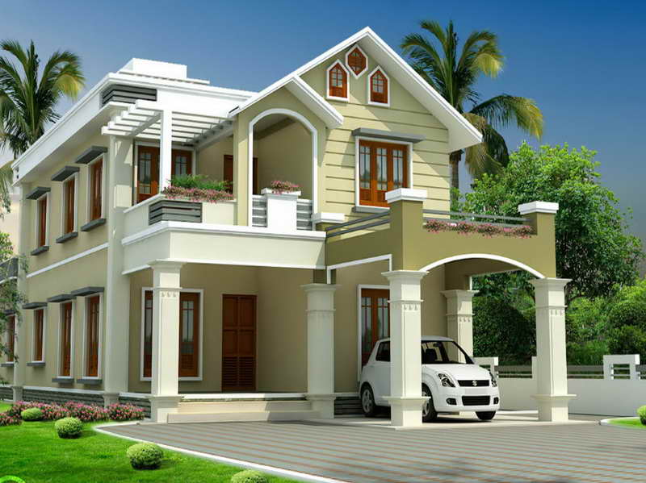
PRIC€?
REDEFINE THE NORM
800.000 €

Slide 58
PRIC€?
ANCHORING
1.000.000 €
3 000 000€

Slide 59
SUMMARY
Define the frame, the context
Be consistent, respect the pattern
Pick a motivation
Use emotion accordingly
Redefine the norm
MAIN FUNCTIONS
Notes:
Certain bundle of neurons using the same neurotransmitter creates pathway in our nervous system having specific psychological effects.

Slide 60
QUESTIONS ?

Slide 61
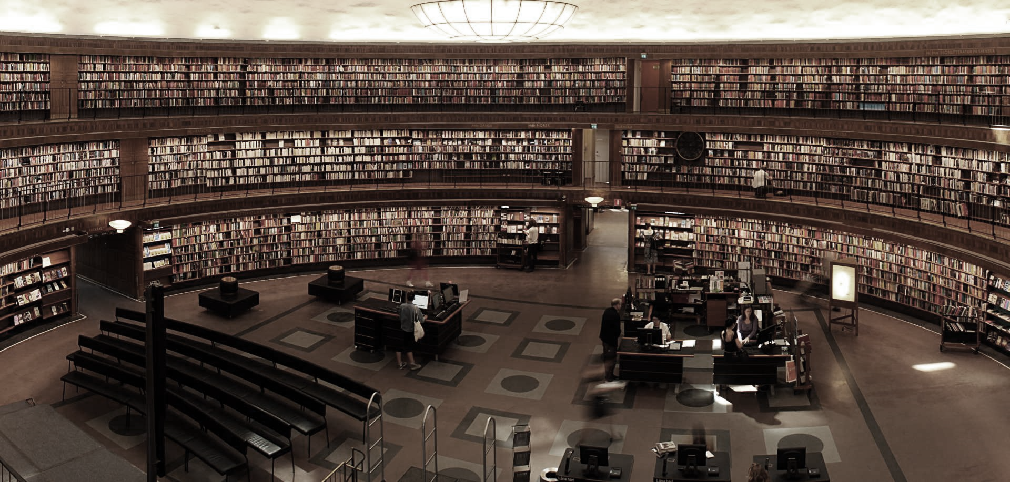
Ressources
Nancy Duarte (2008) “Slide:ologie”, O’Reilly
Daniel Kahneman (2013) “Thinking, fast & slow”
Garr Reynolds (2010) “Presentation Zen Design”, Pearson
Garr Reynolds (2008) “Presentation Zen”, Pearson
Phil Rozenzweig (2007) “The halo effect”

Slide 62
Ressources
www.duarte.com - advises from the queen of slideology
toastmasters.be - meetings to improve your presentation skills
iconmonstr.com - a nice collection of free icons
unsplash.com - A large collection of free pictures
www.presentationzen.com – advises from Garr Reynolds

Slide 63
What’s normal is relative
We tend to trust everything we are told except if our vigilance is triggered
Any justification is good even if it doesn't make sense in the situation
Emotions
Telling a story makes it easier to remember and change mind: multi modal, identification, emotion
We don’t like to loose something we have

Slide 64
Brain’s purpose is to analyse the world and make sense out of it => Find patterns
If it doesn’t make sense, we fill the gaps to make it consistent (Cognitive dissonance)
Change blindness
Attention needs focus
2 kind of processes: Fast and slow (Asic vs VLSI) – fast are stereotypes
Our brain use what he knows
If the question is too complex, we answer with an easier question, if we don’t know all the parameters, we “deduct” it from what we know (halo effect)
Time pressure
Authority

