Slide 1
Defensive strategies
How to build a defense-in-depth
Claus Cramon Houmann

Slide 2
Key take aways:
Never ever rely on a single solution
Defense in depth. In Depth...
Both threat prevention and threat detection are important
If the bad guys want to get in bad enough, they will – be able to reduce the ”dwell time” they have inside your systems
The ”CLICKER” is the colleague who clicks on that ”interesting link or attachment” in a suspicious e-mail...

Slide 3
1 Single 0-day or unpatched system is all ”they” need

Slide 4
Breach methods
Hacking (Fx SQL injection against DB servers)
Malware (fx phishing)
Social engineering
Physical

Slide 5
Source: Verizon’s 2012 Data Breach investigations report

Slide 6
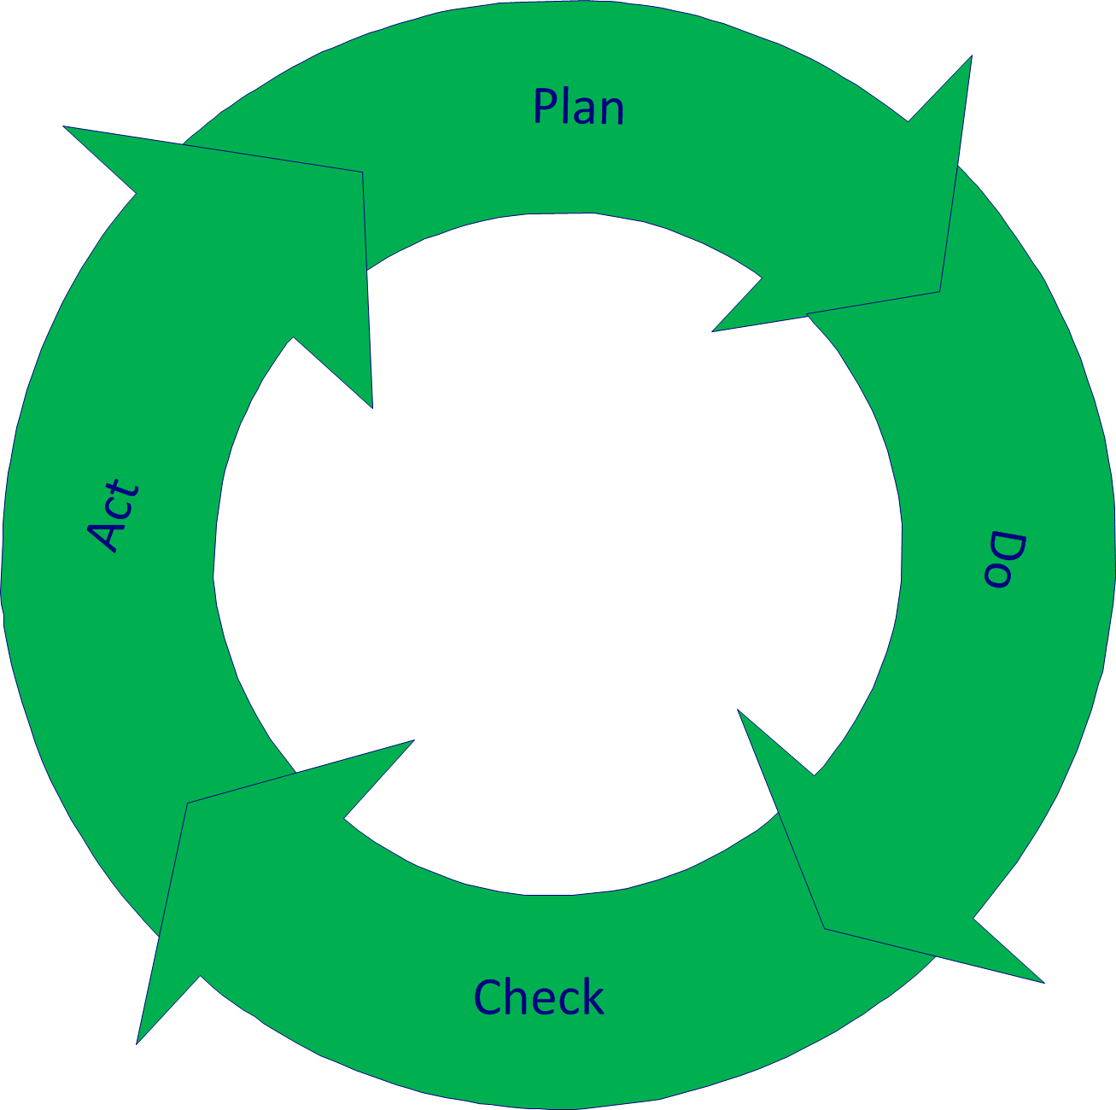
Defense-in-depth. Isnt is simple and beatiful?

Slide 7
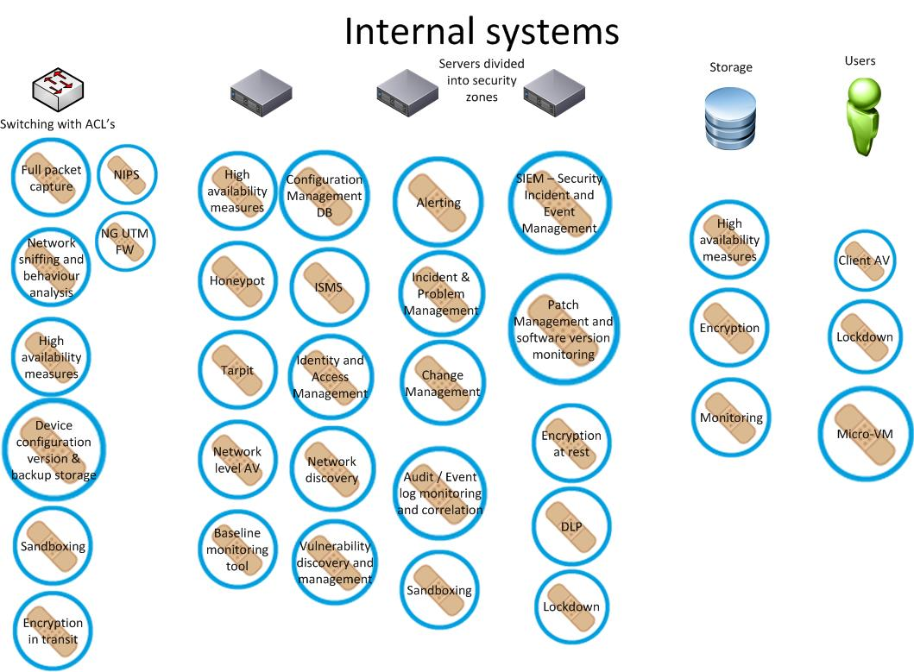

Slide 8
Where to start a defense-in-depth?
First establish where you are as an IT-security organization today, then find out where you want to be
Get the right people.
As your organizations “Infosec level” matures – you may be able to pass or almost pass a pentest. Most low hanging fruits have been “picked” already
This makes it very hard for “them” to get in via hacking methods
-> they will try malware next

Slide 9
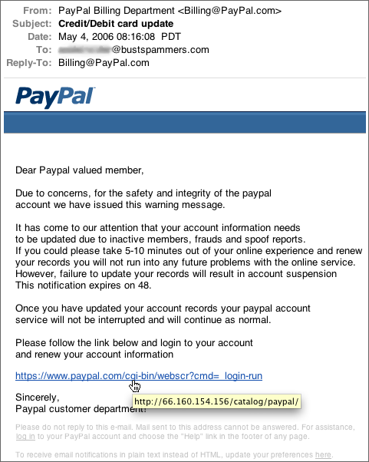
Advanced targetted Malware leveraging 0-days or recently patched vulnerabilities = CIO/CISO nightmare
The CLICKER becomes your biggest external threat!

Slide 10
Mitigating the “CLICKER”
There are now innovative next-generation tools available for advanced threat prevention and/or detection = AMP’s
Microvirtualization
Advanced code handling/analysis/reverse-engineering tools
Network level Sandboxing or detection based on behavioural analysis/packet inspection
System and registry level lockdown of process/user-rights
Cloud based Big Data analytical/defense tools
Whitelisting tech
Others – this “market segment” is booming right now

Slide 11
Risk assessments match?
The approach to pick the lowest hanging apples first should be identical to the approach your IT risk management would recommend
Mitigating the easy-value-for-money threats first

Slide 12
Why is the AMP market booming?
The AV industry in the traditional sense has declared their tools insufficient and the war on malware lost
Hacking is increasing supported by big budgets – think nation-state-sponsored APT’s
0-days abound in the Wild – being purchased by “hackers” – unofficial hackers or nation-state sponsored hackers alike
The black market cyber-industry is a huge! economy

Slide 13
The future of defense strategies
Whatever the name (Defense-in-depth, layered defense, defensible security posture)
almost everyone in IT/Infosec agree that you need to think in security at all levels
Defenders are always behind attackers
Defenders need to share knowledge, experience and methodologies better and faster
Develop capabilities to stop attackers at several points in the cyber kill chain

Slide 14
Conclusion
To build a defense-in-depth you want to:
Have capabilities within Threat Prevention, Detection, Alerting, Incident Response, some kind of IOC / Threat sharing community. AMP’s + more.
To be able to this way both block+detect known and unknown attacks/payloads, and when penetrated, regain control and limit losses

Slide 15
Can I help? Can you help?
There are people trying to help us: on twitter #wearethecavalry for example
In the UK: Strategic security advisors alliance
My plan:
Turn www.defense-in-depth.com into the WIKIPEDIA of IT-security/Infosec

Slide 16
About me
Claus Cramon Houmann, 38, married to Tina and I have 3 lovely kids
CISSP, ITIL Certified Expert, Prince2 practitioner
You can contact me anytime:
Skype: Claushj0707
Twitter: @claushoumann or @improveitlux
Sources used:
Verizon: Data Breach investigations report 2012
@gollmann from IOactive Blog posts
http://nigesecurityguy.wordpress.com/2013/10/02/advanced-threat-defense-part-1/ and other blog posts
@RobertMLee

Slide 17
Questions?

Slide 18
More questions?

