Slide 1
BIOS Chronomancy: Fixing the Core Root of Trust for Measurement
John Butterworth
Corey Kallenberg
Xeno Kovah

Slide 2
Introduction
Who we are:
Trusted computing researchers at The MITRE Corporation
What MITRE is:
A not-for-profit company that runs six US Government "Federally Funded Research & Development Centers" (FFRDCs) dedicated to working in the public good
The first .org, !(.mil | .gov | .com | .edu | .net), on the ARPANET
Manager for a number of standards such as CVE, CWE, OVAL, CAPEC, STIX, TAXII, etc

Slide 3
Motivation
Why should you care about BIOS security?
It's the first code that runs on your CPU
Almost no one is integrity checking the BIOS, so it's a great place for multi-year backdoors to reside
BIOS overwrite leads to very annoying/time-consuming to recover from bricking of machines (CIH Virus)
It's rarified knowledge, so it's cool :)
We cared because we wanted to know how trusted computing BIOS security mechanisms work.
What is actually measured to generate Trusted Platform Module (TPM)-stored BIOS measurements?
Can an attacker defeat these measurements?
How can we build a better root of trust – one that detects an attacker at the same privilege level as the defender?
Heresy!? Read-on!
Notes:
Because we like you.

Slide 4
Outline
How an attacker could get into BIOS
How the trusted computing technology of the Core Root of Trust for Measurement (CRTM) is rooted in the writable BIOS, and therefore vulnerable to manipulation
BIOS malware (tick, flea) that can subvert TPM-mediated trust
Our defensive strategy – BIOS Chronomancy
Conclusions

Slide 5
Shoulders of Giants
Firmware shows up in many different contexts
Today we're going to be talking predominantly about x86 PCs' BIOS firmware
But we're only going to hit about 10 select talks
Here is a timeline that includes more interesting and tangential things I've had to skip
http://timeglider.com/timeline/5ca2daa6078caaf4
Or write down http://bit.ly/1bvusqn

Slide 6
What's been targeted?
Notes:
http://commercebugdemo.pulsestorm.net/media/catalog/product/cache/1/image/9df78eab33525d08d6e5fb8d27136e95/a/c/acer-ferrari-3200-notebook-computer-pc.jpg
http://4.bp.blogspot.com/-4b7z_XskJ3c/T2V3InNkhRI/AAAAAAAABvU/-fo-sVq_Wdo/s1600/MacBookPro.jpg

Slide 7
What's been targeted? – intra-architecture
Notes:
http://commercebugdemo.pulsestorm.net/media/catalog/product/cache/1/image/9df78eab33525d08d6e5fb8d27136e95/a/c/acer-ferrari-3200-notebook-computer-pc.jpg
http://4.bp.blogspot.com/-4b7z_XskJ3c/T2V3InNkhRI/AAAAAAAABvU/-fo-sVq_Wdo/s1600/MacBookPro.jpg

Slide 8
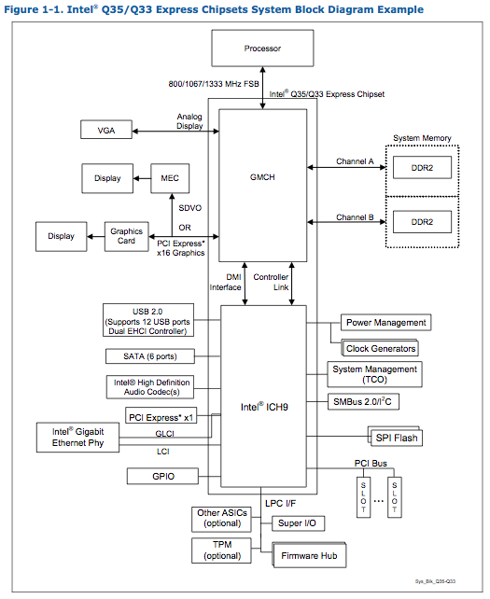
What's been targeted? – intra-architecture
http://www.intel.com/Assets/PDF/datasheet/316966.pdf
Notes:
Yes, this is an outdated picture. It was chosen because it's what most people will be familiar with

Slide 9
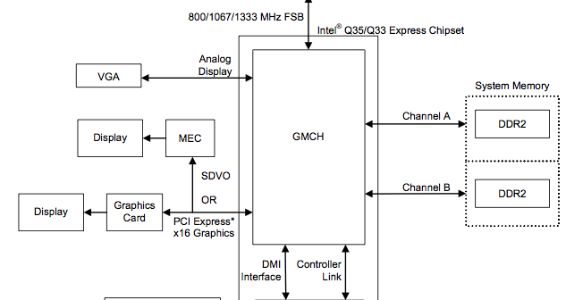
What's been targeted? – intra-architecture
System Management RAM
Intel Active Management Technology (AMT)
http://www.intel.com/Assets/PDF/datasheet/316966.pdf
Notes:
Yes, this is an outdated picture. It was chosen because it's what most people will be familiar with

Slide 10
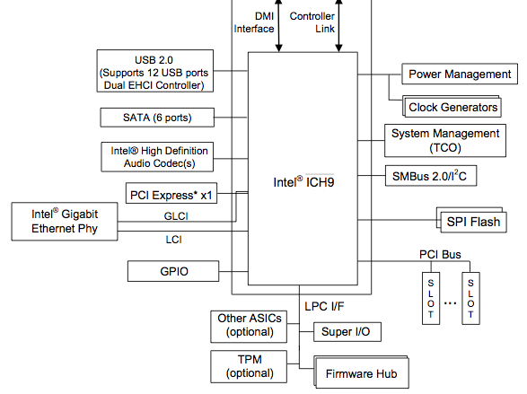
What's been targeted? – intra-architecture
Hard Drive
Controller
Battery
Main BIOS
Option ROMs
NICs
Keyboard Controller
Keyboard
http://www.intel.com/Assets/PDF/datasheet/316966.pdf
Notes:
Yes, this is an outdated picture. It was chosen because it's what most people will be familiar with

Slide 11
What's been targeted? – intra-architecture
FTW!
http://www.intel.com/Assets/PDF/datasheet/316966.pdf
Notes:
Yes, this is an outdated picture. It was chosen because it's what most people will be familiar with
https://cdn1.iconfinder.com/data/icons/defaulticon/icons/png/256x256/padlock-open.png

Slide 12
What's been targeted? – intra-architecture
SMM
FTW!
http://www.intel.com/Assets/PDF/datasheet/316966.pdf
Notes:
Yes, this is an outdated picture. It was chosen because it's what most people will be familiar with
Even if the access controls are properly applied, there's a move toward restricting it so that SMM can still write to the BIOS if others can't

Slide 13
1998 – CIH/Chernobyl Virus
Just have to mention it :)
One of only two known in-the-wild BIOS-targetting malware
Rendered unbootable ("bricked") machines by writing junk to the BIOS flash chip
Also zeroed the first MB of the HD
This attack works against one particular chipset, and assumes an unlocked BIOS

Slide 14
2006 – Implementing and Detecting an ACPI BIOS Rootkit – Heasman [8]
The BIOS sets up Advanced Configuration and Power Interface (ACPI) tables.
The tables have ACPI Machine Language (AML) which is then read an interpreted by the OS (acpi.sys)
The AML "OperationRegions" construct can be used to read and write memory
Used AML to do typical type kernel mode rootkit modifications
Side note: ACPI tables were used by Wojtczuk & Rutkowska [7] to buffer overflow Intel TXT's SINIT code later in 2011 – showing how the Dynamic Root of Trust for Measurement can depend on the Static Root of Trust for Measurement - more about that later
This work assumes an unlocked BIOS
Notes:
The basic point here is to exist outside the OS and make changes within it – this will be a common theme of deeper system attacks
http://www.invisiblethingslab.com/resources/2011/Attacking_Intel_TXT_via_SINIT_hijacking.pdf

Slide 16
2006 – "Using CPU System Management Mode to Circumvent Operating System Security Functions " – Duflot et al. [10]
Utilized x86 CPU's System Management Mode (SMM) to defeat OpenBSD's secure levels limitations on superuser privileges
The notion that code running in SMM can be invisible to, and more privileged than, OS (or even hypervisor) code lead to a great expansion of interest in SMM
At the time, SMM was generally unlocked (D_LCK = 0), but BIOS vendors started turning on this access control
This lead to work on how to break into SMM, including the independent discovery by Duflot et al.[11] and Wojtczuk & Rutkowska[12] that it was possible to write to SMRAM by manipulating CPU caching
This is a CPU architectural flaw that could only be fixed by newer CPUs
BIOS instantiates SMM, so generally a BIOS compromise indicates an SMM compromise but not vice versa
However we recently disclosed an exception to this rule [13]

Slide 17
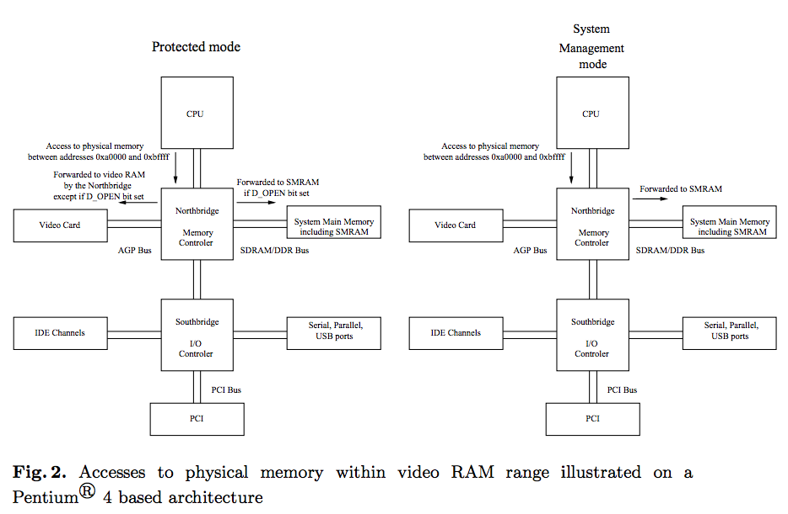
From [10]

Slide 18
2007 – Implementing and Detecting a PCI Rootkit – Heasman [9]
Not PCI so much as PCI Expansion ROM (XROM)
XROMs are bits of code that exist in PCI family peripherals
The code is meant to provide initialization for the peripheral when used with a BIOS that doesn't know about the hardware
It is essentially trying to enable plug and play for expansion cards
XROM code is automatically searched for and executed by the main BIOS
Ergo, if you want write to an XROM, you can get code execution in the context of the BIOS
This was more like a concept talk, because as best we can tell, he didn't actually implement anything
Our preliminary evidence indicates true *direct* (that is, non-memory mapped) XROM read/write to be fairly vendor-specific. But we're currently investigating this. We'll let you know at a future con ;)
This work assumes an open XROM flash
Notes:
But we're not currently aware of any additional protections which have been added to XROMs such as signed BIOS updates. Our UEFI XROM audit will provide more detail.

Slide 19
2009 – Persistent BIOS Infection – Sacco & Ortega [15]
Discussed the practicality of BIOS infection
Explained that because the boot block will generally be decompressed x86 asm (and contain a decompressor for other sections), it serves as a good target for infection
Also showed infection of the VMware virtual BIOS file
which is nice and easy to understand because there's a GDB stub built into vmware that lets you break at the very first instruction. Normal BIOS researchers and attackers do not have that luxury
This work assumes an unlocked legacy BIOS

Slide 21
2009 – Deactivate the Rootkit – Ortega & Sacco [16]
Described the CompuTrace software which is embedded in some OEM BIOSes.
It is anti-theft software ("a laptop lo-jack") which is meant to exist in the BIOS, load itself into the OS (even if the thief changes/reformats the hard drive), and then beacon out to CompuTrace's server, so they can try to find your stolen laptop
The software is generally disabled by default, and requires changing a BIOS setting to enable
An interesting thing here is that the software has a mini-NTFS driver embedded in it, so that it can drop an EXE into the filesystem, and register it as a Windows service.
The problematic thing here is that the CompuTrace BIOS code reads and executes unauthenticated (only CRCed!) code from the HD in space outside the partitions, allowing an attacker to potentially get arbitrary BIOS code execution across a wide range of BIOSes (whatever has CompuTrace embedded)
Notes:
"This agent doesn't contain any code except for a small stub used to load additional code from a sector on the hard disk located outside normal Partitions"

Slide 22
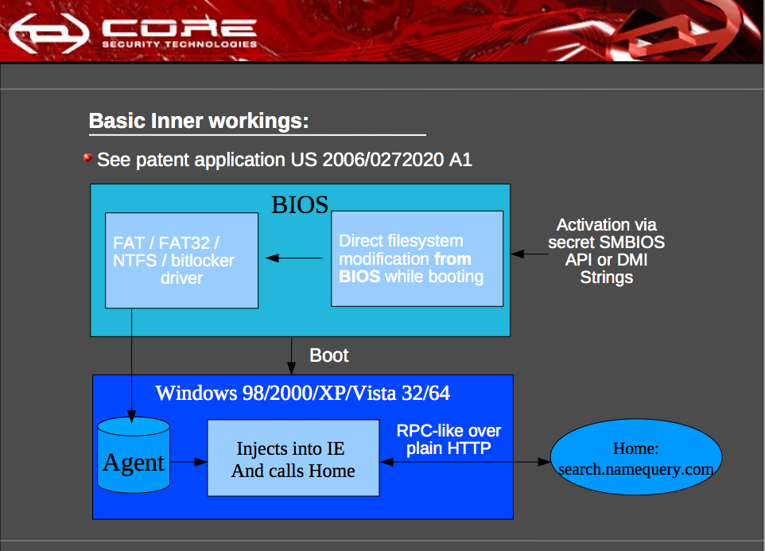

Slide 23
2009 – Attacking Intel BIOS – Wojtczuk & Tereshkin [1]
Explained that for properly secured systems, the BIOS reboots into an open state, checks for BIOS update, and then locks down the system post-update (if any)
This gives very few opportunities for an attacker to provide malicious input to the BIOS to try to gain code execution.
But it turns out that there is some parsing involved in handling unsigned subcomponents of the UEFI flash filesystem…
In particular, the user-customizable BIOS splash screen
They consequently leveraged a parsing error in BMP processing to gain arbitrary code execution in the context of the BIOS, and subsequently reflash the BIOS (without having a valid, signed, BIOS update)
This work assumes a non-writable, signed, UEFI BIOS! Awesome work!
(although, having the TianoCore UEFI reference source code did make it a little easier on them than we had it for our bug ;))

Slide 24
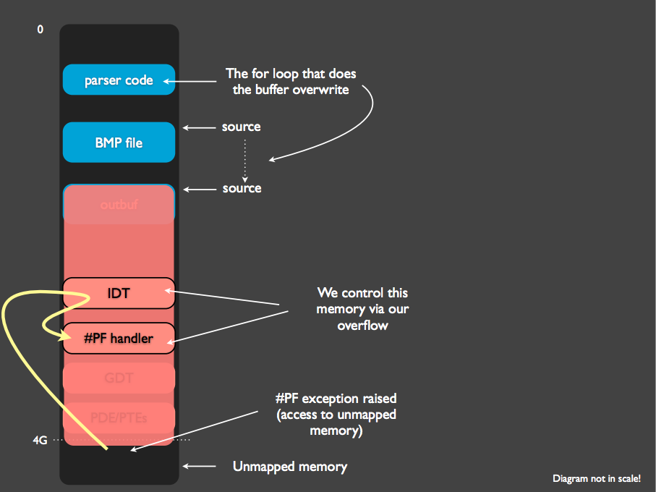

Slide 25
2011 – Sticky Finger & KBC Custom Shop – Gazet [17]
This lesser-known work was also very good. The presentation had a great snowballing effect where it just kept building to more and more power
First analyzed how his BIOS recovery password worked
Found that it involved SMM and the Keyboard Controller (KBC)
Looked at a KBC update and 1) figured out the architecture (ARCompact) 2) adapted their disassembler to display it and 3) subsequently reflashed the KBC with custom code (no access controls, just required a lot of RE)
Then analyzed the SMM code and found that there is a buffer overflow when SMM talks to the KBC!
Persisting in the KBC *and* breaking back into SMM? Delightful!
Assumes no KBC locks. We've been told newer KBCs have more access controls but we haven't looked into it further.

Slide 27
2012 - DE MYSTERIIS DOM JOBSIVS Mac EFI Rootkits – Snare [18]
Apple was the first major vendor to adopt EFI, when they first released their Intel Macs
Unfortunately they are late to the game with implementing the newer UEFI specs such as 2.3.1's UEFI Secure Boot
All Macs have openly writable BIOSes, but…
"Anecdotal evidence has indicated that Mac systems also contain a 'boot ROM', which is executed before the EFI firmware and verifies the integrity of the firmware image including its cryptographic signature at the end of the firmware volume. If the firmware image is not deemed to be valid, the system generates the 'S.O.S.' beep sound (literally 'S O S' in Morse code) and refuses to boot. The author has not explored this any further; however, it may be a future area of research."
Showed persistence through patching the bootloader and rewriting an XROM
Then showed patching the OS kernel from both those places
Behold your attacker…

Slide 28
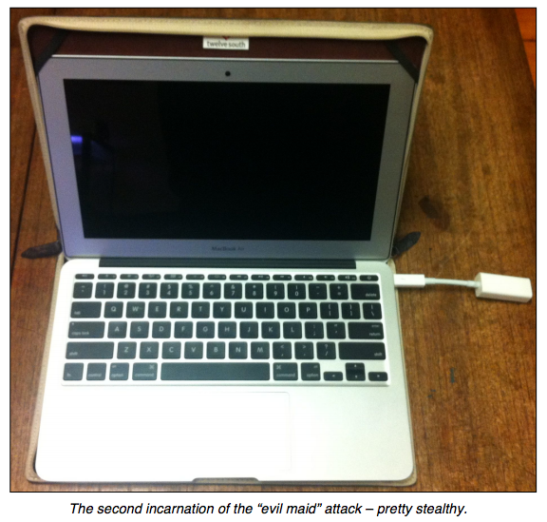
From [18]

Slide 29
2011 – Mebromi[14]
The other known in-the-wild BIOS-infecting malware
Discovered in Sept. 2011
Based on IceLord's 2007 proof of concept Award BIOS infector
Is in the BIOS primarily for persistance of installation of standard Master Boot Record (MBR)-based kernel infector.
Does IRP hooks to hide files on disk
This malware assumes an open and writable Legacy BIOS

Slide 30
2013 – Evil Maid Just Got Angrier: Why Full-Disk Encryption With TPM is Insecure on Many Systems – Bulygin [3], A Tale of One Software Bypass of Windows 8 Secure Boot – Bulygin et al. [4]
Showed that ASUS UEFI systems are not properly setting BIOS access controls
[3] shows that you can use this to modify the BIOS without TPM-stored measurements changing, thus defeating BitLocker
Which is fundamentally about a poor S-CRTM implementation, but it wasn't discussed what regions the S-CRTM actually measures
[4] shows that you can use this to disable Windows 8 Secure Boot
Also hinted that the vulnerability was more wide-spread, and hinted at, but didn't disclose, another technique for defeating Secure Boot from userspace
Provides initial evidence that BIOSes are more open than people think. We thought these sorts of problems were behind us, but since they're clearly not, this is part of why we made Copernicus

Slide 32
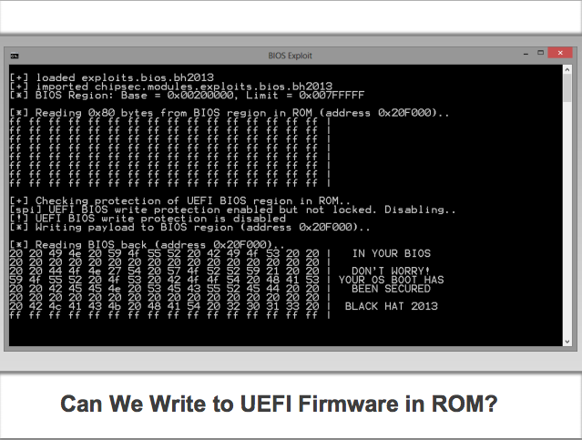

Slide 33
2013 – BIOS Chronomancy – Butterworth et al.[18], Defeating Signed BIOS Enforcement – Kallenberg et al. [13]
We found the 2nd ever signed-bios-bypassing exploit
And then we found a bunch of easier ways to attack than exploits
We show that once an attacker is in the BIOS, he can completely defeat the S-CRTM's TPM-stored measurement
We call this BIOS parasite a tick
We also show that trying to just use a standard BIOS upgrade/downgrade reflash can also be defeated
We call this BIOS parasite a flea – because it "hops" across BIOS updates
We propose the BIOS Chronomancy defensive system which uses timing-based attestation, and which is designed specifically under the assumption that the attacker is at the same privilege level (in the BIOS) as the defensive code

Slide 34
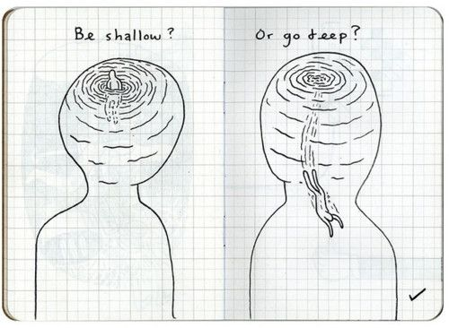
http://picforfuns.blogspot.com/2011/01/be-shallow-or-go-deep.html
Notes:
http://3.bp.blogspot.com/_QCcMTHCBJ4c/TUFURUtqeiI/AAAAAAAAFQ0/wcCzrBNMHXI/s1600/Be%2BShallow%2BOr%2BGo%2BDeep.jpeg

Slide 35
Getting into BIOS
Access Controls
There are registers that can prevent writes to the BIOS flash*
Signed firmware updates
Latitude E6400 BIOS revisions:
A29 did not protect the flash from direct writes to the firmware flash from privileged applications
A30 and higher do
A29 did not provide an option to require signed updates
A30 and higher have the option, on newer Dell’s systems it's required
However, even access controls can fail or be bypassed:
In 2009 ITL showed that firmware signing can be bypassed in their "Attacking Intel BIOS" presentation[1]
Until now, the only BIOS talk to bypass signed update with an exploit
*A detailed discussion about these architectural controls is beyond the scope of this presentation
Notes:
Can mention Yuriy Bulygin's talk pertains to the access control bits

Slide 36
Dell E6400 BIOS Update
Firmware update binary (“HDR”) is copied to kernel memory
Default method is to packetize the HDR file into “rbu packets”
HDR contains more than just the BIOS update (Keyboard Controller, Management Engine, too)
A bit in CMOS byte 0x78 is flipped
The system is rebooted
BIOS sees CMOS bit is flipped and triggers an SMI to execute the SMM BIOS Update routine
Notes:
For a good talk that overlaps this, check out the Sticky Keys talk (Broussard)

Slide 37
BIOS Update Routine (1 of 2)
OS Kernel Driver
$RPK… Packet=1, size=0x400
Copyright 2011 Dell Inc.. A29
$RPK… Packet=2, size=0x1000
00 00 FF FF FF FF FF…
The Operating System packetizes the new BIOS image across the address space. Each packet has a 33 byte rbu_packet header that describes the contents and order of the BIOS image information the packet contains.
A bit is then flipped in CMOS to indicate to the BIOS upon the next reboot that an update is pending.
$RPK… Packet=N, size=0x100
EB 39 00 00 00 FF FF FF FF …

Slide 38
BIOS Update Routine (2 of 2)
SMM Update Routine
System Management Mode RAM
Copyright 2011 Dell Inc. A29..
FF FF FF FF FF FF FF FF FF FF
…
…
EB 39 00 00 FF FF FF FF FF FF
$RPK… Packet=N-1, size=0x1000
00 00 FF FF FF FF FF…
Upon reboot, the System Management Mode update routine scans for the individual rbu packets and uses them to reconstruct the complete BIOS image.
SMM then verifies the reconstructed BIOS image is signed by Dell before writing to the flash chip.
$RPK… Packet=N, size=0x100
EB 39 00 00 00 FF FF FF FF FF …

Slide 39
Attacker Objective and Plan
Reflash BIOS chip with arbitrary image despite signed BIOS enforcement.
Method: find a memory corruption vulnerability in the parsing of the BIOS update information (RBU packets). This will allow us to seize control of SMM and reflash the BIOS chip at will.
The memory corruption vulnerability must occur before the signature on the bios update image is checked.
SMM parses the 33 byte rbu_packet header that describes metadata about the BIOS update image. This parsing occurs before the signature check.

Slide 40
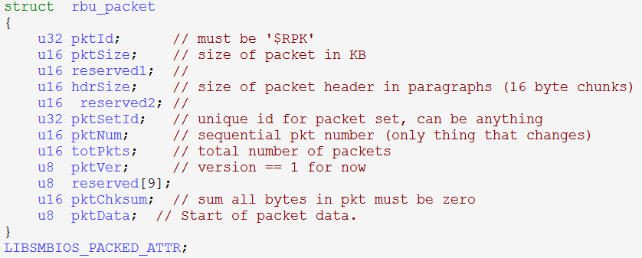
Attack Surface
http://linux.dell.com/libsmbios/main/RbuLowLevel_8h-source.html

Slide 41
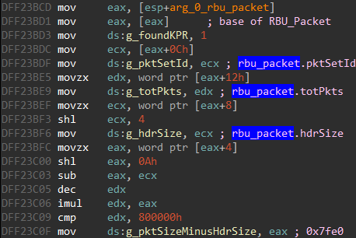
Packet Parsing
SMM first locates the RBU packet by scanning for an ASCII signature upon page aligned boundaries.
Once located, members of the RBU packet are stored in an SMM data area for use in later calculations…

Slide 42
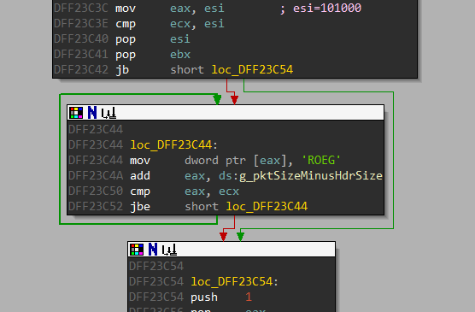
Curious GEOR?
When reconstructing the BIOS image from the rbu packets, SMM writes an initialization string “GEOR” to the destination memory space where the BIOS image is being reconstructed….

Slide 43
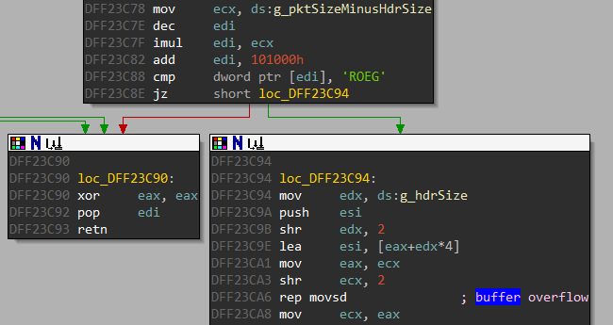
RBU Packet Copied
Eventually the portion of the BIOS image described by the RBU packet is copied to the reconstruction location in memory.
Notice the size parameter (ecx) for the inline memcpy (rep movsd) is derived from attacker data (g_pktSizeMinusHdrSize).

Slide 44
RBU Packet Parsing Vulnerability
In fact, the copy destination and copy source are also both derived from attacker data read in from the current rbu_packet.
This is an exploitable buffer overflow.

Slide 45
Lack of Mitigations
System Management Mode is missing all of the traditional exploit mitigations you would expect to find in modern applications.
No ASLR, NX, stack canaries, and so on….
This means we can pursue any target with our overwrite, such as the return address for the rbu packet copying function…

Slide 46
Exploiting the Vulnerability
There are actually a number of constraints on the RBU packet data that make exploiting this buffer overflow tricky.

Slide 47
Constraints Overview
Our copy destination must point to an area pre-initialized with the “GEOR” string.
Copy_dest must be lower in memory than the return address.
We can’t overwrite too much lest we die in the inline memcpy and never return.
Copy source must be positioned such that attacker controlled data in the address space ends up overwriting the saved return address.
Others….

Slide 48
More Problems
The source, destination and size operands are all derived from the same rbu_packet members.
Changing one operand, changes the others.
All of the constraints previously mentioned must be satisfied.
Exploitation of this vulnerability can be modeled as a constraints solving problem.

Slide 49
Constraints Corollary
An initialization routine populates the “GEOR” string at the expected copy dest location under “normal” circumstances.
We skip this normal initialization routine by setting rbu_packet.totPkts to 1 (which as you can see from the above code, sets totalDataSize=0). If we don’t, the large memset and GEOR writing operation performed by the initialization routine are problematic.
This means the expected “GEOR” string won’t naturally occur in the address space, and we will have to inject it somehow to satisfy the *copy_dest = “GEOR” constraint.

Slide 50
Faux GEOR
The vulnerable memcpy will only execute if the copy destination points to a location containing this GEOR string.
We use a Windows kernel driver that performs memory mapped i/o to write the GEOR string as high up in memory as possible, to allow us to force copy_dest to be within striking distance of the return address we want to overwrite.
Like the BIOS update process, we are abusing the fact RAM remains intact during a soft reboot so the GEOR strings we wrote will remain in the address space.

Slide 51
RBU Packet Solution
With all those constraints in mind, we brute force an rbu_packet configuration that allows us to pass the sanity checks and overwrite the return address gracefully.

Slide 52
Malicious BIOS Update
SMM Update Routine
System Management Mode RAM
Packet Reconstruction Space
Shellcode
Shellcode
Shellcode
….
The unusually large packet size and packet sequence number cause the packet reconstruction area to overflow into SMRAM.
This allows us to overwrite a return address inside of SMRAM and gain control of EIP while in the context of the BIOS update routine.
$RPK.. Packet=0x83f9, size=0xfffe
Shellcode
Shellcode
…
Shellcode

Slide 53
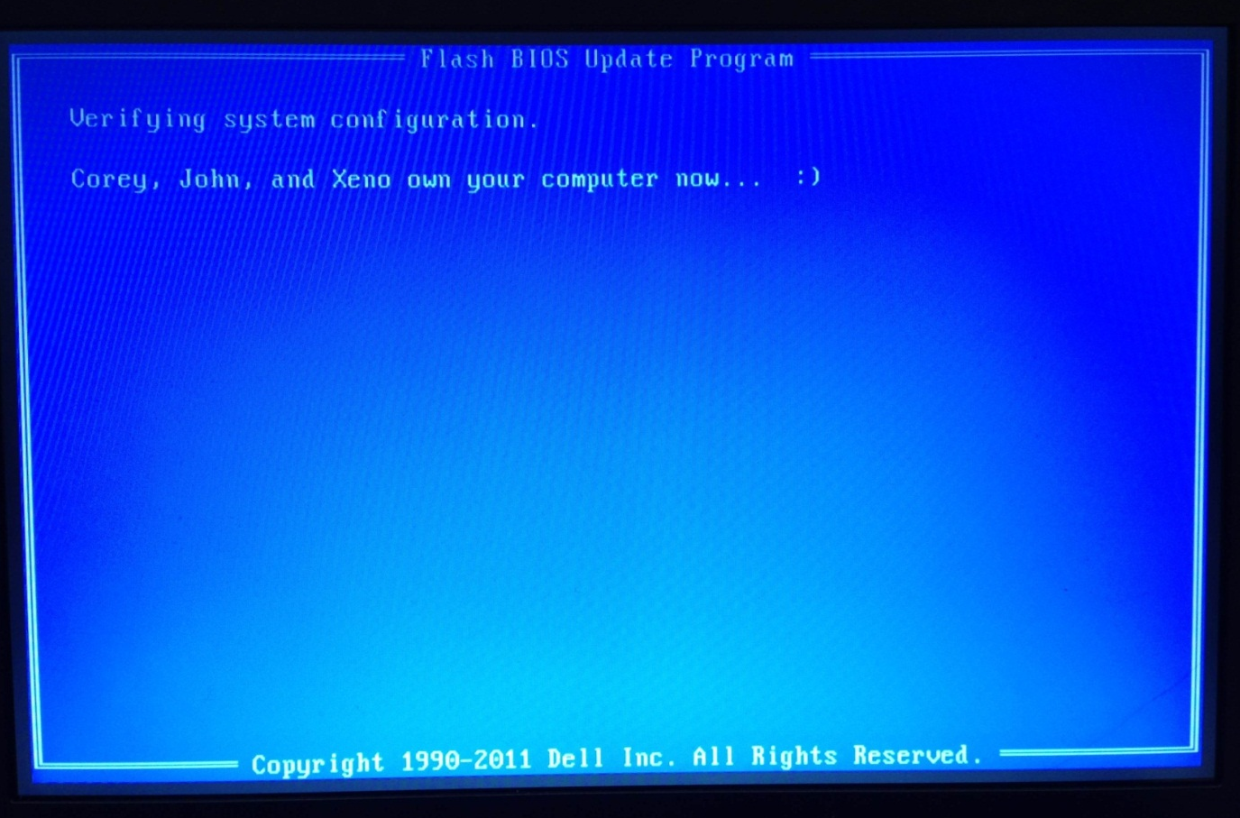
PoC Demonstration Video http://youtu.be/V_ea21CrOPM

Slide 54
Vulnerability Conclusion
The vulnerability allows an attacker to take control of the BIOS update process and reflash the BIOS with an arbitrary image despite the presence of signed bios enforcement.
Because BIOS is charged with instantiating System Management Mode (SMM), control of the BIOS implies complete control of SMM.
Once the attacker has complete control of BIOS and SMM, really Bad Things can start to happen…

Slide 55
How can we detect attackers in the BIOS? Trusted Computing Group (TCG) Static Root of Trust for Measurement (SRTM)
In the PC Client Specification[2], the TCG lays out a strategy for obtaining measurements of critical boot-time components
This should detect things like MBR-based bootkits, or even BIOS attackers
The SRTM is a chain of trust which is built up at boot time from the BIOS measuring itself, and measuring every other bit of executable code before control is passed to that code
Measurements stored in TPM, discussed shortly
All these measurements are typically gained "for free" when the BIOS is configured to enable the TPM

Slide 56
Terminology
Trusted Platform Module (TPM)
Supports secure key generation and secure key storage.
Can “seal” keys or data such that they can only be decrypted if the PCR set hasn’t changed.
Can act as a root of trust for reporting by signing a quote of its current PCR set.
Platform Configuration Register (PCR)
Store 20 byte hashes representing measurements of the system.
Are reset to 0x00₂₀ upon reboot.
Can only be modified with an “Extend” operation.
Extend_PCR0(data): PCR0_{new} = SHA1(PCR0_{old} || SHA1(data))

Slide 57
Example Measured Boot ("measured boot" != UEFI "secure boot")
Master Boot Record
Partition Table
Peripheral's
option/expansion ROMs code
Config
Peripheral's
option/expansion ROMs code
Config
Peripheral's
option/expansion ROMs code
Config
Measure 4
Measure 5
Measure 2
Measure 3
BIOS code on flash chip
Core Root of Trust for Measurement
(CRTM)
Measure 1
BIOS configuration
in non-volatile RAM ("nvram"/"CMOS")
Measure 0
…
Extend PCR0
Extend PCR5
Extend PCR1
Extend PCR2
Extend PCR3
Extend PCR4
Trusted Platform Module (TPM)
This collection of measurements going forward is the
Static Root of Trust for Measurement (SRTM)

Slide 58
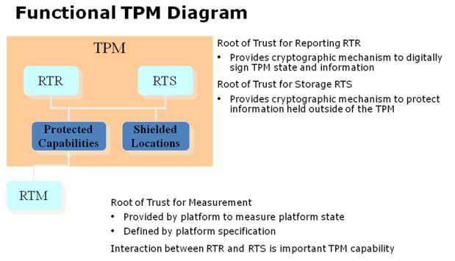
All roots of trust are not created equal
Tarnovsky attack
PCRs
Our attack
Base diagram from
http://www.intel.com/content/dam/doc/white-paper/uefi-pi-tcg-firmware-white-paper.pdf
Notes:
http://www.intel.com/content/dam/doc/white-paper/uefi-pi-tcg-firmware-white-paper.pdf

Slide 59
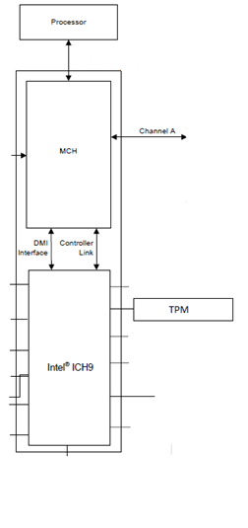
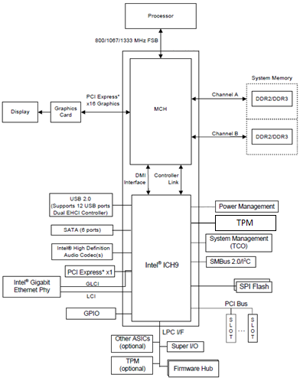
Q45 Express Chipset
0
4GB
System RAM
BIOS Region Begin
SPI Flash
www.intel.com/.../datasheet/io-controller-hub-9-datasheet.pdf
Notes:
www.intel.com/.../datasheet/io-controller-hub-9-datasheet.pdf
Modified slightly by moving the TPM to a more visible location (removed the clocks – hey who needs those!)

Slide 60
Normal E6400 boot sequence 1
0
4GB
SMRAM
System RAM
BIOS Region Begin
Configuration
Modules
…
SPI Flash
Boot Block
FFFF_FFF0

Slide 61
Normal E6400 boot sequence 2
0
4GB
SMRAM
System RAM
PCR0=SHA1(0₂₀ | hash)
PCR Extend (hash)
hashing
…
TCG Measure (SRTM)
SPI Flash
Boot Block

Slide 62
The Problems with PCRs
Opaqueness
No golden set of PCRs is provided by the OEM.
No description of what is actually being measured and incorporated into the PCR values.¹
Homogeneous systems can have different PCR values.²
Duplicate PCR values are unexpected if they're measuring different data…
Example E6400 PCR Set
The TCG specification gives vague guidelines on what should be incorporated into individual PCR values, and many decisions are left to the vendor.
Based on our own observation of PCR values across various systems.
Notes:
Make sure you say the TCG-provided description is not actually accurate to what's actually being measured, and then point out that 1,2,3 are just hashes of 0

Slide 63
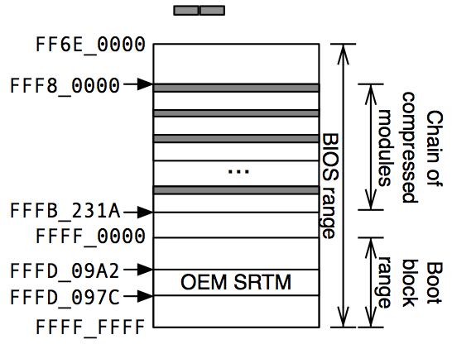
E6400 PCR0 (SRTM) Measurement
PCR0 should contain a measurement of the SRTM and other parts of the BIOS.
In the above diagram, the dark areas represent what the E6400 actually incorporates into the PCR0 measurement.
Only 0xA90 of the total 0x1A0000 bytes (.15%) in the BIOS range are incorporated, including:
The first 64 bytes of the 42 compressed modules.
Two 8 byte slices at 0xDF4513C0 and 0xDF4513C7.
The SRTM is not incorporated at all.
*BIOS Base is located at FFE6_0000
Notes:
Will need to caveat that there is a size field in the first 64 bytes. We should

Slide 64
Implications of the weak SRTM
Measurements for things like PCI option ROMs and BIOS configuration are not actually captured.
We can modify the majority of the E6400 BIOS without changing any of the PCR values.
Yuriy Bulygin presented a similar discovery at CanSecWest 2013 regarding his ASUS P8P67[3], but did not investigate the details of what information was being measured into what PCRs
What if we want to modify any part of the BIOS under the assumption that the entire BIOS is being measured?

Slide 65
Forging the PCRs
We can arbitrarily modify any part of the BIOS while still maintaining the expected PCR set if we do the following:
Record the expected hashes that the SRTM calculates and forwards to the TPM for the PCR_Extend operation(s).
Modify the BIOS to prevent the legitimate SRTM from being called.
Insert your own SRTM which simply replays the aforementioned “expected” hashes to the TPM.
This method maintains a valid PCR set even if the SRTM incorporates the entire BIOS into the measurement.

Slide 66
3 Firmware Malware Types
All firmware malware is resident on the NVRAM firmware and is therefore persistent
Naïve
That which can be detected by simply observing PCRs
Tick
Embeds itself in the firmware
Evades detection by forging PCRs
Once in place, can modify any other portion of the BIOS (even injecting itself into SMM)
Flea (to be discussed shortly)
Notes:
I only mention Naïve because I plan to show it in Demo to “prove” that changing the splash screen does change PCR0.

Slide 67
Normal BIOS PCR0 Measurement
0
4GB
System RAM
PCR0=SHA1(0₂₀ | 0xf005b411…)
BIOS
PCR_Extend(0xf005b411…)
SHA1(self)
SPI Flash
0xf005b411…
Notes:
Wasn’t this covered in the E6400 boot process slide? Perhaps a reminder? :/

Slide 68
PCR0 Measurement with a Tick
0
4GB
System RAM
PCR0=SHA1(0₂₀ | 0xf005b411…)
BIOS
SHA1(self)
PCR_Extend (0xf005b411…)
SPI Flash
Notes:
And just say here that the tick can also keep a compressed copy of the BIOS image that he decompresses and measures
The tick from http://th04.deviantart.net/fs6/PRE/i/2005/087/1/b/The_Tick_by_emucoupons.png

Slide 69
Tick Demo Video

Slide 70
Tick Demo Video
http://youtu.be/S0lRcm3jvFo
Narrative: (for those watching offline)
Show how a stealth rootkit can evade detection by forging PCR0
Bootup of a healthy E6400 laptop, with stock BIOS.
Notice the original Dell splash screen. The module that contains this splash screen is measured by the SRTM and thus will trigger a change in PCR0 if it is modified.
Log in:
Top right of screen will display our kernel driver debug output
Bottom right text file will contain our read PCR0 hashes
Run OpenTPM driver to read PCRs, save original (good) PCR0
Install a custom BIOS containing a “naïve” firmware rootkit
Mods the splash screen, has no stealth capability
Log in, dump PCRs, new PCR0 does not match good PCR0
Install a custom BIOS containing a “Tick” firmware rootkit
Also mods the splash screen, does have stealth capability
Log in, dump PCRs, new PCR0 does match PCR0.
Tick is now free to modify any other portion of the firmware without ever being detected.

Slide 71
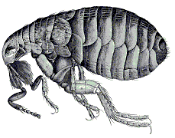
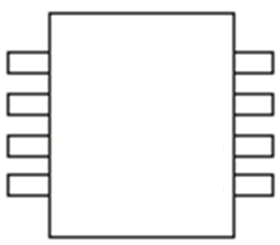
The Flea
All the same stealth capabilities of the Tick
Achieves persistence beyond BIOS re-flashes
“Jumps” from one BIOS revision to another
A31
A30
A29
Notes:
Extra slide.

Slide 72
The Flea
0
4GB
BIOS Firmware Update
BIOS Firmware Update
System RAM
BIOS Update
Flash!
Start BIOS Update
Clone!!
BIOS
SPI Flash
BIOS update?
Notes:
Dell’s updates are performed upon rebooting the system, so there is code in the BIOS that only executes when an update is going to take place.
Normally this update code locates the image and installs it. However the Flea controls this update code so it knows when an update is about to occur.
It then locates the firmware update image in RAM, and patches itself into the update image after which it permits the update process to proceed.

Slide 73
Flea Demo Video

Slide 74
Flea Demo Video
http://youtu.be/fvQjhqzxHR8
Narrative: (for those watching offline)
Show how the flea persists beyond BIOS updates
Not showing the stealth capabilities (same as Tick)
E6400 laptop already has a Flea present in its firmware
Mode of entry is same as the Tick (installed via kernel driver)
BIOS Revision A29
Install the manufacturers Stock BIOS Update
Will update to BIOS revision A30
BIOS updates to revision A30 and reboots
On startup we see that the Flea is still present in the malware.
The flea is able to forge the PCR0 value of the BIOS revision it has cloned itself into. In the interest of time I cut off the video after showing that the Flea persists.

Slide 75
Countermeasure: Timing-Based Attestation "BIOS Chronomancy"
The fundamental premise:
"Build your software so that if its code is modified, it runs slower."
We coined "timing-based" because it is a superset of the "software-based" techniques, but using hardware (e.g. TPM) for timing measurement
Meant to replace CRTM, but not reimplement entire SRTM
Assumptions:
Attacker has complete control of execution environment before self-checking begins (i.e. same privilege as defender)
Self-checking code is time-optimal for a given microarchitecture
There are no free execution slots where an attacker can insert a "free" instruction and suffer no timing slowdown
There is a decade of work in this area, we can't do the many many nuances justice. A timeline of related work here:
bit.ly/11xEmlV (timeglider.com link)

Slide 76
Components of All Self-Checks
Read your own data
Incorporated into checksum so if it changes the checksum changes
Read your own data pointer and instruction pointer
Indicates where in memory the code itself is reading and executing
Nonce/PseudoRandom Number(PRN)
Prevent trivial replay, decrease likelihood of precomputation due to storage constraints
Do all the above in millions of loop iterations
So that ideally an instruction or two worth of conditional checks per loop iteration leads to millions of extra instructions in the overall runtime

Slide 77
Simplified Selfcheck()
Selfcheck(checksum, nonce, codeStart, codeEnd, codeSize) {
while (iteration < 2500000)
{
checksum[0] += nonce;
checksum[1] ^= DP;
checksum[2] += *DP;
checksum[4] ^= EIP;
mix(checksum);
nonce += (nonce*nonce) | 5;
DP = codeStart + (nonce % codeSize);
iteration++;
}
}
Notes:
In reality our real implementation is X core lines of asm

Slide 78
Simplified Selfcheck() Forgery
Selfcheck_forge(checksum, nonce, codeStart, codeEnd, codeSize) {
while (iteration < 2500000)
{
checksum[0] += nonce;
checksum[1] ^= DP;
if (DP == myHookLocation)
checksum[2] += copyOfGoodBytes;
else
checksum[2] += *DP;
checksum[2] += *DP;
checksum[4] ^= EIP;
mix(checksum);
nonce += (nonce*nonce) | 5;
DP = codeStart + (nonce % codeSize);
iteration++;
}
}

Slide 79
TPM-Timing Based Implementation (BIOS Boot-Time)
Server
Client
TPM
BOOT
Request Tickstamp(hardcoded)
Signed Tickstamp 1
Time
Δt
Self-Check (nonce = signature)
Request Tickstamp(Self-Checksum)
Signed Tickstamp 2
Signed Tickstamp 1 & 2
Self-Checksum
Separate agent requests stored
measurement, and sends to server
for verification

Slide 80
Without attacker
With attacker
Notes:
16900 ticks ~= 1.081sec
What causes the spikes?
We don't know yet actually. One speculation is that we're getting system management interrupts (SMI) during the measurement. Another is that given the extra instructions introduced by the attacker, we're occasionally hitting pathologically bad cases of caching behavior. Or it could be due to erratic behavior of the TPM. This coming fiscal year when we go through another round of self-check revision (when looking at attacks from peripherals), we are going to evaluate it with a fine-toothed performance monitor comb. We just learned about some useful built in x86 performance monitors from other work. They monitor things like cache hits/misses.

Slide 81
Without attacker
With attacker
Notes:
21072 ticks ~= 1.35sec

Slide 82
Without attacker
With attacker
Notes:
29744 ticks ~= 1.90sec

Slide 83
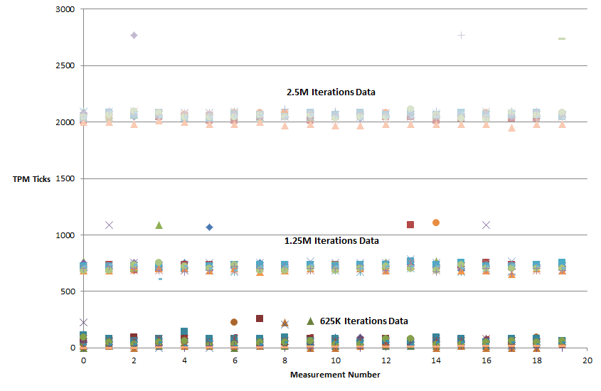
BIOS Chronomancy – attacker overhead vs. clean measurement 18 E6400s, 20 measurements, 3 different loop iteration counts
(1 tick = 64 μsec)
Takeaway: If you only do 625k iterations, occasionally the attacker wins.
With 1.25M or more the attacker doesn't even get close.

Slide 84
Is BC perfect? NOPE! TOCTOU attackers are ongoing work Enter the "flash hopper" :P
0
4GB
Start
System RAM
BIOS
Gbe LAN
SPI Flash
Self-check
Done
Notes:
"Flash Hopper"
http://www.middleschoolscience.com/an00487_.gif
There is a paper from CMU named VIPER specifically on attesting peripheral firmware. We will play with malicious peripherals & TOCTOU attacks this coming year.

Slide 85
Conclusion
Assume attackers can get in
Bad things happen when attacker get in
Trusted Computing implementations should not be trusted implicitly, they should only be trusted if they are open for independent review (and someone has actually reviewed them ;)
It's ironic that they're overwhelmingly closed source & proprietary. (Even academics don't usually post their code for open review!¹)
As long as the CRTM is implemented in writable firmware, ticks and fleas will mean that you can't trust any of your SRTM.
And as ITL has shown, a TXT-based Dynamic RTM can depend, in a security-critical way, on the BIOS/SRTM-generated info [5][6][7]
If you're not going to be using BC, you better be using super simple true ROM CRTM code
¹ Our code for our self-check is at http://code.google.com/p/timing-attestation
Notes:
Note, we are going to work toward getting the core self-checking code public released, just couldn't get it done in time for this con.

Slide 86
Conclusion deux!
We need more people working in this space!
You should try your hand at making and breaking timing-schemes¹.
It's obviously a very challenging and cool defensive security area
¹ Again, our code for our self-check is at http://code.google.com/p/timing-attestation

Slide 87
But wait…there's just One More Thing!
We have released Copernicus ("Question your assumptions!"), a tool to check for basic BIOS/SMM security vulnerabilities
http://www.mitre.org/work/cybersecurity/blog/cyber_tools_butterworth1.html
Checks configuration bits to see if the BIOS/SMM is writable, ala Yuriy's talks[3][4]
Dumps BIOS image to allow diffing & analysis
Can detect Rakshasa, last year's "undetectable" BIOS malware[7] ;)
Government organizations:
Talk to us about running this in your environment (pushable via HBSS - but the data goes to a different server, not ePO)
Commercial security vendors:
Contact us to incorporate Copernicus's capabilities into your kernel/hypervisor agents. We want maximum availability of this capability. MITRE is a not-for-profit company that only works for the government in the public interest.

Slide 88
Questions?
jbutterworth, ckallenberg, xkovah @ mitre.org
To learn more about TPMs, Reverse Engineering, and other deep security stuff, check out
http://OpenSecurityTraining.info/Training.html
John will be creating BIOS/UEFI classes this coming year, follow @OpenSecTraining to keep up with news
And if you already know the stuff, take the materials and teach it!
Also Corey released OpenTPM so you too can play around with and learn more about the TPM
http://code.google.com/p/opentpm/

Slide 89
References
[1] Attacking Intel BIOS – Alexander Tereshkin & Rafal Wojtczuk – Jul. 2009http://invisiblethingslab.com/resources/bh09usa/Attacking%20Intel%20BIOS.pdf
[2] TPM PC Client Specification - Feb. 2013http://www.trustedcomputinggroup.org/developers/pc_client/specifications/
[3] Evil Maid Just Got Angrier: Why Full-Disk Encryption With TPM is Insecure on Many Systems – Yuriy Bulygin – Mar. 2013 http://cansecwest.com/slides/2013/Evil%20Maid%20Just%20Got%20Angrier.pdf
[4] A Tale of One Software Bypass of Windows 8 Secure Boot – Yuriy Bulygin – Jul. 2013 http://blackhat.com/us-13/briefings.html#Bulygin
[5] Attacking Intel Trusted Execution Technology - Rafal Wojtczuk and Joanna Rutkowska – Feb. 2009http://invisiblethingslab.com/resources/bh09dc/Attacking%20Intel%20TXT%20-%20paper.pdf
[6] Another Way to Circumvent Intel® Trusted Execution Technology - Rafal Wojtczuk, Joanna Rutkowska, and Alexander Tereshkin – Dec. 2009http://invisiblethingslab.com/resources/misc09/Another%20TXT%20Attack.pdf
[7] Exploring new lands on Intel CPUs (SINIT code execution hijacking) - Rafal Wojtczuk and Joanna Rutkowska – Dec. 2011http://www.invisiblethingslab.com/resources/2011/Attacking_Intel_TXT_via_SINIT_hijacking.pdf
[7] Meet 'Rakshasa,' The Malware Infection Designed To Be Undetectable And Incurable - http://www.forbes.com/sites/andygreenberg/2012/07/26/meet-rakshasa-the-malware-infection-designed-to-be-undetectable-and-incurable/

Slide 90
Backup slides

Slide 91
Copernicus: "Question your assumptions (about BIOS security)"
Sam Cornwell, John Butterworth, Xeno Kovah, Corey Kallenberg

Slide 92
Motivations
We want to know if a BIOS is writable
We want to be able to integrity check the BIOS
We want our integrity checks to be more actionable than "the hash changed. Do 'something' about it."
We want BIOS integrity checking to be a widely available capability for both industry and our government sponsors
We want to know what the state of the wild for BIOS security looks like right now
Copernicus is available now for you to play around with!
http://www.mitre.org/capabilities/cybersecurity/overview/cybersecurity-blog/copernicus-question-your-assumptions-about or http://bit.ly/19rYHin
Please contribute your data back to us
Notes:
Because we like you.

Slide 93
BIOS Access Control Checking
BIOS makers are supposed to set certain access control bits that are scattered around a number of hardware registers. These bits should make it so that no one can write to the BIOS flash chip until next reboot.
Unfortunately vendors don't always set these bits correctly, and the BIOS can therefore be written to directly by anyone with admin privileges
Copernicus checks these bits and reports whether a BIOS flash chip is open for modification
Notes:
http://cdn3.iconfinder.com/data/icons/humano2/128x128/stock/stock_lock-open.png

Slide 94
Running Copernicus Video
standalone.bat
http://www.youtube.com/watch?v=zZe88jW9PuE
Notes:
Compare two of the same machines over time, and show correlation to the UEFI flash filesystem.
Show one example which is "natural" changes between runs/reboots

Slide 95
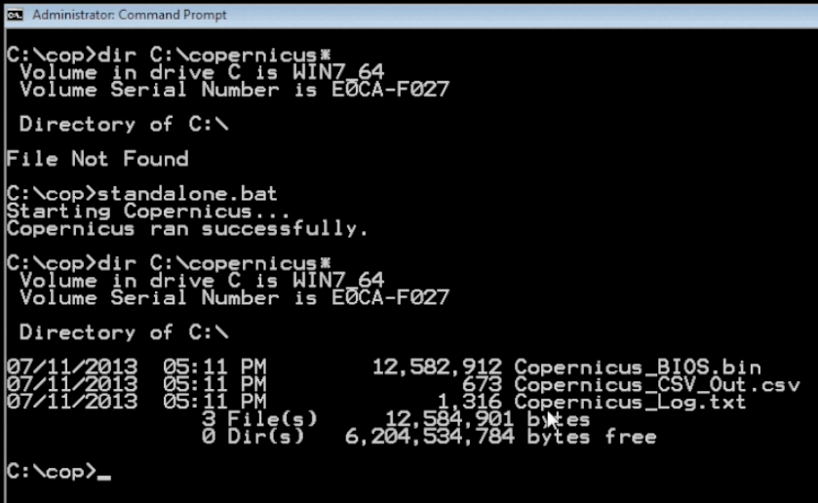
Running Copernicus 2

Slide 96
Running Copernicus 3 – .csv output

Slide 97
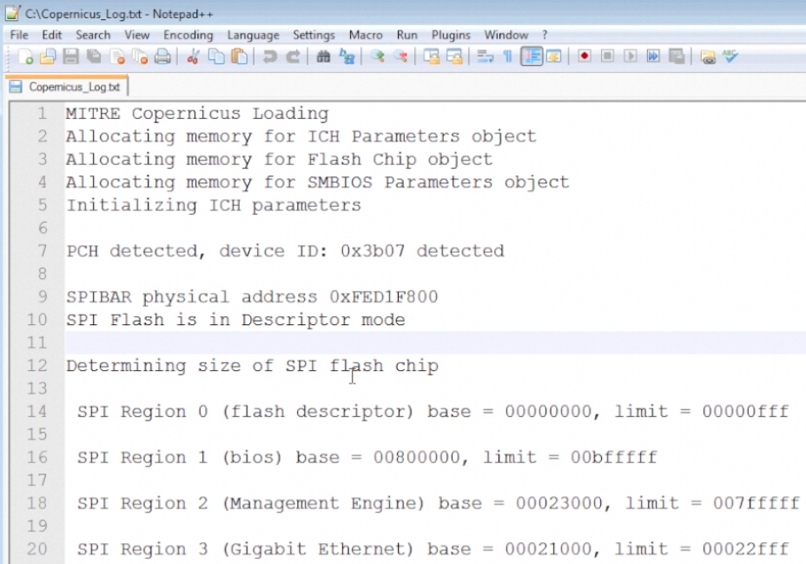
Running Copernicus 4 – .log output

Slide 98
BIOS/SMRAM Writability Analysis Video
protections.py
Public youtube link will be added later
Notes:
Compare two of the same machines over time, and show correlation to the UEFI flash filesystem.
Show one example which is "natural" changes between runs/reboots

Slide 99
Example Analysis Results
We've tested on > 8k machines from various organizations so far
~55% have unlocked BIOS
COUNT | BIOS_VENDOR | PRODUCT_NAME | BIOS_VERSION | SMRAM_UNLOCKED | BIOS_UNLOCKED
7 | Dell Inc. | Latitude E6400 | A25 | 0 | 7
3 | Dell Inc. | Latitude E6400 | A27 | 0 | 3
10 | Dell Inc. | Latitude E6400 | A29 | 0 | 10
7 | Dell Inc. | Latitude E6400 | A30 | 0 | 0
1 | Dell Inc. | Latitude E6400 | A31 | 0 | 0
2 | Dell Inc. | Latitude E6400 | A32 | 0 | 0
1 | Dell Inc. | Latitude E6400 | A33 | 0 | 0
Notes:
Note that this also shows how when you upgrade to a high enough BIOS revision, the BIOS stops being vulnerable.

Slide 100
Possible Defenses
For some machines (such as the Dell E6400), newer BIOS updates have the access controls set
Rev A29 is open & vulnerable, Rev A30 and newer aren't
We are collecting a more comprehensive matrix of which models and BIOS revisions are secure
This can be the basis for determining whether to perform enterprise-wide BIOS updates
When we find enough machines for which there is no BIOS update fix, we can go to the vendor and ask them to fix this
Notes:
http://www.iconfinder.com/icondetails/115716/128/lock_password_secure_security_unlock_icon

Slide 101
Looking for BIOS Changes
If a difference is found, now what are you going to do?
We want to be able to attribute changes in a hash to specific locations in the BIOS image that changed.
We need to be able to compare the before and after raw BIOS dumps. We can then say something about the purpose of the location where the change occurred, and whether it's expected or not.
This helps tamp down false positives
Copernicus gives us a BIOS dump, and therefore an integrity checking capability!

Slide 102
BIOS Change Detection Video
bios_diff.py
http://www.youtube.com/watch?v=XaeMrL1LqPo
Notes:
Compare two of the same machines over time, and show correlation to the UEFI flash filesystem.
Show one example which is "natural" changes between runs/reboots

Slide 103
PCR Change Response with Copernicus
Now when a BIOS change is found it can be in detail, and most importantly it is now actionable.
UEFI firmware is compiled from C code into Microsoft's Portable Executable format.
Therefore Windows reverse engineering skills from other people (such as malware analysts) can be reused to understand UEFI changes.
"Just" need to read some UEFI specs
We will be making classes to help existing reverse engineers be able to understand UEFI binaries, and posting them to OpenSecurityTraining.info in the future

Slide 104
BIOS Static Analysis in IDA Video
IDA
http://www.youtube.com/watch?v=R-5UO6jLkEI
Notes:
Compare two of the same machines over time, and show correlation to the UEFI flash filesystem.
Show one example which is "natural" changes between runs/reboots

Slide 105
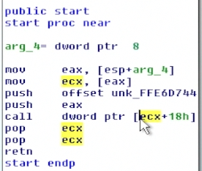
BIOS Static Analysis in IDA 2
Clean BIOS TPM module entry point
Attacked BIOS TPM module entry point
A single byte change means the TPM module will immediately return, and never initialize the TPM for early-system use

Slide 106
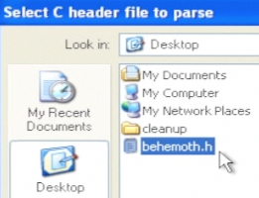
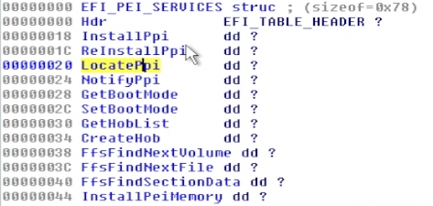
BIOS Static Analysis in IDA 3
UEFI BIOSes make use of a number of specified data structures. Snare extracted some of these structures into "behemoth.h", which can then be imported into IDA

Slide 107
BIOS Static Analysis in IDA 4
Because the BIOS is written in 32 bit C, Hexrays can be used to decompile
When we apply structure definitions from behemoth.h, we now know the function which is being called; in this case, InstallPpi()

Slide 108
BIOS Static Analysis in IDA 5
Some other pseudocode made more readable thanks to applying structures
This translates to
If(LocatePpi() succeeds){
GetBootMode()
do some other functions
InstallPpi()
etc
}
Which is much easier to read than a bunch of handcoded assembly

Slide 109
BIOS Static Analysis in IDA 6
If we have data locations which the structures say are UEFI_GUIDs
We can look the GUID up in a list of GUIDs extracted from the UEFI reference implementation and see if it's a well-known GUID
In this case, if we didn't already suspect this module had to do with the TPM, the fact that it's installing a PPI named "TPM_INITIALIZED" would be a dead giveaway.

Slide 110
Conclusion
Assume attackers can get in
Bad things happen when attackers get in
Trusted Computing implementations should not be trusted implicitly, they should only be trusted if they are open for independent review (and someone has actually reviewed them ;)
It's ironic that they're overwhelmingly closed source & proprietary. (Even academics don't usually post their code for open review!¹)
As long as the CRTM is implemented in writable firmware, ticks and fleas will mean that you can't trust any of your SRTM.
And as ITL has shown, a TXT-based Dynamic RTM can depend, in a security-critical way, on the BIOS/SRTM-generated info [5][6][7]
If you're not going to be using BC, you better be using super simple true ROM CRTM code
¹ Our code for our self-check is at http://code.google.com/p/timing-attestation
Notes:
Note, we are going to work toward getting the core self-checking code public released, just couldn't get it done in time for this con.

Slide 111
References
[1] Attacking Intel BIOS – Alexander Tereshkin & Rafal Wojtczuk – Jul. 2009http://invisiblethingslab.com/resources/bh09usa/Attacking%20Intel%20BIOS.pdf
[2] TPM PC Client Specification - Feb. 2013http://www.trustedcomputinggroup.org/developers/pc_client/specifications/
[3] Evil Maid Just Got Angrier: Why Full-Disk Encryption With TPM is Insecure on Many Systems – Yuriy Bulygin – Mar. 2013 http://cansecwest.com/slides/2013/Evil%20Maid%20Just%20Got%20Angrier.pdf
[4] A Tale of One Software Bypass of Windows 8 Secure Boot – Yuriy Bulygin – Jul. 2013 http://blackhat.com/us-13/briefings.html#Bulygin
[5] Attacking Intel Trusted Execution Technology - Rafal Wojtczuk and Joanna Rutkowska – Feb. 2009http://invisiblethingslab.com/resources/bh09dc/Attacking%20Intel%20TXT%20-%20paper.pdf
[6] Another Way to Circumvent Intel® Trusted Execution Technology - Rafal Wojtczuk, Joanna Rutkowska, and Alexander Tereshkin – Dec. 2009http://invisiblethingslab.com/resources/misc09/Another%20TXT%20Attack.pdf
[7] Exploring new lands on Intel CPUs (SINIT code execution hijacking) - Rafal Wojtczuk and Joanna Rutkowska – Dec. 2011http://www.invisiblethingslab.com/resources/2011/Attacking_Intel_TXT_via_SINIT_hijacking.pdf
[7] Meet 'Rakshasa,' The Malware Infection Designed To Be Undetectable And Incurable - http://www.forbes.com/sites/andygreenberg/2012/07/26/meet-rakshasa-the-malware-infection-designed-to-be-undetectable-and-incurable/

Slide 112
References 2
[8] Implementing and Detecting an ACPI BIOS Rootkit – Heasman, Feb. 2006http://www.blackhat.com/presentations/bh-europe-06/bh-eu-06-Heasman.pdf
[9] Implementing and Detecting a PCI Rookit – Heasman, Feb. 2007 http://www.blackhat.com/presentations/bh-dc-07/Heasman/Paper/bh-dc-07-Heasman-WP.pdf
[10] Using CPU System Management Mode to Circumvent Operating System Security Functions - Duflot et al., Mar. 2006http://www.ssi.gouv.fr/archive/fr/sciences/fichiers/lti/cansecwest2006-duflot-paper.pdf
[11] Getting into the SMRAM:SMM Reloaded – Duflot et. Al, Mar. 2009 http://cansecwest.com/csw09/csw09-duflot.pdf
[12] Attacking SMM Memory via Intel® CPU Cache Poisoning – Wojtczuk & Rutkowska, Mar. 2009http://invisiblethingslab.com/resources/misc09/smm_cache_fun.pdf
[13] Defeating Signed BIOS Enforcement – Kallenberg et al., Sept. 2013 – URL not yet available, email us for slides
[14] Mebromi: The first BIOS rootkit in the wild – Giuliani, Sept. 2011 http://www.webroot.com/blog/2011/09/13/mebromi-the-first-bios-rootkit-in-the-wild/

Slide 113
References 3
[15] Persistent BIOS Infection – Sacco & Ortega, Mar. 2009 http://cansecwest.com/csw09/csw09-sacco-ortega.pdf
[16] Deactivate the Rootkit – Ortega & Sacco, Jul. 2009 http://www.blackhat.com/presentations/bh-usa-09/ORTEGA/BHUSA09-Ortega-DeactivateRootkit-PAPER.pdf
[17] Sticky Fingers & KBC Custom Shop – Gazet, Jun. 2011 http://esec-lab.sogeti.com/dotclear/public/publications/11-recon-stickyfingers_slides.pdf
[18] BIOS Chronomancy: Fixing the Core Root of Trust for Measurement – Butterworth et al., May 20

Slide 114
E6400 PCR[1-3]
PCRs 1-3 should contain configuration and option rom measurements.
Interesting because they are duplicate values.
We had also seen this a89fb8f… value on other (non-E6400) systems.
PCR[1..3] = SHA1(0x00₂₀ || SHA1(0x00))

Slide 115
Future Work: Combat TOCTOU
Attacker moves out of the way, just in time
Notes:
Time of Check, Time of Use attack
Segue: "While this is obviously a sophisticated defense system, we are under no illusions that it's perfect…yet :P"

Slide 116
Conditions for TOCTOU
1) The attacker must know when the measurement is about to start.
2) The attacker must have some un-measured location to hide in for the duration of the measurement.
3) The attacker must be able to reinstall as soon as possible after the measurement has finished.
It turns out a bunch of the example attacks in the literature are TOCTTOU without being explicit about it.
And it turns out TOCTOU more severely undercuts the technique than prior work had recognized

Slide 117
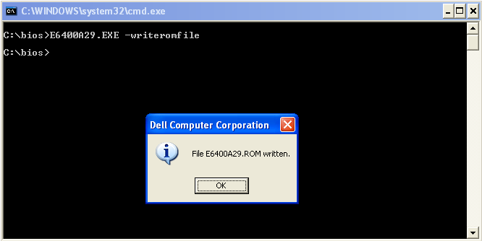
BIOS Acquisition
Method 1: Obtain the BIOS ROM from manufacturer
Dependent on manufacturer
May not provide straight-forward method to obtain the actual ROM image
Dell, for example, no longer provides this handy feature.
Notes:
Can remove the text if you want and just make the picture bigger. The text doesn’t add anything anyway.

Slide 118
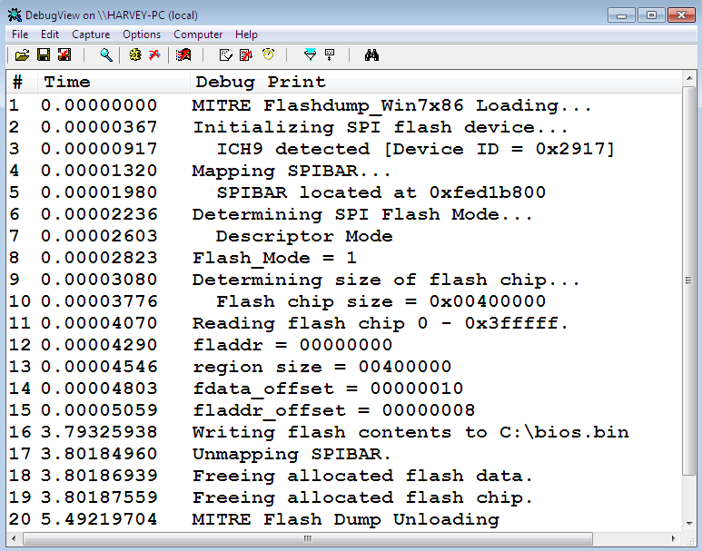
BIOS Acquisition
Method 2: Read it from the BIOS chip using software
Write your own if you want to learn the architecture very well
Time consuming (but fun and educational)
Linux app with iopl() also works well, better for testing
Notes:
Can remove the text if you want and just make the picture bigger. The text doesn’t add anything anyway.

Slide 119
BIOS Acquisition
Method 3: Read it from the BIOS chip using hardware
Turned out to actually be a requirement …
Not necessarily easy to get at the BIOS chip

Slide 120
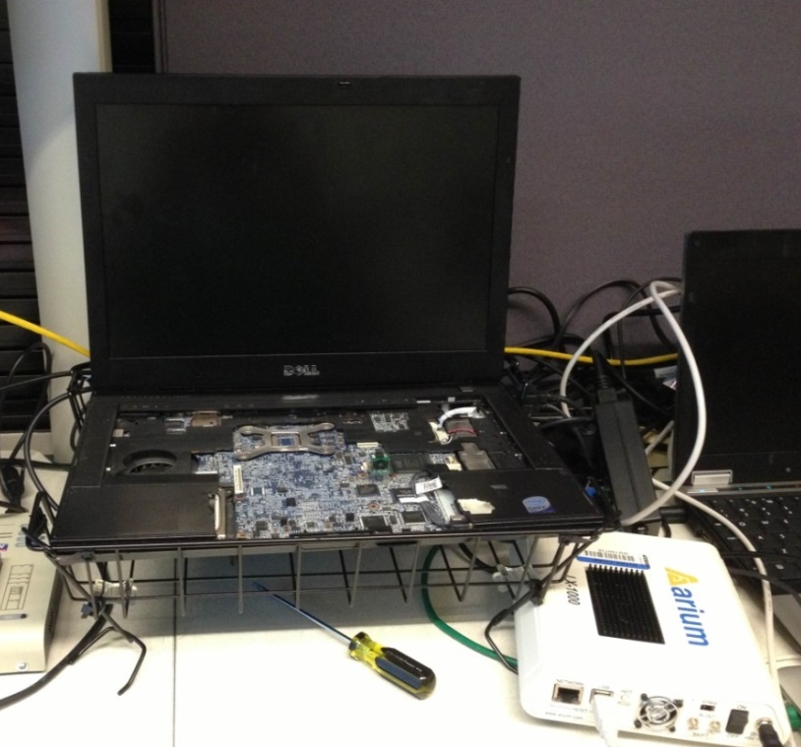
BIOS Analysis: Arium CPU Debugger FTW!*
*Some [dis]assembly required.
Notes:
Not shown: elbow grease

Slide 121
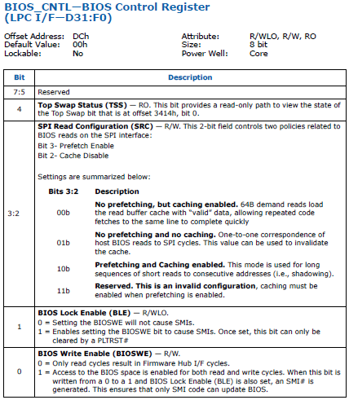
BIOS Modification: Access Controls 2
BIOSWE can “always” be set to make the flash chip writeable (R/W attributes!)
BLE, however provides SMRAM the final say as to whether or not writes to the flash will be permitted.
E6400 version A29 didn't set BLE, A30 did
Notes:
www.intel.com/content/www/us/en/io/io-controller-hub-9-datasheet.html

