Slide 1
Global Logfile of (IN)security
Using SHODAN to change the world.

Slide 2
Who the hell… Éireann Leverett BEng: Software Engineering and Artificial Intelligence MPhil: Advanced Computer Science …and I have some alphabet soup after my name. I am primarily here because I used SHODAN to find tens of thousands of industrial system devices directly connected to the internet. This is not about that. This is about using SHODAN for empirical computer science research, security metrics, and mitigation.

Slide 3
GR33TZ Shawn Merdinger, Bob Radvanovsky, Ruben Santamarta, Mike Davis, Michael Milvich, Reid Wightman, Alexandre Dulanoy, Morgan Marquis-Debois, Shailendra Fuloria, Arthur Gervais, Colin Cassidy, Ben Miller, Billy Rios, Terry McCorkle, Carlos Hollman And of course: John Matherly @achillean www.shodanhq.com/promo/hacklu

Slide 4
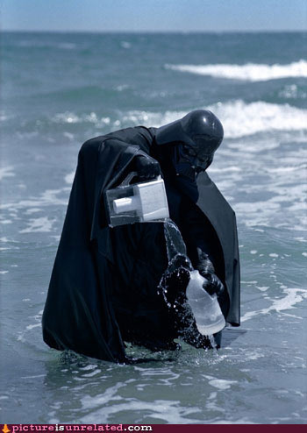
Filtering the ocean of data

Slide 5
List o’ Filters
Freetext
Host
Net
City
Country
Port
OS
Before/After
Geo
Hostname
Org (ASN)
Title
ISP
Assigned
peered
HTML

Slide 6
Hack the filters!
The country filter is
ISO-3166-2
Which is not TLD or Country
And has some surprises like A0. A1. A2
AQ
Take down AQ! Damn Terroirists!
(Antarctica)

Slide 7
The Undocumented Filters!
ORG
http://www.shodanhq.com/search?q=org%3A%22Akamai+Technologies%22
Title
http://www.shodanhq.com/search?q=title%3A%22Test%22
Coming Soon:
ISP
HTML

Slide 8
SSL/TLS Filters
Cert Version
Cert Bits
Cert Issuer
Cert Subject
Cipher Name
Cipher Bits
Cipher Protocol

Slide 9
Setting up the API (Linux)
sudo apt-get install python-setuptools easy_install shodan
easy_install –U shodan

Slide 10
Inspirational Dorks!
Throughout this workshop I will drop inspirational queries to keep things interesting. You can have a copy of the slides, so don’t panic and write them down.
I have carefully chosen queries that don’t just tell you ‘here is a device’ but suggest some other problem or interesting research question…

Slide 11
Surveillence/Censorship Dorks
http://www.shodanhq.com/search?q=port%3A137%20calea
http://www.shodanhq.com/search?q=C7200-ADVIPSERVICESK9_LI-M
http://www.shodanhq.com/search?q=Blue+Coat+PacketShaper

Slide 12
Common Coding Pitfalls
Paging through results
Matches are not all the data; use host.get()
Regular expressions (Groups)
Multiple net filters
Check your encodings before serialisation
Exploits can be cached
Don’t forget to search both Metasploit and ExploitDB (They use different API calls)

Slide 13
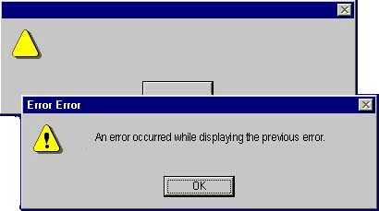
Luckily…I haz code templatez!!!

Slide 14
Comedy Queries
http://www.shodanhq.com/search?q=%22I%27m+a+teapot.%22
http://www.shodanhq.com/search?q=port%3A23+Nyancat

Slide 15
Storing the data
Serialise the data if you want to analyse it later.
I pickle it in python.
Watch your encodings.
For example, you want to keep devices but re-run exploit searches.

Slide 16
Statefullness!
Configuration state:
http://www.shodanhq.com/search?q=%22Default%3A+admin%2Fpassword%22
http://www.shodanhq.com/search?q=PUBLICLY-KNOWN+CREDENTIALS
Run time state:
http://www.shodanhq.com/search?q=%5Cx04Host

Slide 17
Complimentary sources of Info
ERIPP
Team Cymru IP to ASN Lookup
Rwhois
DNS && rDNS
Google hacks

Slide 18
Network Oddities:
http://www.shodanhq.com/search?q=255.255.255.255

Slide 19
Working with CERTs
Many of you know more about this than me…
My experience is be patient, maintain dialog, and ask what would assist them.
Try to teach them what you do, and then leave them alone.

Slide 20
Reserved Spaces
http://www.shodanhq.com/search?q=net%3A0.0.0.0%2F8
http://www.shodanhq.com/search?q=net%3A10.0.0.0%2F8
http://www.shodanhq.com/search?q=net%3A127.0.0.0%2F8
http://www.shodanhq.com/search?q=net%3A169.254.0.0%2F16
http://www.shodanhq.com/search?q=net%3A172.16.0.0%2F12
http://www.shodanhq.com/search?q=net%3A100.64.0.0%2F10

Slide 21
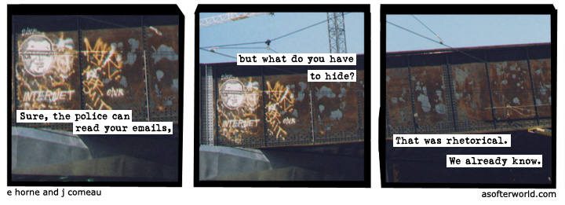
DISCUSSION TIME!

Slide 22
Staring into the void
http://www.shodanhq.com/search?q=net%3A192.0.0.0%2F24
http://www.shodanhq.com/search?q=net%3A198.18.0.0%2F15
http://www.shodanhq.com/search?q=net%3A240.0.0.0%2F4

Slide 23
Preparing Reports For CERTs
De-Duplicate IPs
Add ASNs
Use CSV
Add Abuse Emails
Add Exploits
Exchange keys
Get them to sign keys later

Slide 24
Devices
http://www.shodanhq.com/search?q=SMSLockSys
http://www.shodanhq.com/search?q=port%3A23+switch

Slide 25
Services
http://www.shodanhq.com/search?q=port%3A23+%22list+of+built+in+commands%22
http://www.shodanhq.com/search?q=port%3A23+Anonymous+ftp+is+still+available

Slide 26
SSL/TLS
http://www.shodanhq.com/search?q=cipher_protocol%3ATLSv1+cipher_name%3ANULL-SHA
http://www.shodanhq.com/search?q=cipher_protocol%3ATLSv1+cipher_name%3ANULL-MD5

Slide 27
Session ID Research!
http://www.shodanhq.com/search?q=PHPSESSID%3D
http://www.shodanhq.com/search?q=+AIROS_SESSIONID%3D
http://www.shodanhq.com/search?q=JSESSIONID%3D

Slide 28
Broad Ideas
Profile an ISP/ASN/Country
Examine the state of surveillance
Comparison of countries
Comparison of SSL
Uniqueness of session IDS

Slide 29
Conclusions
Network oddities
Host oddities
Config State
Runtime State
Political State
Location or connection types
Cipher types

Slide 30
Conclusions
SHODAN is for more than just finding cool boxen. You can research AT SCALE, CHEAPLY.
Think about researching THE WHOLE THING and outputting metrics that will help us all.
Then go to cool places and talk about it!

Slide 31
Thanks for coming (if you did)!
Email: eireann (.) leverett [AT] ioactive (dot) co (dot) uk
Twitter: @blackswanburst
PGP: C97C1513

