Slide 1
KillBot: Conspiracy Theories
Inbar Raz hack.lu lightning talk 25 October 2012

Slide 2
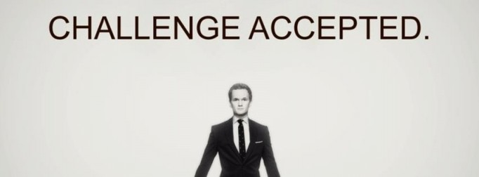
Why am I giving this talk?
Too much social engineering talk got me excited.
Luxembourg trip and dinner are for speakers only.

Slide 3
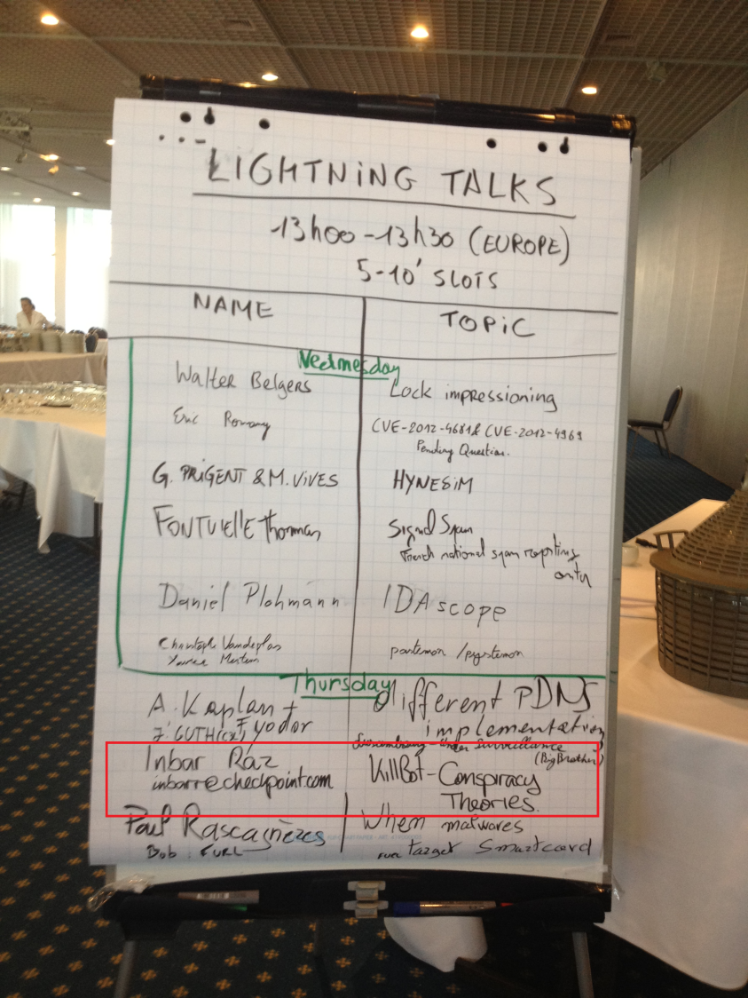
Why am I giving this talk?
Cover story: I’m giving a lightning talk!

Slide 4
Why am I giving this talk?
It worked ☺
Only problem: Turns out I actually need to give a talk.
Luckily, I have one ready.

Slide 5
Agenda
1
Background
2
Coding peculiarities
3
Logic peculiarities
4
Conspiracy Theories
Notes:
5
5
5

Slide 6
Background
A malicious Word document is detected.
The document drops and executes an EXE file.
Time of attack: 2012-03-05 02:55:54 (US)
End of preliminary analysis: 2012-03-05 18:45 (Israel)
Within two days, 2 more attacks are documented
EXE was sent directly by mail (no encapsulation).
Targets were not Check Point customers.
On at least one of the cases the KillBot succeeded.

Slide 7
Agenda
1
Background
2
Coding peculiarities
3
Logic peculiarities
4
Conspiracy Theories
Notes:
7
7
7

Slide 8
No sophistication whatsoever
No Zero-Day vulnerabilities used.
Enabled Macros required for dropping the EXE.
They don’t have Minos…
This makes an “affordable loss”.

Slide 9
Almost no protection
EXE is neither packed nor encrypted.
Server IP, HTTP message and bot name in plain text:
.rdata:00402250 aHTTP_POST db 'POST %s HTTP/1.0',0Dh,0Ah .rdata:00402250 db 'Content-Type: application/x-www-form-urlencoded',0Dh,0Ah .rdata:00402250 db 'Content-transfer-encoding: base64',0Dh,0Ah .rdata:00402250 db 'Content-Length: %d',0Dh,0Ah .rdata:00402250 db 'Host: %s',0Dh,0Ah .rdata:00402250 db 'Connection: Keep-Alive',0Dh,0Ah .rdata:00402250 db 0Dh,0Ah .rdata:00402250 db 'id=%s&code=2&md5=wer&data=',0
.data:0040302C server_ip db '193.104.153.31',0 .data:0040303C aServerPath db '/fl/task',0 .data:00403048 aKillbot db 'KillBOt',0
BUT: Encrypted Registry Key name
SOFTWARE\Microsoft\Windows\CurrentVersion\Run\
This string is always a cause for alarm…

Slide 10
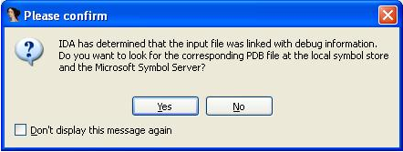
Partial debug information
When loaded to IDA:
Inside disassembly:
.rdata:004028E0 ; Debug Information resource .rdata:004028E0 dd 'SDSR' ; MagicWord - RSDS signature .rdata:004028E0 db 031h,06Dh,049h,0FAh,004h,0C2h,083h,046h ; GUID .rdata:004028E0 db 0A1h,098h,00Fh,0A1h,082h,0EAh,0ECh,05Fh ; GUID .rdata:004028E0 dd 1 ; Age .rdata:004028E0 db 'C:\Users\admin\Documents\projects\loader\Screen\Release\killAll_exe.pdb',0’ ; FilePath

Slide 11
Unnecessarily duplicated code
“KillSelf()” function:
.text:004012C0 push 0 ; lParam .text:004012C2 push 0F020h ; wParam .text:004012C7 push 112h ; Msg .text:004012CC push 1 ; gaFlags .text:004012CE push 0 ; lpszWindow .text:004012D0 push 0 ; lpszClass .text:004012D2 push 0 ; hWndChildAfter .text:004012D4 push 0FFFFFFFDh ; hWndParent .text:004012D6 call ds:FindWindowExW .text:004012DC push eax ; hwnd .text:004012DD call ds:GetAncestor .text:004012E3 push eax ; hWnd .text:004012E4 call ds:PostMessageW .text:004012EA call ElevatePriviledge .text:004012EF push offset LibFileName ; "ntdll.dll“ .text:004012F4 call ds:LoadLibraryA .text:004012FA push offset ProcName ; "RtlSetProcessIsCritical“ .text:004012FF push eax ; hModule .text:00401300 call ds:GetProcAddress .text:00401306 push 0 ; void* u .text:00401308 push 0 ; bool* pOld .text:0040130A push 1 ; bool IsCritical .text:0040130C call eax ; int __cdecl NTDLL:RtlSetProcessIsCritical() .text:0040130E push 222 ; uExitCode .text:00401313 call ds:GetCurrentProcess .text:00401319 push eax ; hProcess .text:0040131A call ds:TerminateProcess

Slide 12
Unnecessarily duplicated code
BUT, the end of “ThreadMain()” function:
.text:0040194D push 0 ; lParam .text:0040194F push 0F020h ; wParam .text:00401954 push 112h ; Msg .text:00401959 push 1 ; gaFlags .text:0040195B push 0 ; lpszWindow .text:0040195D push 0 ; lpszClass .text:0040195F push 0 ; hWndChildAfter .text:00401961 push 0FFFFFFFDh ; hWndParent .text:00401963 call ds:FindWindowExW .text:00401969 push eax ; hwnd .text:0040196A call ds:GetAncestor .text:00401970 push eax ; hWnd .text:00401971 call ds:PostMessageW .text:00401977 call ElevatePriviledge .text:0040197C push offset LibFileName ; "ntdll.dll“ .text:00401981 call ds:LoadLibraryA .text:00401987 push offset ProcName ; "RtlSetProcessIsCritical“ .text:0040198C push eax ; hModule .text:0040198D call ds:GetProcAddress .text:00401993 push 0 ; void* u .text:00401995 push 0 ; bool* pOld .text:00401997 push 1 ; bool IsCritical .text:00401999 call eax ; int __cdecl NTDLL:RtlSetProcessIsCritical() .text:0040199B push 222 ; uExitCode .text:004019A0 call ds:GetCurrentProcess .text:004019A6 push eax ; hProcess .text:004019A7 call ds:TerminateProcess

Slide 13
One more time…

Slide 14
Unnecessarily duplicated code
“KillSelf()” function:
.text:004012C0 push 0 ; lParam .text:004012C2 push 0F020h ; wParam .text:004012C7 push 112h ; Msg .text:004012CC push 1 ; gaFlags .text:004012CE push 0 ; lpszWindow .text:004012D0 push 0 ; lpszClass .text:004012D2 push 0 ; hWndChildAfter .text:004012D4 push 0FFFFFFFDh ; hWndParent .text:004012D6 call ds:FindWindowExW .text:004012DC push eax ; hwnd .text:004012DD call ds:GetAncestor .text:004012E3 push eax ; hWnd .text:004012E4 call ds:PostMessageW .text:004012EA call ElevatePriviledge .text:004012EF push offset LibFileName ; "ntdll.dll“ .text:004012F4 call ds:LoadLibraryA .text:004012FA push offset ProcName ; "RtlSetProcessIsCritical“ .text:004012FF push eax ; hModule .text:00401300 call ds:GetProcAddress .text:00401306 push 0 ; void* u .text:00401308 push 0 ; bool* pOld .text:0040130A push 1 ; bool IsCritical .text:0040130C call eax ; int __cdecl NTDLL:RtlSetProcessIsCritical() .text:0040130E push 222 ; uExitCode .text:00401313 call ds:GetCurrentProcess .text:00401319 push eax ; hProcess .text:0040131A call ds:TerminateProcess

Slide 15
Unnecessarily duplicated code
BUT, the end of “ThreadMain()” function:
.text:0040194D push 0 ; lParam .text:0040194F push 0F020h ; wParam .text:00401954 push 112h ; Msg .text:00401959 push 1 ; gaFlags .text:0040195B push 0 ; lpszWindow .text:0040195D push 0 ; lpszClass .text:0040195F push 0 ; hWndChildAfter .text:00401961 push 0FFFFFFFDh ; hWndParent .text:00401963 call ds:FindWindowExW .text:00401969 push eax ; hwnd .text:0040196A call ds:GetAncestor .text:00401970 push eax ; hWnd .text:00401971 call ds:PostMessageW .text:00401977 call ElevatePriviledge .text:0040197C push offset LibFileName ; "ntdll.dll“ .text:00401981 call ds:LoadLibraryA .text:00401987 push offset ProcName ; "RtlSetProcessIsCritical“ .text:0040198C push eax ; hModule .text:0040198D call ds:GetProcAddress .text:00401993 push 0 ; void* u .text:00401995 push 0 ; bool* pOld .text:00401997 push 1 ; bool IsCritical .text:00401999 call eax ; int __cdecl NTDLL:RtlSetProcessIsCritical() .text:0040199B push 222 ; uExitCode .text:004019A0 call ds:GetCurrentProcess .text:004019A6 push eax ; hProcess .text:004019A7 call ds:TerminateProcess

Slide 16
Agenda
1
Background
2
Coding peculiarities
3
Logic peculiarities
4
Conspiracy Theories
Notes:
16
16
16

Slide 17
Document Name
Unordinary and suspicion-arising name:
“xc8xedxf1xf2xf0xf3xeaxf6xe8xff_xecxe8xf2xe8xedxe3.doc”
Is actually Windows-1251 (Cyrillic script):
Инстукция митинг
Instruction Meeting
Russians in the crowd: Did I get this right?

Slide 18
Involved IP addresses
C&C Server IP: 193.104.153.31
Registered to “TRADE COMPANY TANJA s.r.o.”
Located in Prague, Czech Republic
Sending Mail Server IP: 79.127.3.100
Registered to “Asiatech DSL Broadband Services”
Located in Tehran, Iran
No attempt was made to hide either address

Slide 19
Incomplete communications logic
Data Validation:
“id=” and “code=” in response.
Code value must not start with ‘0’.
If validation succeeds:
Leave socket open!
But… exit.
Either way:
Do nothing.
send()
recv()
Fail
exit
Success
Valid Data
No
Close socket
Yes
exit
exit

Slide 20
File type “Kill List”
KillBot iterates on all files and directories.
Looks for the following substrings (not extensions):
.msc
.exe
.doc
.xls
.rar
.zip
.7z
DLL files are not on the list, but MSC files are.

Slide 21
Agenda
1
Background
2
Coding peculiarities
3
Logic peculiarities
4
Conspiracy Theories
Notes:
21
21
21

Slide 22
Suspicious facts
It’s obvious that code has been commented out:
Socket is intentionally left open but nothing else happens.
No code processes the response from C&C.
KillBot makes no attempt to hide itself or its origin:
It causes damage, which alerts victim.
This is not so common anymore.
IP addresses are visible.
Iran as a source – Really?

Slide 23
Conclusions
We’re not seeing the whole picture.
Code could be either a Proof-of-Concept or a Test Drive
Option 1: Testing the customer’s susceptibility
Customer is now alert
Option 2: Testing the technology
The customer was a random target
Iran is not necessarily not involved
Option 1: Someone is throwing dirt – they’re easy to blame
Option 2: This is a script kiddie (We’re not so sure about this anymore…)

Slide 24
Questions?

