Slide 1
Security Tools for the SDL
Ivan Medvedev
Principal Security Development Lead
Microsoft Corporation

Slide 2
Session Objectives and Takeaways
Session Objective(s):
  Give an overview of the Security Development Lifecycle
  Discuss the externally available tools that support the SDL
  Provide guidance on using the tools to build more secure software
Key takeaways:
  Microsoft is investing into supporting the SDL
  Customers should use the tools to build more secure software

Slide 3

Security Timeline at Microsoft…
Now
2005-2007
Optimize the process through feedback,
analysis and automation
Evangelize
the SDL to the software development community:
  SDL Process Guidance
  SDL Optimization Model
  SDL Pro Network
  SDL Tools
  SDL Process Templates
2004
SDL is enhanced
  “Fuzz” testing
  Code analysis
  Crypto design requirements
  Privacy
  Banned APIs
  and more…
Windows Vista is the first OS to go through full SDL cycle
2002-2003
Microsoft Senior Leadership Team agrees to require SDL for all products that:
  Are exposed to meaningful risk and/or
  Process sensitive data
Bill Gates writes “Trustworthy Computing” memo early 2002
“Windows security push” for Windows Server 2003
Security push and FSR extended to other products

Slide 4
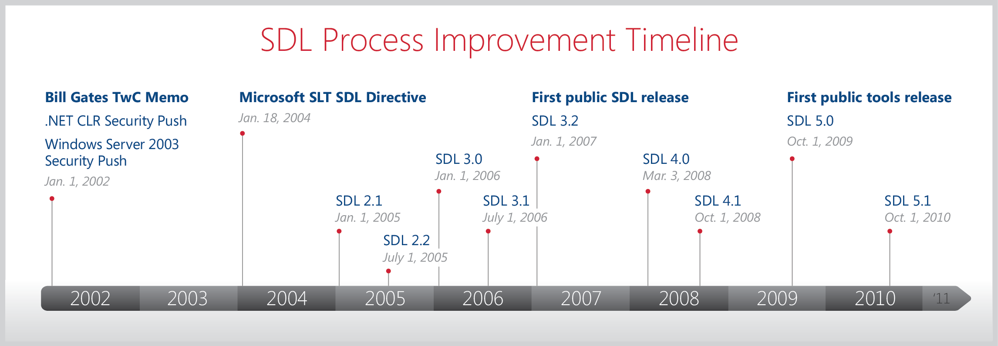
SDL – Continual Improvement
Now at version 5.2
Microsoft’s secure development processes have come a long way since the SDL was first introduced – the SDL is constantly evolving

Slide 5
Pre-SDL Requirement: Security Training
Training
Requirements
Design
Implementation
Verification
Release
Response
Core Security Training
Access organizational knowledge
Establish training criteria
  Content choices - covering secure design, development, test and privacy
Establish minimum training frequency
  Employees must attend n classes per year
Establish minimum acceptable group training thresholds
  Organizational training targets (e.g. 80% of all technical personnel trained prior to product RTM)

Slide 6
Phase One: Requirements
Training
Requirements
Design
Implementation
Verification
Release
Response
Core Security Training
Establish Security Requirements
Create Quality Gets / Bug bars
Security & Privacy Risk Assessment
Consider security at the outset of a project
Establish Security Requirements
  One time, project wide requirements – security leads identified, security bug tracking process mandated, architectural requirements set given the planned operational environment
Create Quality Gates / Bug Bars
  Minimum performance and quality criteria for each stage and for the project as a whole,
Security and Privacy Risk Assessment
  Risk assessment performed to determine critical components for the purposes of deep security and privacy review

Slide 7
Phase Two: Design
Training
Requirements
Design
Implementation
Verification
Release
Response
Core Security Training
Establish Security Requirements
Create Quality Gets / Bug bars
Security & Privacy Risk Assessment
Establish Design Requirements
Analyze Attack Surface
Threat Modelling
Identify security critical components
Establish Design Requirements
  Required activities which include creation of design specifications, analysis of proposed security technologies (e.g. crypto requirements) and reconciliation of plans against functional specs.
Analyze Attack Surface
  Defense in depth strategies employed – use of layered defenses used to mitigate severity.
Threat Modeling
  Structured, component-level analysis of the security implications of a proposed design.

Slide 8
Phase Three: Implementation
Training
Requirements
Design
Implementation
Verification
Release
Response
Core Security Training
Establish Security Requirements
Create Quality Gets / Bug bars
Security & Privacy Risk Assessment
Establish Design Requirements
Analyze Attack Surface
Threat Modelling
Use Approved Tools
Deprecate Unsafe Functions
Static Analysis
Determine processes, documentation and tools
Use approved tools
  Approved list for compilers, security test tools, switches and flags; enforced project wide.
Deprecate Unsafe Functions
  Prohibition of unsafe functions, APIs, when using native (C/C++) code.
Static Code Analysis
  Scalable in-depth code review, augmentation by other methods as necessary to address weaknesses in static analysis tools.

Slide 9
Phase Four: Verification
Training
Requirements
Design
Implementation
Verification
Release
Response
Core Security Training
Establish Security Requirements
Create Quality Gets / Bug bars
Security & Privacy Risk Assessment
Establish Design Requirements
Analyze Attack Surface
Threat Modelling
Use Approved Tools
Deprecate Unsafe Functions
Static Analysis
Dynamic Analysis
Fuzz Testing
Attack Surface Review
Verification of SDL security and privacy activities
Dynamic Analysis
  Runtime verification and analysis of programs to identify critical security problems
Fuzz Testing
  Specialized dynamic analysis technique used to deliberately cause program failure by injection of random, deliberately malformed inputs.
Attack Surface / TM review
  Re-review of attack surface and threat models when the program is “code complete” to ensure security assumptions and mitigations specified at design time are still relevant.

Slide 10
Phase Five: Release
Training
Requirements
Design
Implementation
Verification
Release
Response
Core Security Training
Establish Security Requirements
Create Quality Gets / Bug bars
Security & Privacy Risk Assessment
Establish Design Requirements
Analyze Attack Surface
Threat Modelling
Use Approved Tools
Deprecate Unsafe Functions
Static Analysis
Dynamic Analysis
Fuzz Testing
Attack Surface Review
Incident Response Plan
Final Security Review
Release Archive
Satisfaction of clearly defined release criteria
Incident Response Plan
  Creation of a response plan that outlines engineering, management and “on-call” contacts, security servicing plans for all code, including 3rd party artifacts.
Final Security Review
  Deliberate examination of all security and privacy activities conducted during development
Release Archive
  SDL compliance certification and archival of all information and data necessary for post-release servicing of the software.

Slide 11
Post-SDL Requirement: Response
Training
Requirements
Design
Implementation
Verification
Release
Response
Core Security Training
Establish Security Requirements
Create Quality Gets / Bug bars
Security & Privacy Risk Assessment
Establish Design Requirements
Analyze Attack Surface
Threat Modelling
Use Approved Tools
Deprecate Unsafe Functions
Static Analysis
Dynamic Analysis
Fuzz Testing
Attack Surface Review
Incident Response Plan
Final Security Review
Release Archive
Execute Incident Response Plan
“Plan the work, work the plan…”
Execute Incident Response Plan
  Performance of activities outlined in response plan created during Release phase
Other non-development, post-release process requirements
  Root cause analysis of found vulnerabilities: Is it a human, process, or automation failure? Addressed immediately and tagged for inclusion in next revision of SDL

Slide 12


SDL for Agile Development
Simple: Consistent with Agile principles
Integrates well with existing Agile development methodologies. SDL for Agile Development was developed to be simple yet consistent with the core principles for Agile development.
Comprehensive: All the rigor of SDL
The SDL for Agile Development guidance incorporates the full breadth of the learning, tools and guidance that are part of the traditional Microsoft SDL process.
Customizable: Three Categories of SDL Requirements
By recognizing that the Agile development release cycles can vary in size and length, SDL for Agile Development guidance gives development teams the flexibility to apply their secure code development practices to meet the specific goals and timeframe of a project.
Major differentiators of Agile:
No distinct phases
Short release cycles

Slide 13
What About the Cloud?
Native code requirements address implementation of cloud services
SDL has applied to web properties since v3.2
  Requirements address issues such as cross site scripting and SQL injection
Cloud services and web properties often use agile development models
  “Product cycle” might be 2 weeks, not three years
Multiple iterations of SDL for agile development since 2006

Slide 14
Motivation for Action
The application space is under attack things are bad, and getting worse
  Users expect security *without* having to pay for it
Software security and holistic development practices are becoming a competitive differentiator
  Procurement
Showing up in government regulations
  DISA STIG
  NIST Smart Grid Requirements
Failure to show forward momentum will lead to unintended consequences and loss of consumer trust

Slide 15
Tools for SDL: Requirements and Release
SDL Process Template
MSF-Agile + SDL Process Template

Slide 16
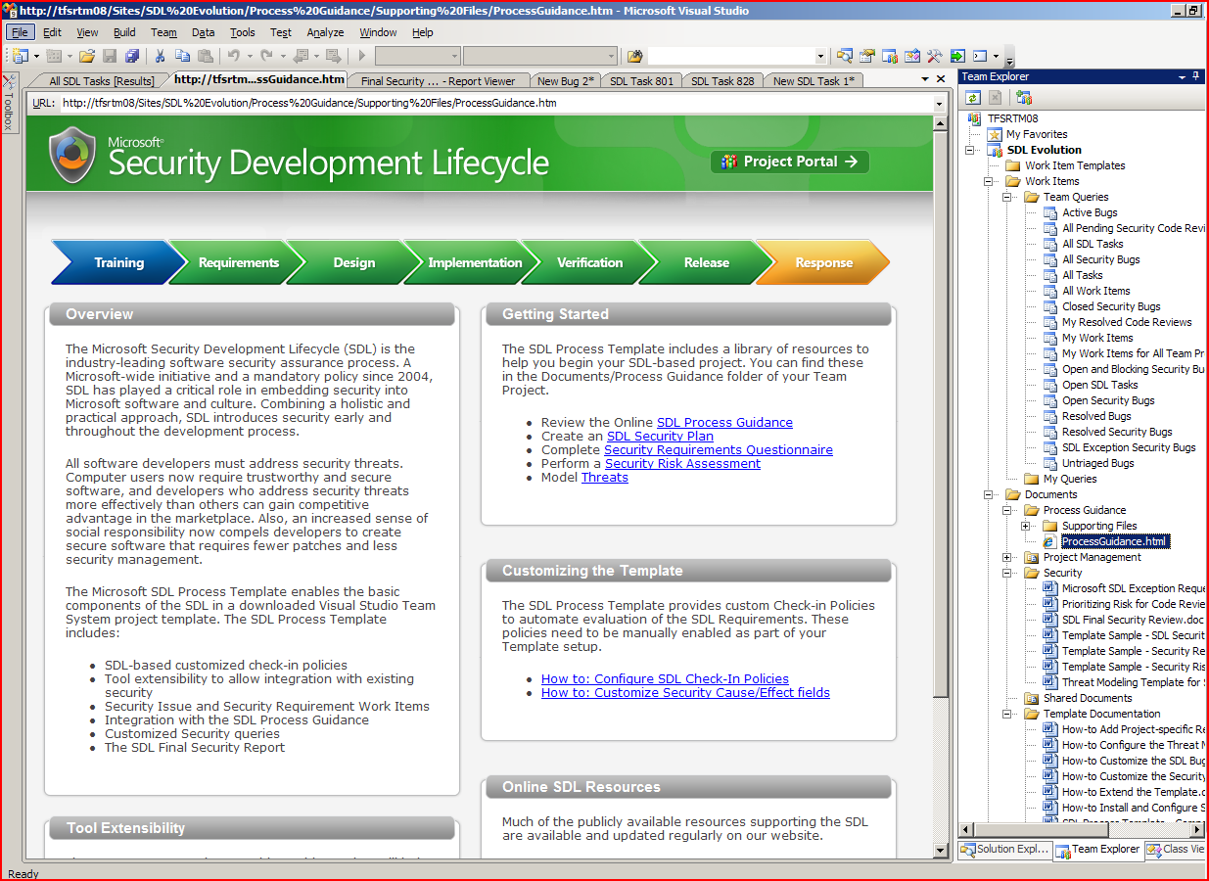
SDL Template for VSTS (Spiral)
Incorporates
  SDL requirements as work items
  SDL-based check-in policies
  Generates Final Security Review report
  Third-party security tools
  Security bugs and custom queries
  A library of SDL how-to guidance
Integrates with previously released free SDL tools
  SDL Threat Modeling Tool
  Binscope Binary Analyzer
  Minifuzz File Fuzzer
The SDL Process Template integrates SDL directly into the VSTS software development environment.

Slide 17
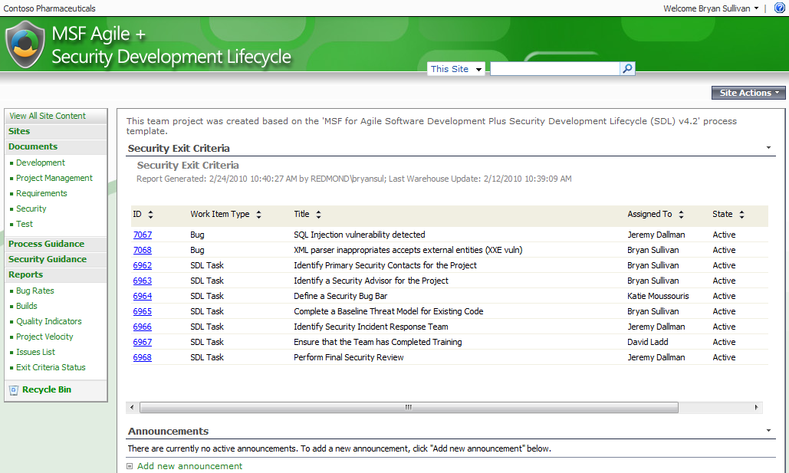
MSF Agile + SDL Template for VSTS
Automatically creates new security workflow items for SDL requirements whenever users check in code or create new sprints
Ensures important security processes are not accidentally skipped or forgotten
Integrates with previously released free SDL tools
  SDL Threat Modeling Tool
  Binscope Binary Analyzer
  Minifuzz File Fuzzer
Incorporates SDL-Agile secure development practices directly into the Visual Studio IDE - now available as beta (planned release at the end of Q2CY10)

Slide 18
Tools for SDL: Design
SDL Threat Modeling Tool
Vision
Model
Identify Threats
Mitigate
Validate

Slide 19
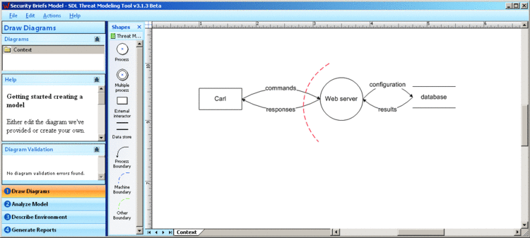
SDL Threat Modeling Tool
Transforms threat modeling from an expert-led process into a process that any software architect can perform effectively
Provides:
  Guidance in drawing threat diagrams
  Guided analysis of threats and mitigations
  Integration with bug tracking systems
  Robust reporting capabilities

Slide 20
SDL Threat Modeling Tool
demo

Slide 21
Tools for SDL: Implementation
Banned.h
Code Analysis for C/C++
  Visual Studio 2012 (including Express edition).
Microsoft Code Analysis Tool .NET (CAT.NET) 1.1
  Detects common web app vulnerabilities, like XSS
FxCop
  Standalone or integrated into VS Premium and Ultimate
Anti-Cross Site Scripting (Anti-XSS) Library 4.2
SiteLock ATL Template

Slide 22
CAT.NET and Anti-XSS library
demo

Slide 23
FxCop
demo

Slide 24
Tools for SDL: Verification
BinScope Binary Analyzer
  Ensures the build process followed the SDL
MiniFuzz File Fuzzer
  !exploitable
RegexFuzzer
Attack Surface Analyzer
  Snapshot based analysis
AppVerifier
  Dynamic analysis

Slide 25
Basic Mitigations
Mitigation | Mitigates | Available in | Enabled by
Stack cookies |  | Dev 10 | /GS
Strict GS | ‘non-traditional’ stack overflows | Dev 10 | #pragma strict_gs_check(on)
DEP | W^X | XP SP2+ | /NXCOMPAT
Heap hardening | Heap metadata attacks | Vista + | (OS Platform Support)
Heap terminate on corruption | “ | XPSP3 | HeapSetInformation or /SUBSYSTEM:WINDOWS,6.0
ASLR | ROP |  | /DYNAMICBASE
SafeSEH | SEH overwrites |  | /SAFESEH
SEHOP | “ | Win 7+ | Reg key entry
See http://msdn.microsoft.com/en-us/library/bb430720.aspx

Slide 26
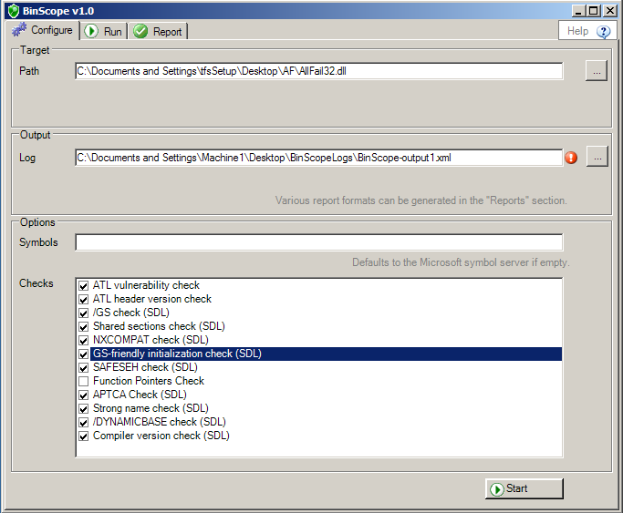
Binscope Binary Analyzer
Provides an extensive analysis of an application binary
Checks done by Binscope
  /GS - to prevent buffer overflows
  /SafeSEH - to ensure safe exception handling
  /NXCOMPAT - to prevent data execution
  /DYNAMICBASE - to enable ASLR
  Strong-Named Assemblies - to ensure unique key pairs and strong integrity checks
  Known good ATL headers are being used
Use either standalone or integrated with Visual Studio (VS) and Team Foundation Server (TFS)

Slide 27
BinScope Binary Analyzer
demo

Slide 28
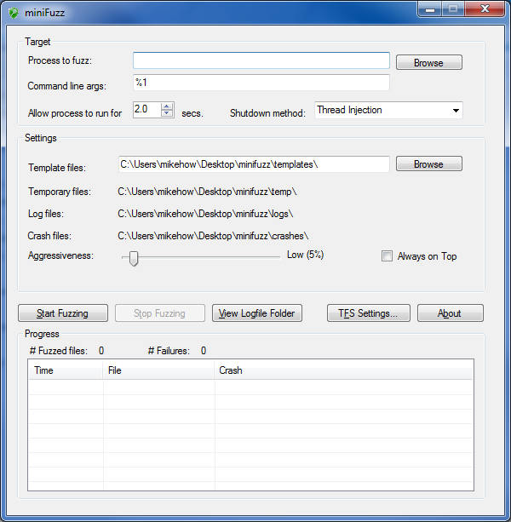
MiniFuzz File Fuzzer
MiniFuzz is a basic testing tool designed to help detect code flaws that may expose security vulnerabilities in file-handling code.
  Creates corrupted variations of valid input files
  Exercises the code in an attempt to expose unexpected application behaviors.
  Lightweight, for beginner or advanced security testing
  Use either standalone or integrated with Visual Studio (VS) and Team Foundation Server (TFS)

Slide 29
!exploitable
Creates hashes to determine the uniqueness of a crash
Assigns an exploitability rating to the crash: Exploitable, Probably Exploitable, Probably Not Exploitable, or Unknown.
An extension of Microsoft debuggers
  windbg badapp.exe \users\mike\desktop\minifuzz\crashes\foobar8776.bad
  !load winext\msec.dll
  Run the process and have it parse the file: g
  Finally, run !exploitable to take a first pass analysis of the failure: !exploitable
Open source http://msecdbg.codeplex.com/

Slide 30
MiniFuzz File Fuzzer and !exploitable
demo

Slide 31
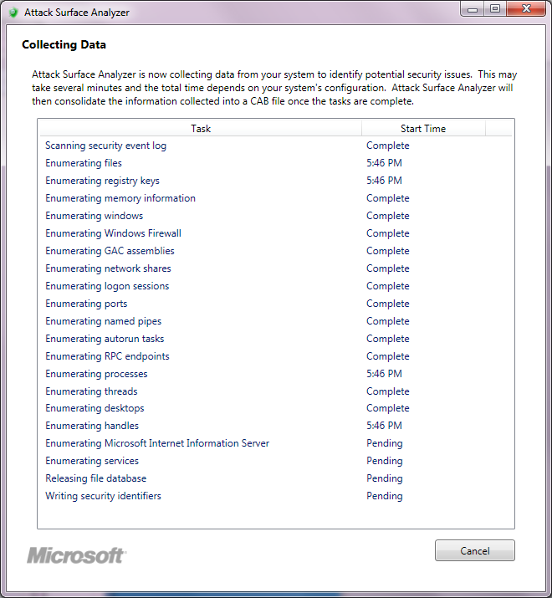
Attack Surface Analyzer
Takes system attack surface snapshots
One before and one after installing the product
Compares the snapshots and generates a report

Slide 32
Attack Surface Analyzer
demo

Slide 33
SDL Tools: Response
EMET

Slide 34
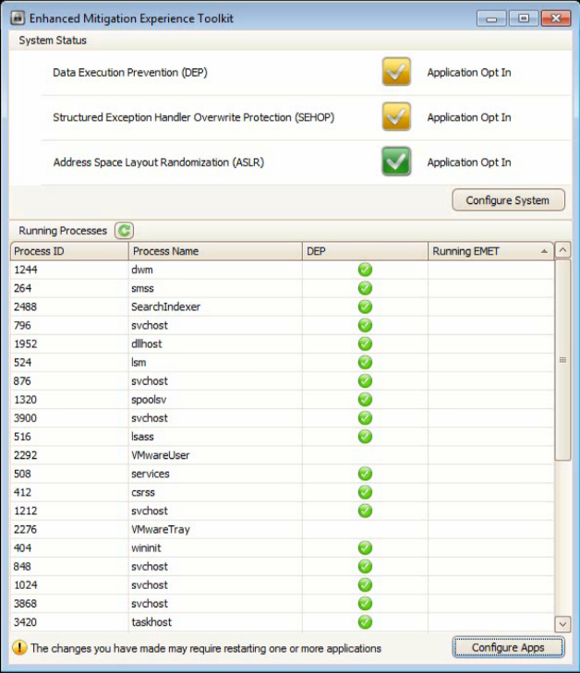
EMET: Simplifying mitigation deployment
GUI and command line interface
Configure system-wide mitigations
Enable mitigations for specific applications
Verify mitigation settings

Slide 35
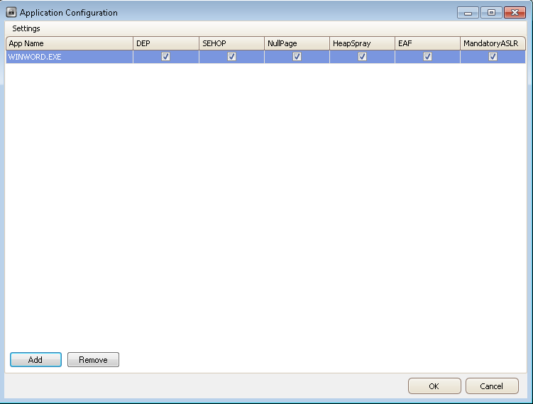
EMET: Protecting applications
Protect at-risk or known vulnerable applications
Protect against active 0day attacks in the wild
Granular control over which mitigations are enabled

Slide 36
Important Resources
Microsoft SDL Portal http://microsoft.com/sdl
SDL Tools (with download links and training/videos) http://www.microsoft.com/security/sdl/adopt/tools.aspx
Visual Studio http://msdn.microsoft.com/en-us/vstudio
FxCop documentation http://msdn.microsoft.com/en-us/library/dd264939(v=VS.100).aspx
!exploitable http://msecdbg.codeplex.com/
MSEC http://www.microsoft.com/security/msec.aspx
SAFECode http://safecode.org

Slide 37
In Review: Session Objectives and Takeaways
Session Objective(s):
  Give an overview of the Secure Development lifecycle
  Discuss the externally available tools that support the SDL
  Provide guidance on using the tools to build more secure software
Key takeaways:
  Microsoft is investing into supporting the SDL
  Our customers should use the tools to build more secure software

Slide 38
We are hiring!

Slide 39

© 2011 Microsoft Corporation. All rights reserved. Microsoft, Windows, Windows Vista and other product names are or may be registered trademarks and/or trademarks in the U.S. and/or other countries.
The information herein is for informational purposes only and represents the current view of Microsoft Corporation as of the date of this presentation. Because Microsoft must respond to changing market conditions,
it should not be interpreted to be a commitment on the part of Microsoft, and Microsoft cannot guarantee the accuracy of any information provided after the date of this presentation.
MICROSOFT MAKES NO WARRANTIES, EXPRESS, IMPLIED OR STATUTORY, AS TO THE INFORMATION IN THIS PRESENTATION.

