Slide 1
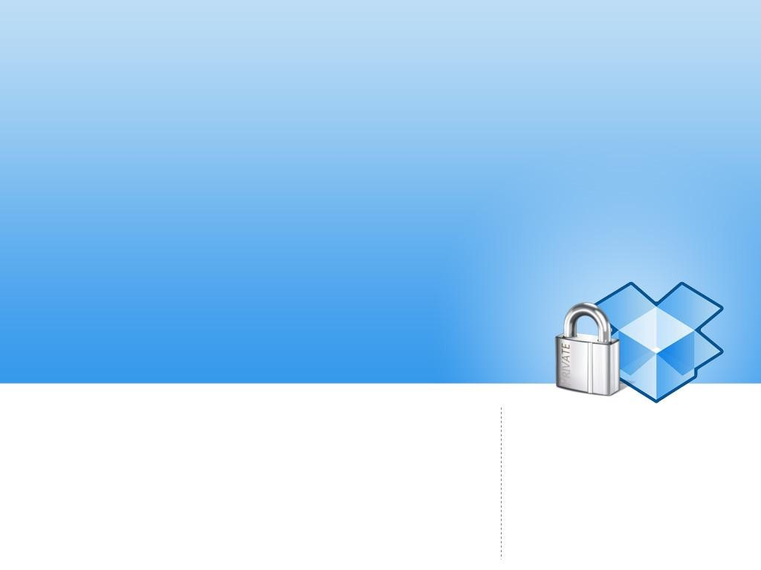
A critical analysis of
Dropbox software security
EADS Innovation Works
SE/IT department
Suresnes, FRANCE
Florian LEDOUX
florian.ledoux(at)eads.net
@Myst3rie
Nicolas RUFF
nicolas.ruff(at)eads.net
@newsoft

Slide 2
Dropbox overview
Dropbox: a leader in Cloud backup
Over 50 million users
Estimated company value: over $1 billion
(Year: 2011 / Source: Wikipedia)
Client software available for
Windows, OS X, Linux, Android, iOS and web browser
Lot of competitors
Google Drive, SkyDrive, iCloud, box.com ...

Slide 3
Dropbox overview
Dropbox security record (partial)
March 2011: Dropbox client for Smartphones do not make use of SSL/TLS encryption
April 2011: Derek Newton realized that login/password is useless (if you happen to know host_id secret)
June 2011: a software upgrade issue provided password-free access to all user accounts for one day
USENIX 2011: "Dark Clouds on the Horizon“
August 2012: a stolen password from Dropbox employee lead to massive spam

Slide 4
Dropbox overview
Why studying Dropbox ?
Dropbox is a leader
No previous work on the effective implementation
"LAN Sync" protocol routinely observed during penetration testing assignments
We are happy Dropbox users too ☺
Notes:
http://securityreactions.tumblr.com/post/32324377943/whenever-i-see-licensee-hereby-agrees-not-to

Slide 5
Dropbox overview
Further analysis holds true for client versions 1.1.x to 1.5.x
Windows, Linux and OS X clients are mostly written in Python
"How Dropbox Did It and How Python Helped" (PyCon 2011)
Windows client
Generated using PY2EXE
A ZIP with all PYC files to be found within PE resources
Python 2.5 interpreter has been slightly customized

Slide 6
Source quest

Slide 7
Source quest
Standard PYC (redux)
PYC is Python bytecode
PYO is Python optimized bytecode
Bytecode version
Timestamp
Marshalled bytecode
Dropbox PYC

Slide 8
Source quest
Diffing PYTHON25.DLL with original
53 modified functions (out of ~4500)
Opcodes have been swapped in PyEval_EvalFrame()
Decryption function added in ReadObjectFromString()
Which encryption algorithm is used ?
0x9e3779b9 constant is linked to TEA symmetric encryption family
Here: XXTEA
MT_getnext() / MT_decrypt() functions are involved
Notes:
shema

Slide 9
Source quest
XXTEA implementation
void btea(char *data, uint32 len, uint32 const key[4])
Key seed
Block len
ReadObjectFromString()
Read 1st byte (e.g. 0x63 = code)
1st DWORD (e.g. 0x0479F970) used for key generation
2nd DWORD (e.g. 0x208e) gives block size
Not as easy as it may sounds
Spurious NULL bytes all over the place
Notes:
shema

Slide 10
Source quest
Bytecode decompilation
Pyretic / unpyc
Targets Python 2.5 (Fails in real life)
Uncompyle2
Targets Python 2.7 only (Works in real life)
Our solution
Uncompyle2 fork
Bytecode translator 2.5 & 2.6 ► 2.7
Single decompilation engine
Kudos to Eloi Vanderbeken
https://github.com/Mysterie/uncompyle2
Notes:
work on box.com

Slide 11
Code injection (bonus)
PYTHON25.DLL is not easy to reach
Anonymously mapped in memory
Not easy to locate import / export tables
Some functions like PyRun_File() are nop'ed
Yet …
PyRunString() is not patched
Arbitrary Python statements can be run in Dropbox context ☺

Slide 12
Debug mode
Debugging is hard
DBDEV environment variable to the rescue
Dropbox <= 1.1
def is_valid_time_limited_cookie(cookie):
t_when = int(cookie[:8], 16) ^ 1686035233
if abs(time.time() - t_when) < 172800:
if md5.new(cookie[:8] + 'traceme').hexdigest()[:6] == cookie[8:]:
return True

Slide 13
Debug mode
Dropbox ≥ 1.2
IS_DEV_MAGIC = DBDEV and hashlib.md5(DBDEV).hexdigest().startswith('c3da6009e4')

Slide 14
Debug mode
DBTRACE can help, too
10.224 | MainThread: Dropbox-win-1.1.45 (2796) starting
10.865 | MainThread: u'host_id' = u'ab75c...
13.509 | MainThread: Opened Dropbox key
32.356 | RTRACE: Sending trace 1327936014 (C:\...\Dropbox\l\4f26b5fc)
33.058 | STATUS: Creating named pipe
59.318 | UPLOAD_HASH: Next needed hash: AUCwQ6iYIfVxGs1f6HjkWZgqcbmWZiTCs6HU8HRykzU

Slide 15
Debug mode
… and many others
DBMEMPROF, DBCPUPROFILE, DBPROFILE
FAKE_BLOCK
DROPBOX_HOST
Who's in charge here?
host = 'tarak.corp.dropbox.com‘
Not exposed on the Internet ☺

Slide 16
Gimme results …
… not excuses !

Slide 17
Configuration database
SQLite 3 database: config.dbx
Dropbox < 1.2: easy to dump
Dropbox ≥ 1.2: "encrypted" SQLite
Encryption
Not: http://sqlcipher.net/
But: http://www.hwaci.com/sw/sqlite/see.html
Activation password == license key == default value ☺
Namely: 7bb07b8d471d642e

Slide 18
Configuration database
Encryption key is machine-protected
Windows
Seed stored in HKCU\Software\Dropbox\ks\Client
DPAPI encryption
Linux
Seed stored in ~/.dropbox/hostkeys
Custom "obfuscator" (reversible encryption)
Mac OS X
Seed stored in ~/.dropbox/hostkeys
Custom "obfuscator" based on IOPlatformSerialNumber, DAVolumeUUID and more
Kudos to the Mac OS X developer for full API re-implementation!

Slide 19
Configuration database
Effective encryption key is PBKDF2(seed)
Please use this information for forensics purpose only ☺
USER_HMAC_KEY = '\xd1\x14\xa5R\x12e_t\xbdw.7\xe6J\xee\x9b'
APP_KEY = '\rc\x8c\t.\x8b\x82\xfcE(\x83\xf9_5[\x8e'
APP_IV = '\xd8\x9bC\x1f\xb6\x1d\xde\x1a\xfd\xa4\xb7\xf9\xf4\xb8\r\x05'
APP_ITER = 1066
USER_KEYLEN = 16
DB_KEYLEN = 16

Slide 20
Network protocols

Slide 21
Network protocols
Network traffic
fully transported over HTTPS
OpenSSL + nCrypt wrapper
Proper certificate checking
Hardcoded CA list
root_certs = '# Subject: C=ZA, ST=Western Cape, L=Cape Town, O=Thawte Consulting cc, (…)
-----BEGIN CERTIFICATE-----\n
MIIDEzCCAnygAwIBAgIBATA
(…)
L7tdEy8W9ViH0Pd\n
-----END CERTIFICATE-----\n\n'

Slide 22
Network protocols
Issues
OpenSSL … 0.9.8e ?
as of DropBox 1.4.17
Hello CVE-2011-4109, CVE-2012-2110, and others
nCrypt … completely buggy and unsupported software?
http://bugs.debian.org/cgi-bin/bugreport.cgi?bug=614051
No patch since 2007

Slide 23
Network protocols
File synchronisation: RSYNC protocol
File storage: Amazon Cloud S3
Implementation details
Blocks of 4 MB in size
SHA-256 of each block
Encryption is provided by SSL/TLS only

Slide 24
Dropbox protocol
Servers of interest
Blockserver: manages 4MB blocks
Authserver: user authentication, software setup
Metaserver: handles information requests about files and directories
Metaexcserver / blockexcserver: handle exceptions
Statserver / notifyserver: statistics
set_server(ret, 'blockserver', secure=True, timeout=60, **non_exc_kwargs)
set_server(ret, 'metaserver', secure=True, timeout=90, **non_exc_kwargs)
set_server(ret, 'metaexcserver', secure=True, timeout=90, **exc_kwargs)
set_server(ret, 'blockexcserver', secure=True, timeout=90, **exc_kwargs)
set_server(ret, 'statserver', secure=True, timeout=90, **exc_kwargs)
set_server(ret, 'notifyserver', secure=False, timeout=90, **non_exc_kwargs)
Notes:
del++

Slide 25
Dropbox protocol
HOST_ID
Unique and forever user identifier
128-bit length
Server-side generated on 1st installation
Not affected by password change
Stored in local configuration database
HOST_INT
Unique identifier per device
NS_MAP
User namespace identifier
Killed "dropship" hack
Before: get_block( hash_for_block )
After: get_block( hash_for_block ; ns_map + host_id)

Slide 26
LAN sync protocol

Slide 27
LAN Sync protOcol
Local sync between two Dropbox clients
Discovery: UDP/17500 broadcasts
Data exchange: TCP/17500
Data exchange protocol
Each Dropbox instance can act as a Client or a Server
Client SSL/TLS authentication
Key pair in configuration database

Slide 28
LAN Sync protOcol
Attacking a client in server mode
Requires a server-known key pair ☹
Notes:
Demo

Slide 29
LAN Sync protOcol
Attacking the client mode
Server certificate is not checked
LAN Sync protocol (redux)
HELLO / HOWDY
PING / PONG
HAS / HASREPLY / HASFAIL (+ hash)
GET / GETREPLY / GETFAIL (+ hash & file content)

Slide 30
Lan sync protocol
Demo !

Slide 31
Questions

