Slide 1
Binary instrumentation for Hackers
Gal Diskin / Intel
(@gal_diskin)
Hack.lu 2011

Slide 2
Legal Disclaimer
INFORMATION IN THIS DOCUMENT IS PROVIDED “AS IS”. NO LICENSE, EXPRESS OR IMPLIED, BY ESTOPPEL OR OTHERWISE, ANY INTELLECTUAL PROPERTY RIGHTS IS GRANTED BY THIS DOCUMENT. INTEL ASSUMES NO LIABILITY WHATSOEVER AND INTEL DISCLAIMS ANY EXPRESS OR IMPLIED WARRANTY, RELATING TO THIS INFORMATION INCLUDING LIABILITY OR WARRANTIES RELATING TO FITNESS FOR A PARTICULAR PURPOSE, MERCHANTABILITY, OR INFRINGEMENT OF ANY PATENT, COPYRIGHT OR OTHER INTELLECTUAL PROPERTY RIGHT.
Intel and the Intel logo are trademarks of Intel Corporation in the U.S. and other countries.
*Other names and brands may be claimed as the property of others.
Copyright © 2011. Intel Corporation.

Slide 3
All code in this presentation is covered by the following:
/*BEGIN_LEGAL
Intel Open Source License
Copyright (c) 2002-2011 Intel Corporation. All rights reserved.
Redistribution and use in source and binary forms, with or without modification, are permitted provided that the following conditions are met:
Redistributions of source code must retain the above copyright notice, this list of conditions and the following disclaimer. Redistributions in binary form must reproduce the above copyright notice, this list of conditions and the following disclaimer in the documentation and/or other materials provided with the distribution. Neither the name of the Intel Corporation nor the names of its contributors may be used to endorse or promote products derived from this software without specific prior written permission.
THIS SOFTWARE IS PROVIDED BY THE COPYRIGHT HOLDERS AND CONTRIBUTORS ``AS IS'' AND ANY EXPRESS OR IMPLIED WARRANTIES, INCLUDING, BUT NOT LIMITED TO, THE IMPLIED WARRANTIES OF MERCHANTABILITY AND FITNESS FOR A PARTICULAR PURPOSE ARE DISCLAIMED. IN NO EVENT SHALL THE INTEL OR ITS CONTRIBUTORS BE LIABLE FOR ANY DIRECT, INDIRECT, INCIDENTAL, SPECIAL, EXEMPLARY, OR CONSEQUENTIAL DAMAGES (INCLUDING, BUT NOT LIMITED TO, PROCUREMENT OF SUBSTITUTE GOODS OR SERVICES; LOSS OF USE, DATA, OR PROFITS; OR BUSINESS INTERRUPTION) HOWEVER CAUSED AND ON ANY THEORY OF LIABILITY, WHETHER IN CONTRACT, STRICT LIABILITY, OR TORT (INCLUDING NEGLIGENCE OR OTHERWISE) ARISING IN ANY WAY OUT OF THE USE OF THIS SOFTWARE, EVEN IF ADVISED OF THE POSSIBILITY OF SUCH DAMAGE.
END_LEGAL */

Slide 4
Who am I
Currently @ Intel
  Security researcher
  Evaluation team leader
Formerly a member of the binary instrumentation team @ Intel
Before that a private consultant
Always a hacker
…
Online presence: www.diskin.org, @gal_diskin, LinkedIn, E-mail (yeah, even FB & G+)

Slide 5
Credits
Tevi Devor of the Pin development team for parts of his Pin tutorial that were adapted used as a base for the Pin tutorial part of this presentation
Dmitriy "D1g1" Evdokimov (@evdokimovds) from DSecRG for reviewing the presentation and providing constructive criticism

Slide 6
About this workshop
How does DBI work – Intro to a DBI engine (Pin)
The InfoSec usages of DBI
InfoSec DBI tools

Slide 7
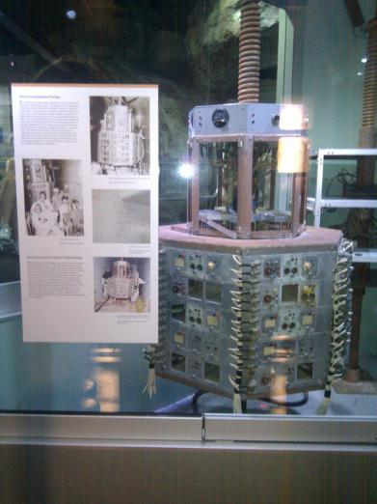

What is Instrumentation
(Binary) instrumentation is the capability to observe, monitor and modify a (binary) program behavior

Slide 8

Instrumentation Types
Source / Compiler Instrumentation
Static Binary Instrumentation
Dynamic Binary Instrumentation

Slide 9
Intro to A DBI Engine and how It works
I told you DBI is wonderful - what’s next?

Slide 10
Binary instrumentation engines
Pin
DynamoRio
Valgrind
DynInst
ERESI
Many more…

Slide 11

Pin & PinTOOLs
Pin – the instrumentation engine
  JIT for x86
PinTool – the instrumentation program
PinTools register hooks on events in the program
  Instrumentation routines – called only on the first time something happens
  Analysis routines – called every time this object is reached
  Callbacks – called whenever a certain event happens

Slide 12
Where to find info about PIN
Website: www.pintool.org
Mailing list @ Yahoo groups: Pinheads

Slide 13

A program’s building blocks
Instruction
Basic Block
Trace (sometimes called Super-block)

Slide 14
PIN execution

Slide 15
Launcher Process
pin.exe –t inscount.dll – gzip.exe input.txt
Count 258743109
Pin Invocation
gzip.exe input.txt
PIN.EXE
Read a Trace from Application Code
Jit it, adding instrumentation code from inscount.dll
Encode the jitted trace into the Code Cache
PinTool that counts application instructions executed, prints Count at end
Starting at first application IP Read a Trace from Application Code
Jit it, adding instrumentation code from inscount.dll
Encode the trace into the Code Cache
Execute Jitted code
Launcher
Source Trace exit branch is modified to directly branch to Destination Trace
Start PINVM.DLL running
(firstAppIp, “inscount.dll”)
Execution of Trace ends
Call into PINVM.DLL to Jit next trace
Pass in app IP of Trace’s target
Load inscount.dll and run its main()
Load PINVM.DLL
WriteProcessMemory(BootRoutine, BootData)
Resume at BootRoutine
GetContext(&firstAppIp)
Inject Pin BootRoutine and Data into application
SetContext(BootRoutineIp)
CreateProcess (gzip.exe, input.txt, suspended)
Boot Routine +
Data:
firstAppIp,
“Inscount.dll”
inscount.dll
Application Process
First app IP
PIN.LIB
Code
Cache
Application
Code and
Data
PINVM.DLL
Decoder
Encoder
System Call Dispatcher
Event Dispatcher
Thread Dispatcher
NTDLL.DLL
app Ip of Trace’s target
Windows kernel

Slide 16
Section Summary
There are many DBI engines
We’re focusing on Pin in this workshop
We’ve seen how Pin injection into a process works
We’ve seen how it behaves during execution

Slide 17
Intro To Pintools
How do you program a DBI engine?

Slide 18
Pintool 101: instruction counting
#include "pin.h"
UINT64 icount = 0;
void docount() { icount++; }
void Instruction(INS ins, void *v)
{
INS_InsertCall(ins, IPOINT_BEFORE,
(AFUNPTR)docount, IARG_END);
}
void Fini(INT32 code, void *v)
{ std::cerr << "Count " << icount << endl; }
int main(int argc, char * argv[]) {
PIN_Init(argc, argv);
INS_AddInstrumentFunction(Instruction, 0);
PIN_AddFiniFunction(Fini, 0);
PIN_StartProgram(); // Never returns
return 0;
}
Execution time routine
Jitting time routine
switch to pin stack
save registers
call docount
restore regs & stack
inc icount
sub $0xff, %edx
inc icount
cmp %esi, %edx
save eflags
inc icount
restore eflags
jle <L1>
inc icount
mov 0x1, %edi

Slide 19
PIN Command line
pin [pin_options] -t pintool.dll [pintool_options] – app_name.exe [app_args]
Pin provides PinTools with a way to parse the command line using the KNOB class

Slide 20
Hooks
The heart of Pin’s approach to instrumentation
Analysis and Instrumentation
Can be placed on various events / objects, e.g:
  Instructions
  Context switch
  Thread creation
  Much more…

Slide 21
Instrumentation and analysis
Instrumentation
  Usually defined in the tool “main”
  Once per object
  Heavy lifting
Analysis
  Usually defined in instrumentation routine
  Every time the object is accessed
  As light as possible

Slide 22
Granularity
INS – Instruction
BBL – Basic Block
TRACE – Trace
RTN – Routine
SEC – Section
IMG – Binary image

Slide 23
Other instrumentable objects
Threads
Processes
Exceptions and context changes
Syscalls
…

Slide 24
Instruction counting: Take 2
#include "pin.H"
UINT64 icount = 0;
void PIN_FAST_ANALYSIS_CALL docount(INT32 c) { icount += c; }
void Trace(TRACE trace, void *v){// Pin Callback
for(BBL bbl = TRACE_BblHead(trace);
BBL_Valid(bbl);
bbl = BBL_Next(bbl))
BBL_InsertCall(bbl, IPOINT_ANYWHERE,
(AFUNPTR)docount, IARG_FAST_ANALYSIS_CALL,
IARG_UINT32, BBL_NumIns(bbl),
IARG_END);
}
void Fini(INT32 code, void *v) {// Pin Callback
fprintf(stderr, "Count %lld\n", icount);
}
int main(int argc, char * argv[]) {
PIN_Init(argc, argv);
TRACE_AddInstrumentFunction(Trace, 0);
PIN_AddFiniFunction(Fini, 0);
PIN_StartProgram();
return 0;
}

Slide 25
Instrumentation points
IPOINT_BEFORE
  Before an instruction or routine
IPOINT_AFTER
  Fall through path of an instruction
  Return path of a routine
IPOINT_ANYWHERE
  Anywhere inside a trace or a BBL
IPOINT_TAKEN_BRANCH
  The taken edge of branch

Slide 26
Inlining
Inlinable
Not-inlinable
int docount0(int i) {
x[i]++
return x[i];
}
int docount1(int i) {
if (i == 1000)
x[i]++;
return x[i];
}
Not-inlinable
Not-inlinable
int docount2(int i) {
x[i]++;
printf(“%d”, i);
return x[i];
}
void docount3() {
for(i=0;i<100;i++)
x[i]++;
}

Slide 27
Inlining
–log_inline records inlining decisions in pin.log
Analysis function (0x2a9651854c) from mytool.cpp:53 INLINED
Analysis function (0x2a9651858a) from mytool.cpp:178 NOT INLINED
The last instruction of the first BBL fetched is not a ret instruction
The disassembly of an un-inlined analysis function
0x0000002a9651858a push rbp
0x0000002a9651858b mov rbp, rsp
0x0000002a9651858e mov rax, qword ptr [rip+0x3ce2b3]
0x0000002a96518595 inc dword ptr [rax]
0x0000002a96518597 mov rax, qword ptr [rip+0x3ce2aa]
0x0000002a9651859e cmp dword ptr [rax], 0xf4240
0x0000002a965185a4 jnz 0x11
The function could not be inlined because it contains a control-flow changing instruction (other than ret)

Slide 28
Conditional instrumentation
XXX_InsertIfCall
XXX_InsertThenCall

Slide 29

Liveness Analysis
Not all registers are used by each program
Pin takes control of “dead” registers
  Used for both Pin and tools
Pin transparently reassigns registers

Slide 30
How translated code looks?

Slide 31
APP IP
2 0x77ec4600 cmp rax, rdx
22 0x77ec4603 jz 0x77f1eac9
40 0x77ec4609 movzx ecx, [rax+0x2]
37 0x77ec460d call 0x77ef7870
Compiler generated code for docount
Inlined by Pin
r14 allocated by Pin
r15 allocated by Pin
Points to
per-thread spill area
Application Trace
How many BBLs in this trace?
20 0x001de0000 mov r14, 0xc5267d40 //inscount2.docount
58 0x001de000a add [r14], 0x2 //inscount2.docount
2 0x001de0015 cmp rax, rdx
9 0x001de0018 jz 0x1deffa0 (PIN-VM) //patched in future
52 0x001de001e mov r14, 0xc5267d40 //inscount2.docount
29 0x001de0028 mov [r15+0x60], rax
57 0x001de002c lahf
37 0x001de002e seto al
50 0x001de0031 mov [r15+0xd8], ax
30 0x001de0039 mov rax, [r15+0x60]
12 0x001de003d add [r14], 0x2 //inscount2.docount
40 0x001de0048 movzx edi, [rax+0x2] //ecx alloced to edi
22 0x001de004c push 0x77ec4612 //push retaddr
61 0x001de0051 nop
17 0x001de0052 jmp 0x1deffd0 (PIN-VM)//patched in future
(
save status flags

Slide 32
Section Summary
The “Hello (DBI) World” is instruction counting
There are various levels of granularity we can instrument as well as various points we can instrument in
Instrumentation routines are called once, analysis routines are called every time
Performance is better when working at higher granularity, when your heavy work is done in instrumentation routines and when your code is inline-able or you use conditional instrumentation

Slide 33
PIN injection
Also known as “Early Injection”
Allows you to instrument every instruction in the process starting from the very first loader instruction

Slide 34
fork
Child (Injector)
gzip (Injectee)
Linux Invocation+Injection
Pin (Injectee)
pin –t inscount.so – gzip input.txt
exitLoop = FALSE;
Ptrace TraceMe
while(!exitLoop){}
gzip input.txt
Pin stack
PinTool that counts application instructions executed, prints Count at end
Ptrace Injectee – Injectee Freezes
Pin Code and Data
gzip Code and Data
Code to Save
Pin Code and Data
MiniLoader
MiniLoader
Code to Save
Injectee.exitLoop = TRUE;
MiniLoader
Ptrace continue (unFreezes Injectee)
execv(gzip);
// Injectee Freezes
Execution of Injector resumes after execv(gzip) in Injectee completes
Ptrace Copy (save, gzip.CodeSegment, sizeof(MiniLoader))
PtraceGetContext (gzip.OrigContext)
PtraceCopy (gzip.CodeSegment, MiniLoader, sizeof(MiniLoader))
Pin Code and Data
MiniLoader
Ptrace continue@MiniLoader (unFreezes Injectee)
IP
MiniLoader loads Pin+Tool, allocates Pin stack
Kill(SigTrace, Injector): Freezes until Ptrace Cont
Wait for MiniLoader complete (SigTrace from Injectee)
gzip OrigCtxt
gzip OrigCtxt
Ptrace Copy (gzip.CodeSegment, save, sizeof(MiniLoader))
Ptrace Copy (gzip.pin.stack, gzip.OrigCtxt, sizeof (ctxt))
Ptrace SetContext (gzip.IP=pin, gzip.SP=pin.Stack)
Code to Save
Inscount2.so
Ptrace Detach

Slide 35
Transparent Debugging & Extending the debugger
Simple, yet powerful

Slide 36
Transparent debugging
Transparent debugging
  “-appdebug” on Linux
Experimental Windows support exists and might go mainline soon (look for vsdbg.bat in the Pin kit)

Slide 37
Pin Debugger Interface
GDB remote protocol(tcp)
Application
Tool
GDB
Debug
Agent
Pin
(unmodified)
Pin process

Slide 38
Extending the debugger
PIN_AddDebugInterpreter
PIN_RemoveDebugInterpreter
PIN_ApplicationBreakpoint
PIN_SetDebugMode
PIN_GetDebugStatus
PIN_GetDebugConnectionInfo
PIN_GetDebuggerType
PIN_WaitForDebuggerToConnect

Slide 39
Symbols, Functions & Probes
We don’t want to concentrate on instructions all the time.

Slide 40
Symbols
Function symbols
Debug symbols
Stripped executables
Init APIs:
  PIN_InitSymbols
  PIN_InitSymbolsAlt

Slide 41
SYMBOL API
SYM_Next
SYM_Prev
SYM_Name
SYM_Invalid
SYM_Valid
SYM_Dynamic
SYM_IFunc
SYM_Value
SYM_Index
SYM_Address
PIN_UndecorateSymbolName

Slide 42
Back to the source line
PIN_GetSourceLocation (
ADDRINT address,
INT32 * column,
INT32 * line,
string * fileName )

Slide 43
Function replacement
RTN_Replace
  Replace app function with tool function
RTN_ReplaceSignature
  Replace function and modify its signature
PIN_CallApplicationFunction
  Call the application function and JIT it

Slide 44

Probe mode
JIT Mode
  Code translated and translation is executed
  Flexible, slower, robust, common
Probe Mode
  Original code is executed with “probes”
  Faster, less flexible, less robust

Slide 45
Probe size
Copy of entry point with original bytes:
  0x50000004: push %ebp
  0x50000005: mov %esp,%ebp
  0x50000007: push %edi
  0x50000008: push %esi
  0x50000009: jmp 0x400113d9
  Entry point overwritten with probe:
  0x400113d4: jmp 0x41481064
  0x400113d9: push %ebx
  Original function entry point:
  0x400113d4: push %ebp
  0x400113d5: mov %esp,%ebp
  0x400113d7: push %edi
  0x400113d8: push %esi
  0x400113d9: push %ebx
0x41481064: push %ebp // tool wrapper func
::::::::::::::::::::
0x414827fe: call 0x50000004 // call original func

Slide 46
Out of Memory fault injection
The following example will show how to use probe mode to randomly inject out of memory errors into programs

Slide 47
#include "pin.H"
#include <time.h>
#include <iostream>
// Injected failure “frequency”
#define FAIL_FREQ 100
typedef VOID * ( *FP_MALLOC )( size_t );
// This is the malloc replacement routine.
VOID * NewMalloc( FP_MALLOC orgFuncptr, UINT32 arg0 )
{
if ( (rand() % FAIL_FREQ) == 1 )
{
return NULL; //force fault
}
return orgFuncptr( arg0 ); //call real malloc and return value
}

Slide 48
// Pin calls this function every time a new img is loaded.
// It is best to do probe replacement when the image is loaded,
// because only one thread knows about the image at this time.
VOID ImageLoad( IMG img, VOID *v )
{
// See if malloc() is present in the image. If so, replace it.
RTN rtn = RTN_FindByName( img, "malloc" );
if (RTN_Valid(rtn))
{
// Define a function prototype of the orig func
PROTO proto_malloc = PROTO_Allocate( PIN_PARG(void *),
CALLINGSTD_DEFAULT, "malloc",
PIN_PARG(int), PIN_PARG_END() );
// Replace the application routine with the replacement function.
RTN_ReplaceSignatureProbed(rtn, AFUNPTR(NewMalloc),
IARG_PROTOTYPE, proto_malloc,
IARG_ORIG_FUNCPTR,
IARG_FUNCARG_ENTRYPOINT_VALUE, 0,
IARG_END);
// Free the function prototype.
PROTO_Free( proto_malloc );
}
}

Slide 49
int main( INT32 argc, CHAR *argv[] )
{
// Initialize sumbols
PIN_InitSymbols();
// Initialize Pin
PIN_Init(argc, argv);
// Initialize RNG
srand( time(NULL) );
// Register ImageLoad to be called when an image is loaded
IMG_AddInstrumentFunction( ImageLoad, 0 );
// Start the program in probe mode, never returns
PIN_StartProgramProbed();
return 0;
}

Slide 50
Tool writer responsibilities
No control flow into the instruction space where probe is placed
  6 bytes on IA-32, 7 bytes on Intel64, 1 bundle on IA64
  Branch into “replaced” instructions will fail
  Probes at function entry point only
Thread safety for insertion and deletion of probes
  During image load callback is safe
  Only loading thread has a handle to the image
Replacement function has “same” behavior as original

Slide 51
Section Summary
Pin supports function symbols and has limited support for debug symbols
Pin supports function replacement
Probe mode allows you to place probes on functions. It is much faster but less robust and less flexible
Certain considerations apply when writing tools
We saw how simple it is to write a pintool to simulate out of memory situations

Slide 52
Attaching and Detaching
When we can’t start the process ourselves

Slide 53
Attaching to A running process
Simply add “-pid <PID#>” command line option instead of giving a program at the end of command line
  pin –pid 12345 –t MyTool.so
Related APIs:
  PIN_IsAttaching
  IMG_AddInstrumentFunction
  PIN_AddApplicationStartFunction

Slide 54
Detaching
Pin can also detach from the application
Related APIs:
  PIN_Detach
  PIN_AddDetachFunction

Slide 55
DBI USAGES
What is it good for?

Slide 56
What non-security people use DBI for
Simulation / Emulation
Performance analysis
Correctness checking
Memory debugging
Parallel optimization
Call graphs
Collecting code metrics
Automated debugging

Slide 57

What do we want to use it for?

Slide 58

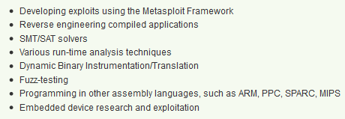
Getting A Job
Ad is © Rapid7/jduck

Slide 59
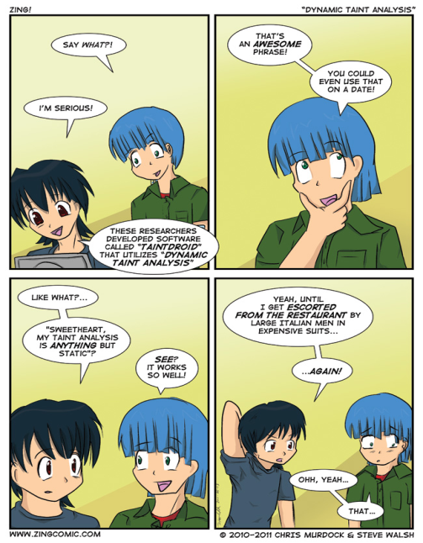
Taint analysis
Following tainted data flow through programs
Transitive property
  X∈T(Y) ∧ Z∈T(X)
  ➔ Z∈T(Y)
  (x<y)∧(z<x)➔(z<y)

Slide 60

Taint (DATA FLOW) analysis
Data flow analysis
  Vulnerability research
  Privacy
Malware analysis
Unknown vulnerability detection
Test case generation
…

Slide 61
Taint (DATA Flow) analysis
Edgar Barbosa in H2HC 2009
Flayer
Some programming languages have a taint mode

Slide 62
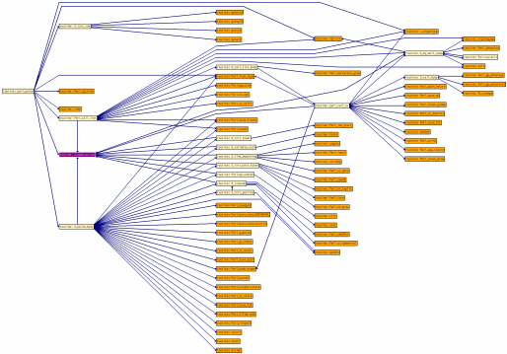
Control flow analysis
Call graphs
Code coverage
Examples:
  Pincov

Slide 63

Privacy monitoring
Relies on taint analysis
  Source = personal information
  Sink = external destination
Examples:
  Taintdroid
  Privacy Scope

Slide 64

KNOWN vulnerability detection
Detect exploitable condition
  Double free
  Race condition
  Dangling pointer
  Memory leak

Slide 65
Unknown vulnerability detection
?
Detect exploit behavior
  Overwriting a return address
  Corruption of meta-data
    E.g. Heap descriptors
  Execution of user data
  Overwrite of function pointers

Slide 66

Vulnerability Detection
Examples:
  Intel ® Parallel Studio
  Determina

Slide 67

Fuzzing / security test case generation
Feedback driven fuzzing
  Code coverage driven
    Corpus distillation
  Data coverage driven
    Haven’t seen it in the wild
  Constraints
  Evolutionary fuzzing
Checkpointing
In-memory fuzzing
Event / Fault injection

Slide 68
Fast fuzzing
Execute DUT
Restore checkpoint
The main overhead of modern instrumentation comes from the first pass on the code (JIT)
Many programs have a constant long initialization (and destruction) before what we’re interested in testing
One solution to this is checkpointing
Over enough time:
(init*overhead) << (init*no of tests)
Total overhead
Create checkpoint
Slow init
No of tests

Slide 69

Corpus distillation
A technique for locating “untested” code
Corpus – the entire collection of existing inputs
Distilled corpus – a subset of the corpus with the same code coverage
Simple set operations or other operations like mutations allow finding new test cases from a distilled corpus that target uncovered areas

Slide 70

Advanced monitoring
Defining advanced restrictions on your program behavior and detecting violations of those
In particular applying vulnerability detection:
  Generic:
    Exploitable condition
    Exploitable behavior
  Specific:
    Illegal state or sequence of states
    Illegal values
    Illegal data-flow
    Illegal control-flow

Slide 71
Fuzzing / security test case generation
Examples:
  Tavis Ormandy @ HITB’09
  Microsoft SAGE

Slide 72

Automated exploit development
Known exploit techniques
SAT/SMT

Slide 73

Automated vaccinations
Detecting attacks
Introducing diversity
Adaptive self-regenerative systems
Examples:
  Sweeper
  GENESIS

Slide 74
Pre-patching of vulnerabilities
Modify vulnerable binary code
Insert additional checks
Example:
  Determina LiveShield

Slide 75
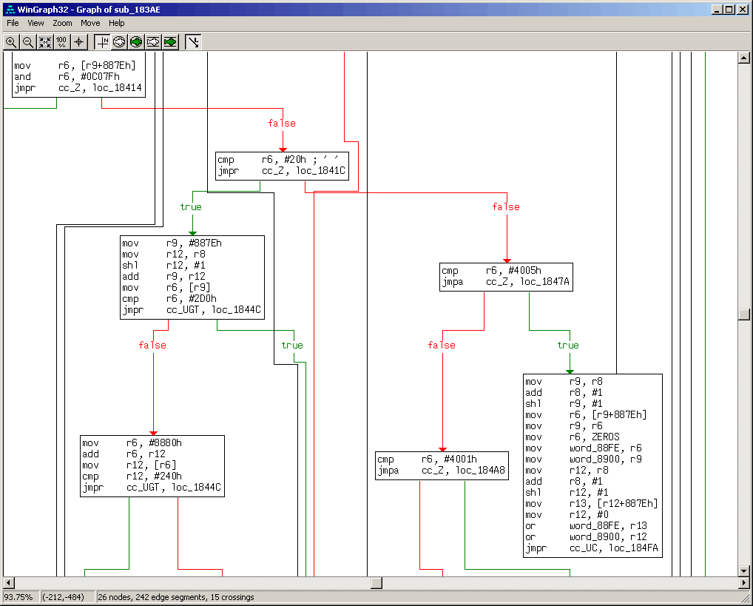
Reversing
De-obfuscation / unpacking
Frequency analysis
SMC analysis
Automated lookup for behavior / functions
Differential analysis / equivalence analysis
Data structure restoration

Slide 76
Reversing
Examples:
  Covert debugging / Danny Quist & Valsmith @ BlackHat USA 2007
  Black Box Auditing Adobe Shockwave - Aaron Portnoy & Logan Brown
  tartetatintools
  Automated detection of cryptographic primitives

Slide 77

Transparent debugging
Hiding from anti-debug techniques
Anti-instrumentation
Anti-anti instrumentation

Slide 78
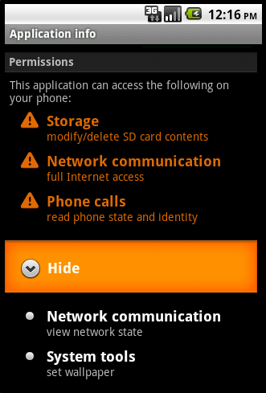
behavior based security
Creating legit behavior profiles and allowing programs to run as long as they don’t violate those
Alternatively, looking for backdoor / Trojan behavior
Examples:
  HTH – Hunting Trojan Horses

Slide 79
Other usages
Vulnerability classification
Anti-virus technologies
Forcing security practices
  Adding stack cookies
  Forcing ASLR
Sandboxing
Forensics

Slide 80
Section Summary
Data & Control flow analysis
Privacy
Vulnerability detection
Fuzzing
Automated exploitation
Reverse engineering & Transparent debugging
Behavior based security
Pre-patching

Slide 81
Security PinTools
The real deal

Slide 82
More taint analysis
What can be tainted?
  Memory
  Register
Can the flags register be tainted?
Can the PC be tainted?

Slide 83
More taint analysis
For each instruction
  Identify source and destination operands
    Explicit, Implicit
  If SRC is tainted then set DEST tainted
  If SRC isn’t tainted then set DEST not tainted
Sounds simple, right?

Slide 84
More taint analysis
Implicit operands
Partial register taint
Math instructions
Logical instructions
Exchange instructions

Slide 85
A simple taint analyzer
Define initial taint
Set of Tainted Memory Addresses
Fetch next inst.
If src is tainted set dest tainted
If src is untainted set dest untainted
bffff081
bffff082
b64d4002
Tainted Registers
EAX
EDX
ESI

Slide 86
#include "pin.H"
#include <iostream>
#include <fstream>
#include <set>
#include <string.h>
#include "xed-iclass-enum.h"
set<ADDRINT> TaintedAddrs; // tainted memory addresses
bool TaintedRegs[REG_LAST]; // tainted registers
std::ofstream out; // output file
KNOB<string> KnobOutputFile(KNOB_MODE_WRITEONCE, "pintool",
"o", "taint.out", "specify file name for the output file");
/*!
* Print out help message.
*/
INT32 Usage()
{
cerr << "This tool follows the taint defined by the first argument to " << endl <<
"the instrumented program command line and outputs details to a file" << endl ;
cerr << KNOB_BASE::StringKnobSummary() << endl;
return -1;
}

Slide 87
VOID DumpTaint() {
out << "======================================" << endl;
out << "Tainted Memory: " << endl;
set<ADDRINT>::iterator it;
for ( it=TaintedAddrs.begin() ; it != TaintedAddrs.end(); it++ )
{
out << " " << *it;
}
out << endl << "***" << endl << "Tainted Regs:" << endl;
for (int i=0; i < REG_LAST; i++) {
if (TaintedRegs[i]) {
out << REG_StringShort((REG)i);
} }
out << "======================================" << endl;
}
// This function marks the contents of argv[1] as tainted
VOID MainAddTaint(unsigned int argc, char *argv[]) {
if (argc != 2) return;
int n = strlen(argv[1]);
ADDRINT taint = (ADDRINT)argv[1];
for (int i = 0; i < n; i++) TaintedAddrs.insert(taint + i);
DumpTaint();
}

Slide 88
// This function represents the case of a register copied to memory
void RegTaintMem(ADDRINT reg_r, ADDRINT mem_w) {
out << REG_StringShort((REG)reg_r) << " --> " << mem_w << endl;
if (TaintedRegs[reg_r]) {
TaintedAddrs.insert(mem_w);
}
else //reg not tainted --> mem not tainted
{
if (TaintedAddrs.count(mem_w)) { // if mem is already not tainted nothing to do
TaintedAddrs.erase(TaintedAddrs.find(mem_w));
}
}
}
// this function represents the case of a memory copied to register
void MemTaintReg(ADDRINT mem_r, ADDRINT reg_w, ADDRINT inst_addr) {
out << mem_r << " --> " << REG_StringShort((REG)reg_w) << endl;
if (TaintedAddrs.count(mem_r)) //count is either 0 or 1 for set
{
TaintedRegs[reg_w] = true;
}
else //mem is clean -> reg is cleaned
{
TaintedRegs[reg_w] = false;
}
}

Slide 89
// this function represents the case of a reg copied to another reg
void RegTaintReg(ADDRINT reg_r, ADDRINT reg_w)
{
out << REG_StringShort((REG)reg_r) << " --> " <<
REG_StringShort((REG)reg_w) << endl;
TaintedRegs[reg_w] = TaintedRegs[reg_r];
}
// this function represents the case of an immediate copied to a register
void ImmedCleanReg(ADDRINT reg_w)
{
out << "const --> " << REG_StringShort((REG)reg_w) << endl;
TaintedRegs[reg_w] = false;
}
// this function represents the case of an immediate copied to memory
void ImmedCleanMem(ADDRINT mem_w)
{
out << "const --> " << mem_w << endl;
if (TaintedAddrs.count(mem_w)) //if mem is not tainted nothing to do
{
TaintedAddrs.erase(TaintedAddrs.find(mem_w));
}
}

Slide 90
Helpers
// True if the instruction has an immediate operand
// meant to be called only from instrumentation routines
bool INS_has_immed(INS ins);
// returns the full name of the first register operand written
REG INS_get_write_reg(INS ins);
// returns the full name of the first register operand read
REG INS_get_read_reg(INS ins)

Slide 91
/*!
* This function checks for each instruction if it does a mov that can potentially
* transfer taint and if true adds the approriate analysis routine to check
* and propogate taint at run-time if needed
* This function is called every time a new trace is encountered.
*/
VOID Trace(TRACE trace, VOID *v) {
for (BBL bbl = TRACE_BblHead(trace); BBL_Valid(bbl); bbl = BBL_Next(bbl)) {
for (INS ins = BBL_InsHead(bbl); INS_Valid(ins); ins = INS_Next(ins)) {
if ( (INS_Opcode(ins) >= XED_ICLASS_MOV) &&
(INS_Opcode(ins) <= XED_ICLASS_MOVZX) ) {
if (INS_has_immed(ins)) {
if (INS_IsMemoryWrite(ins)) { //immed -> mem
INS_InsertCall(ins, IPOINT_BEFORE, (AFUNPTR)ImmedCleanMem,
IARG_MEMORYOP_EA, 0,
IARG_END);
}
else //immed -> reg
{
REG insreg = INS_get_write_reg(ins);
INS_InsertCall(ins, IPOINT_BEFORE, (AFUNPTR)ImmedCleanReg,
IARG_ADDRINT, (ADDRINT)insreg,
IARG_END);
}
} // end of if INS has immed
else if (INS_IsMemoryRead(ins)) //mem -> reg

Slide 92
else if (INS_IsMemoryRead(ins)) { //mem -> reg
//in this case we call MemTaintReg to copy the taint if relevant
REG insreg = INS_get_write_reg(ins);
INS_InsertCall(ins, IPOINT_BEFORE, (AFUNPTR)MemTaintReg,
IARG_MEMORYOP_EA, 0,
IARG_ADDRINT, (ADDRINT)insreg, IARG_INST_PTR,
IARG_END);
}
else if (INS_IsMemoryWrite(ins)) { //reg -> mem
//in this case we call RegTaintMem to copy the taint if relevant
REG insreg = INS_get_read_reg(ins);
INS_InsertCall(ins, IPOINT_BEFORE, (AFUNPTR)RegTaintMem,
IARG_ADDRINT, (ADDRINT)insreg,
IARG_MEMORYOP_EA, 0,
IARG_END);
}
else if (INS_RegR(ins, 0) != REG_INVALID()) { //reg -> reg
//in this case we call RegTaintReg
REG Rreg = INS_get_read_reg(ins);
REG Wreg = INS_get_write_reg(ins);
INS_InsertCall(ins, IPOINT_BEFORE, (AFUNPTR)RegTaintReg,
IARG_ADDRINT, (ADDRINT)Rreg,
IARG_ADDRINT, (ADDRINT)Wreg,
IARG_END);
}
else { out << "serious error?!\n" << endl; }
} // IF opcode is a MOV
} // For INS
} // For BBL
} // VOID Trace

Slide 93
/*!
* Routine instrumentation, called for every routine loaded
* this function adds a call to MainAddTaint on the main function
*/
VOID Routine(RTN rtn, VOID *v)
{
RTN_Open(rtn);
if (RTN_Name(rtn) == "main") //if this is the main function
{
RTN_InsertCall(rtn, IPOINT_BEFORE, (AFUNPTR)MainAddTaint,
IARG_FUNCARG_ENTRYPOINT_VALUE, 0,
IARG_FUNCARG_ENTRYPOINT_VALUE, 1,
IARG_END);
}
RTN_Close(rtn);
}
/*!
* Print out the taint analysis results.
* This function is called when the application exits.
*/
VOID Fini(INT32 code, VOID *v)
{
DumpTaint();
out.close();
}

Slide 94
int main(int argc, char *argv[])
{
// Initialize PIN
PIN_InitSymbols();
if( PIN_Init(argc,argv) )
{
return Usage();
}
// Register function to be called to instrument traces
TRACE_AddInstrumentFunction(Trace, 0);
RTN_AddInstrumentFunction(Routine, 0);
// Register function to be called when the application exits
PIN_AddFiniFunction(Fini, 0);
// init output file
string fileName = KnobOutputFile.Value();
out.open(fileName.c_str());
// Start the program, never returns
PIN_StartProgram();
return 0;
}

Slide 95

Taint visualization
Do we need to visualize registers?
How to visualize memory?
Is the PC important?

Slide 96
Return Address protection
Detecting return address overwrites for functions in a certain binary
Before function: save the expected return address
After function: check that the return address was not modified

Slide 97
#include <stdio.h>
#include "pin.H"
#include <stack>
typedef struct
{
ADDRINT address;
ADDRINT value;
} pAddr;
stack<pAddr> protect; //addresses to protect
FILE * logfile; //log file
// called at end of process
VOID Fini(INT32 code, VOID *v)
{
fclose(logfile);
}
// Save address to protect on entry to function
VOID RtnEntry(ADDRINT esp, ADDRINT addr)
{
pAddr tmp;
tmp.address = esp;
tmp.value = *((ADDRINT *)esp);
protect.push(tmp);
}

Slide 98
// check if return address was overwritten
VOID RtnExit(ADDRINT esp, ADDRINT addr) {
pAddr orig = protect.top();
ADDRINT cur_val = (*((ADDRINT *)orig.address));
if (orig.value != cur_val) {
fprintf(logfile, "Overwrite at: %x old value: %x, new value: %x\n",
orig.address, orig.value, cur_val );
}
protect.pop();
}
//Called for every RTN, add calls to RtnEntry and RtnExit
VOID Routine(RTN rtn, VOID *v) {
RTN_Open(rtn);
SEC sec = RTN_Sec(rtn);
IMG img = SEC_Img(sec);
if ( IMG_IsMainExecutable(img) && (SEC_Name(sec) == ".text") )
{
RTN_InsertCall(rtn, IPOINT_BEFORE,(AFUNPTR)RtnEntry, IARG_REG_VALUE,
REG_ESP, IARG_INST_PTR, IARG_END);
RTN_InsertCall(rtn, IPOINT_AFTER ,(AFUNPTR)RtnExit , IARG_REG_VALUE,
REG_ESP, IARG_INST_PTR, IARG_END);
}
RTN_Close(rtn);
}

Slide 99
// Help message
INT32 Usage()
{
PIN_ERROR( "This Pintool logs function return addresses in main module and reports modifications\n"
+ KNOB_BASE::StringKnobSummary() + "\n");
return -1;
}
// Tool main function - initialize and set instrumentation callbacks
int main(int argc, char *argv[])
{
// initialize Pin + symbol processing
PIN_InitSymbols();
if (PIN_Init(argc, argv)) return Usage();
// open logfile
logfile = fopen("protection.out", "w");
// set callbacks
RTN_AddInstrumentFunction(Routine, 0);
PIN_AddFiniFunction(Fini, 0);
// Never returns
PIN_StartProgram();
return 0;
}

Slide 100
Automated exploitation
This program is the bastard son of the previous two examples
It relies on the ability to find the source of the taint to connect the taint to the input
This PinTool creates a log we can use to exploit the program

Slide 101
// This functions marks the contents of argv[1] as tainted
VOID MainAddTaint(unsigned int argc, char *argv[])
{
if (argc != 2)
{
return;
}
int n = strlen(argv[1]);
ADDRINT taint = (ADDRINT)argv[1];
for (int i = 0; i < n; i++)
{
TaintedAddrs[taint + i] = i+1;
}
}
// This function represents the case of a register copied to memory
void RegTaintMem(ADDRINT reg_r, ADDRINT mem_w)
{
if (TaintedRegs[reg_r])
{
TaintedAddrs[mem_w] = TaintedRegs[reg_r];
}
else //reg not tainted --> mem not tainted
{
if (TaintedAddrs.count(mem_w)) // if mem is already not tainted nothing to do
{
TaintedAddrs.erase(mem_w);
}
}
}

Slide 102
VOID RtnExit(ADDRINT esp, ADDRINT addr)
{
/*
* SNIPPED…
*/
ADDRINT cur_val = (*((ADDRINT *)orig.address));
if (orig.value != cur_val)
{
out << "Overwrite at: " << orig.address << " old value: " << orig.value
<< " new value: " << cur_val << endl;
for (int i=0; i<4; i++)
{
out << “Source of taint at: " << (orig.address + i) << " is: "
<< TaintedAddrs[orig.address+i] << endl;
}
out << "Dumping taint" << endl;
DumpTaint();
}
protect.pop();
}

Slide 103
From LOG to Exploit
Simple processing of the log file gives us the following:
  The indices in the input string of the values that overwrote the return pointer
  All memory addresses that are tainted at the time of use
With a bit of effort we can find a way to encode wisely and take advantage of all tainted memory
  But for sake of example I use the biggest consecutive buffer available
We can mark areas we don’t want to be modified like protocol headers

Slide 104
Bonus: Processes and threads
Because we live in a parallel universe

Slide 105
Multi threading
Application threads execute JITted code including instrumentation code (inlined and not inlined)
  Pin does not introduce serialization
  Instrumentation code can use Pin and/or OS synchronization constructs
  The JITting itself (VM) is serialized
Pin provides APIs for thread local storage.
Pin callbacks are serialized

Slide 106
Instruction counting: Take 3 - MT

Slide 107
#include "pin.H"
INT32 numThreads = 0;
const INT32 MaxNumThreads = 10000;
struct THREAD_DATA
{
UINT64 _count;
UINT8 _pad[56]; // guess why? } icount[MaxNumThreads];
// Analysis routine
VOID PIN_FAST_ANALYSIS_CALL docount(ADDRINT c, THREADID tid) { icount[tid]._count += c; }
// Pin Callback
VOID ThreadStart(THREADID threadid, CONTEXT *ctxt, INT32 flags, VOID *v) {numThreads++;}
VOID Trace(TRACE trace, VOID *v) { // Jitting time routine: Pin Callback
for (BBL bbl = TRACE_BblHead(trace); BBL_Valid(bbl); bbl = BBL_Next(bbl))
BBL_InsertCall(bbl, IPOINT_ANYWHERE, (AFUNPTR)docount, IARG_FAST_ANALYSIS_CALL,
IARG_UINT32, BBL_NumIns(bbl), IARG_THREAD_ID, IARG_END); }
VOID Fini(INT32 code, VOID *v){// Pin Callback
for (INT32 t=0; t<numThreads; t++)
printf ("Count[of thread#%d]= %d\n",t,icount[t]._count); }
int main(int argc, char * argv[]) {
PIN_Init(argc, argv);
for (INT32 t=0; t<MaxNumThreads; t++) {icount[t]._count = 0;}
PIN_AddThreadStartFunction(ThreadStart, 0);
TRACE_AddInstrumentFunction(Trace, 0);
PIN_AddFiniFunction(Fini, 0);
PIN_StartProgram(); return 0; }

Slide 108
Threading callbacks
PIN_AddThreadStartFunction
PIN_AddThreadFiniFunction

Slide 109
THREADING API
PIN_ThreadId
PIN_ThreadUid
PIN_GetParentTid
PIN_WaitForThreadTermination
PIN_CreateThreadDataKey
PIN_DeleteThreadDataKey
PIN_Yield
PIN_ExitThread
PIN_SetThreadData
PIN_GetThreadData
PIN_Sleep

Slide 110
Tool threads
You can create tool threads
  Handle buffers
  Parallelize data processing

Slide 111
TOOL THREAD API
PIN_SpawnInternalThread
PIN_IsApplicationThread
PIN_ExitThread

Slide 112

Instrumenting A Process tree
Fork
Execv
Windows

Slide 113
PROCESS CALLBACKS
PIN_AddFollowChildProcessFunction
PIN_AddForkFunction
PIN_AddFiniFunction
PIN_AddApplicationStartFunction

Slide 114
PRCESS API
PIN_IsProcessExiting
PIN_GetPid
PIN_ExitProcess
PIN_ExitApplication

Slide 115
Section Summary
Pin has various APIs and callbacks to handle multi threading
Pin supports instrumenting entire process trees using
“–follow_execv”
You can get callbacks on fork and execv in Linux

Slide 116
Bibliography and References
Where to look for information?

Slide 117
Bibliography & References
This is a list some relevant material. No specific logical order was applied to the list. The list is in no way complete nor aims to be.
Dino Dai Zvoi publications on DBT and security
Shellcode analysis using DBI / Daniel Radu & Bruce Dang (Caro 2011)
Black Box Auditing Adobe Shockwave / Black Box Auditing Adobe Shockwave
Making Software Dumber / Tavis Ormandy

Slide 118
Bibliography & References
Taint Analysis / Edgar Barbosa
ROPdefender: A Detection Tool to Defend Against Return-Oriented Programming Attacks / Lucas Davi, Ahmad-Reza Sadeghi, Marcel Winandy
Hybrid Analysis of Executables to Detect Security Vulnerabilities
Tripux: Reverse-Engineering Of Malware Packers For Dummies / Joan Calvet
Tripux @ Google code
devilheart: Analysis of the spread of taint of MS-Word

Slide 119
Bibliography & References
PIN home page
PIN mailing list @Yahoo (PinHeads)
Pin online documentation
DynamoRIO mailing list
DynamoRIO homepage
Valgrind homepage
ERESI project
Secure Execution Via Program Shepherding / Vladimir Kiriansky, Derek Bruening, Saman Amarasinghe

Slide 120
Bibliography & References
Pincov – a code coverage module for PIN
P-debugger – a multi thread debugging tool based on PIN
Tartetatintools - a bunch of experimental pintools for malware analysis
PrivacyScope
TaintDroid
Dynamic Binary Instrumentation for Deobfuscation and Unpacking / Jean-Yves Marion, Daniel Reynaud

Slide 121
Bibliography & References
Automated Identication of Cryptographic Primitives in Binary Programs / Felix Grobert, Carsten Willems and Thorsten Holz
Covert Debugging: Circumventing Software Armoring Techniques / Danny Quist, Valsmith
Using feedback to improve black box fuzz testing of SAT solvers
All You Ever Wanted to Know About Dynamic Taint Analysis and Forward Symbolic Execution / Edward J. Schwartz, Thanassis Avgerinos, David Brumley
Automated SW debugging using PIN

Slide 122
Bibliography & References
Determina website (no real information)
Determina blog
Sweeper: A Lightweight End-to-End System for Defending Against Fast Worms / James Newsome, David Brumley, et. el.
Hunting Trojan Horses / Micha Moffie and David Kaeli
Helios: A Fast, Portable and Transparent Instruction Tracer / Stefan Bühlmann and Endre Bangerter
secuBT: Hacking the Hackers with User-Space Virtualization / Mathias Payer

Slide 123
Bibliography & References
Understanding Swizzor’s Obfuscation / Joan Calvet and Pierre-Marc Bureau
GENESIS: A FRAMEWORK FOR ACHIEVING SOFTWARE COMPONENT DIVERSITY
A PinTool implementing datacollider algorithm from MS
Rootkit detection via Kernel Code Tunneling / Mihai Chiriac
Dytan: A Generic Dynamic Taint Analysis Framework / James Clause, Wanchun Li, and Alessandro Orso

