Slide 1
REAL WORLD
Social Engineering

Slide 2
HELLO.

Slide 3
I’m Chris

Slide 4
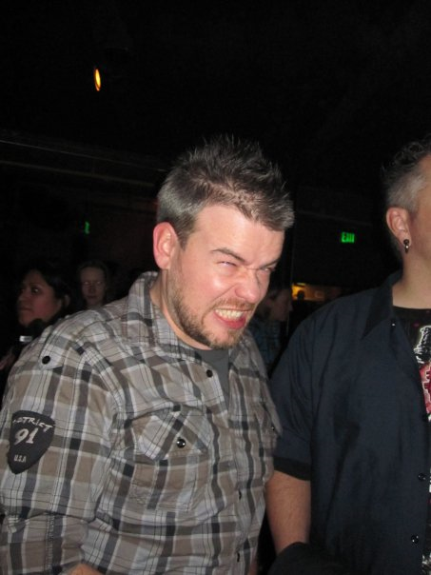
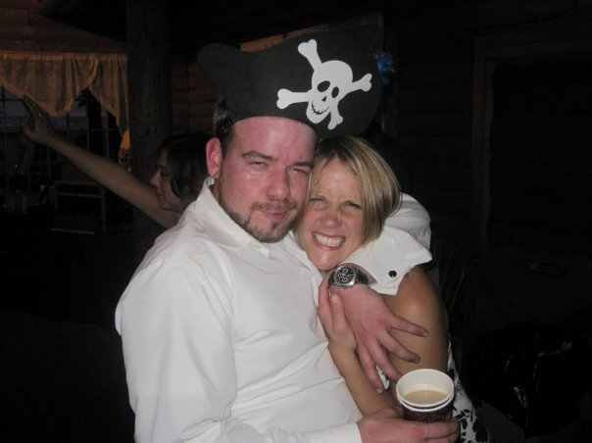
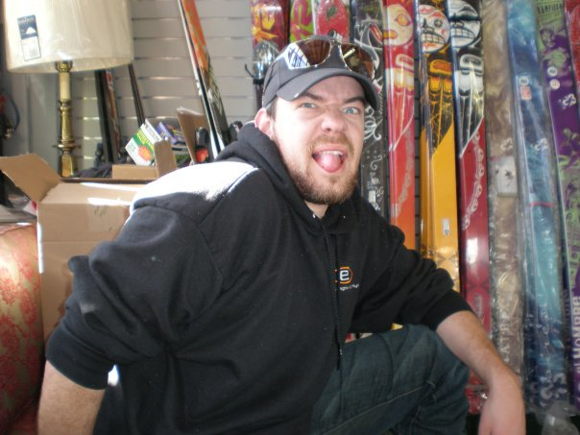
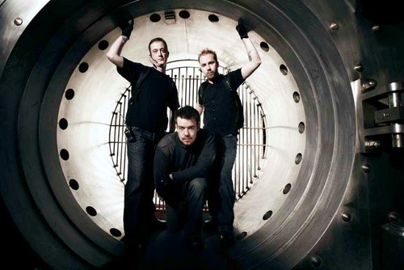
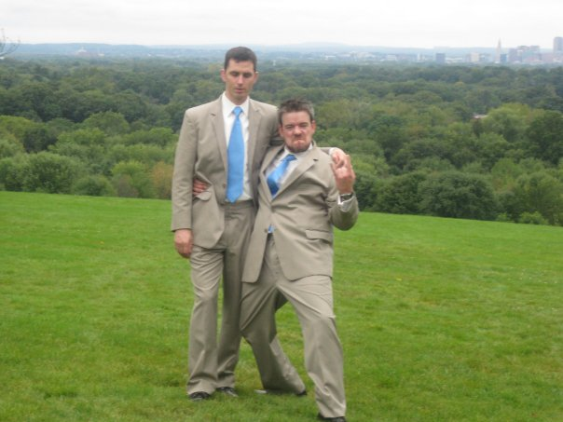
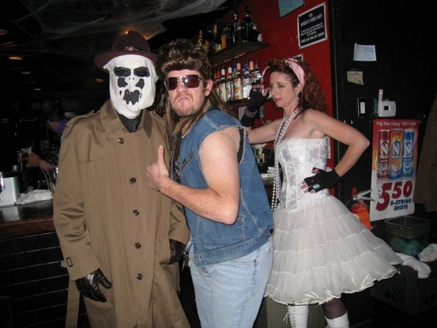

Slide 5
I Like Hacking

Slide 6
People

Slide 7
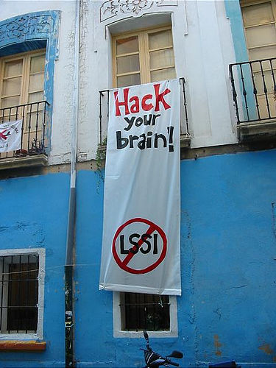
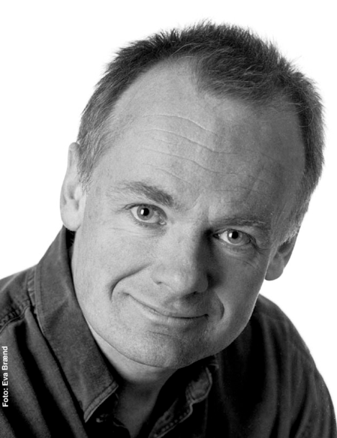
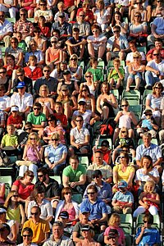
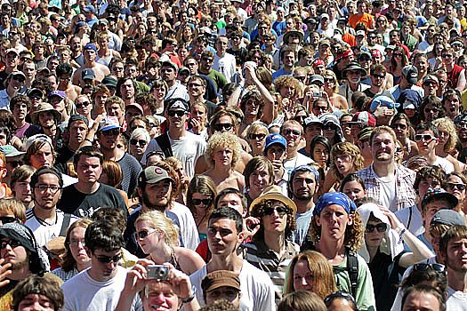
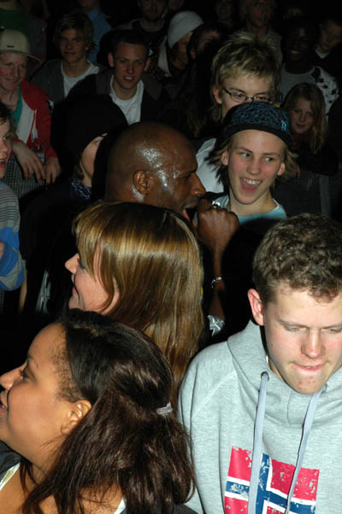
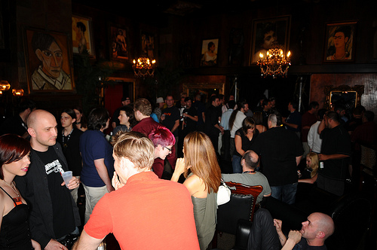
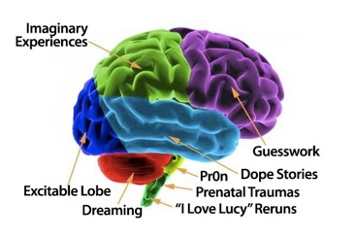

Slide 8
Yah.. We know.. Social engineering
BORING!!!!!

Slide 9
What is Social Engineering?
Social engineering :
Wikipedia: Social engineering is a collection of techniques used to manipulate people into performing actions or divulging confidential information.
*Social: (adjective 1 relating to society, its organization, or hierarchy. 2 needing companionship; suited to living in communities.)
*Engineering: (the branch of science and technology concerned with the design, building, and use of engines, machines, and structures.)
*Taken from Oxford Dictionary.

Slide 10
Pen-testing People
NOT THAT WAY!! Get YOUR mind out of the Gutter!

Slide 11
Computers are WEAK!
Your “shouldertop” calculates at roughly 100 trillion calculations per second
The Processing power…is about 100 trillion Teraflops
Your Neuro network can do 7 terabytes /sec
Your retina has 127million pixles
Your speech patterns and communications ..100bps.

Slide 12
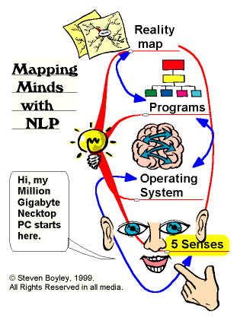
How do our brains communicate ?
Receive messages from external world
2 Million bits per second
We can only deal with
7 + at one time

Slide 13
Just Another Box to Hack.
Information Gathering
Vulnerability Analysis
Building the Session
Planning
Executing The Attack
Dig For The Gold!

Slide 14
Information Gathering

Slide 15
CALIBRATION
+
Look , listen, & feel

Slide 16
Passive Cold Reading
Observations about the “subject”
Clothing/Dress
Demeanor/ Posture
Outlook
Body type
Ethncity
Class
Likes/Dislikes
Physical Markings
Smell

Slide 17
Facial Coding
Paul Eckman
Developed a system with Dr. Friesen of 1000+ unique facial expressions exposed by a neurological connection between the brains emotions and the 43 muscles of the face.
These reactions are charted and coded (FACS) to provide real time facial analysis (Human lie detector)
YOU ALREADY DO THIS!

Slide 18
Building the Session

Slide 19
Good communication session starts with tapping into others mental map …

Slide 20
Perception is Reality

Slide 21
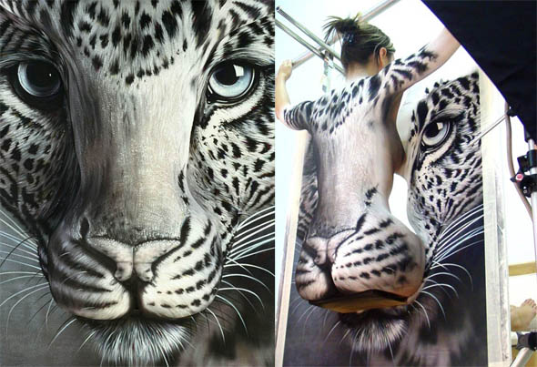
Sometimes…

Slide 22
We must Create a reality for the subject to live in
They must have trust in who we are
They must be able to find hard and “soft” facts
The must have a reason to believe
They must understand our role to them (+ = - )
Superior
Friend
Inferior
Enemy
Etc…

Slide 23
We like people who are like us !
Matching and mirroring
Rapport by becoming like the other person at a deep unconscious level.
How to match
Words that stand out.
Posture and body gesture.
Head tilt and breathing .
Perception and thinking .

Slide 24
We like people who are like us !
Pace , then lead
Matching other person’s perception.
Establish strong rapport.
Gently lead her towards your thinking.
Gradually change you speed of talking & shifting your position.
When she follows, she is changing her emotional state.

Slide 25
The 6-Way Handshake of human connection
Hobby and Appearance
Tempo
Thinking
Breathing
Mannerisms
Voice/Tonality

Slide 26
One way to make the handshake is Mirroring+

Slide 27
Mirroring in thinking

Slide 28
Mirroring in Mannerisms

Slide 29
Mirroring in hobby and appearance

Slide 30
Mirroring in Voice/Tonality

Slide 31
Mirroring of breathing pattern

Slide 32
Pace then lead

Slide 33
Executing the Attack

Slide 34
The EXPLOIT ARCHIVE IS HUGE!
NLP
Hypnosis
Family Therapy
Gestalt Therapy
Provocative Therapy
Transfor-mational Grammar
Persuasion
PUA
Magic
Physical
Fritz Perls
Erving Polster
Walter Kempler
Noam Chomsky
B.F. Skinner
Robert Dilts
Virginia Satir
Alfred Adler
Frank Farrelly
Jeff Brandsma
Robert Ciadini
Kevin Hogan
Eldon Taylor
Richard Bandler
John Grindler
Michael Hall
Tad James
Neil Strauss
IN10SE
Derren Brown
Harry Hodini
Kreskin
Mark Wilson
Bob Cassidy
Ian Rowland
Swami Rama
Ashley Montague
Paul Ekman
Pranyama
Barbra Pease
Milton Erickson
Rick Voit
Zali Segal
Coridna
Banachek
Carol Sommer

Slide 35
Rooten Boxxen

