Slide 1
Anti Virus 2.0 “Compilers in disguise”
Mihai G. Chiriac
BitDefender
Notes:
We will talk about the usage of compiler technology in AV programs.

Slide 2
Talk outline
AV History
Emulation basics
Compiler technology
Intermediate Language
Optimizations
Code generation
Conclusions

Slide 3
AV History!
String searching
Aho-Corasick, KMP, Boyer-Moore
PolySearch
Bookmarks (from top, tail, EP?)
Hashes (B, ofs1, sz1, crc1, ofs2, sz2, crc2)
NYB.A
Notes:
-First viruses were simple, and they were easy to detect with a single scan string. Example: NYB, not encrypted, etc.
-Many AV programs used “dumb” scanning while others used more complex algorithms
-Then some AV programs added “bookmarks”, instead of stupidly scanning the entire file they were looking only in specific areas

Slide 4
AV History (cont’d)
Encrypted viruses
Static decryption loop (signature)
Simple encryption (xray-ing)
Algorithmic detection
Cascade.1706 decryption loop
Notes:
Then encrypted viruses appeared, however their decryption loop is static and big enough to use as a signature.
Some signatures even support wildcards (to skip the encryption key)
X-raying – plaintext attack against an encrypted body, a technique still used today
Algorithmic detection means that a specific routine, written either in C, assembler or a specific virus detection language had to be developed by the AV researcher – very time consuming.

Slide 5
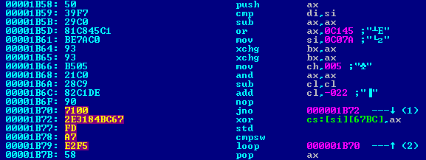
AV History (cont’d)
Polymorphic viruses
Simple encryption (xray-ing)
Algorithmic detection, heuristics
TPE.Giraffe.A
Notes:
Polymorphic viruses – not a single byte of static code, each decryption loop is generated differently by the polymorphic engine.
X-Raying is still used; has the big advantage that it detects viruses with invalid/damaged decryption code.
In this CMP – flags are not used; twice the exchange bx with ax; and with the same register, flags unused; Branch with delta = 00
But of course the most powerful way of dealing with polymorphic viruses is .. Emulation.

Slide 6
Emulation!
Hardware
Virtual CPU
Virtual memory
Virtual devices
Software
Partial OS simulation
Bonus Goodies
Fake IRC, SMTP, DNS, etc servers
Notes:
A complete virtual computer inside the real computer.

Slide 7
Workflow
Init the CPU / VM
Init the virtual OS
Modules
Structures
Map the file
Start emulation from cs:eip
Scan (when conditions are met)
Quit (when conditions are met)
Notes:
In the case of Microsoft Windows there is a bit more to handle, for example Thread Local Storage callbacks.
We will talk later about the Scan and Exit conditions!

Slide 8
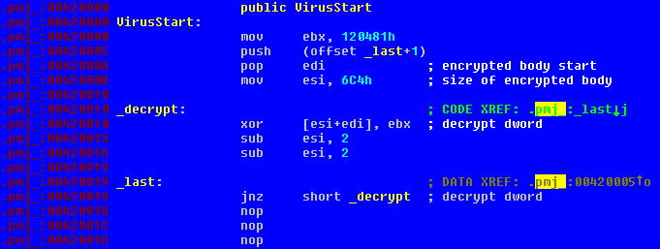
Sample
Win32.Parite (Pinfi) decryption loop
Notes:
EBX – decryption key
EDI – start of encrypted buffer
Operation = xor, 32 bits
Esi = esi - 4

Slide 9
Ready to emulate our first instruction?
…Not yet…

Slide 10
Chores! ☹
Pre-instruction tasks
DRx handling
Segment access rights
Page access rights
Post-instruction tasks
TF handling
Update the virtual EIP
Update the EI number
Notes:
- A hardware debug breakpoint may be set on read/execute on our address, so we have to check DR0-3 and the matching bits in DR7
CS:EIP must be a valid, executable address; we must have the rights to use this CS
It’s a common anti-debugging/anti-emulation trick to set the page access rights to e.g. PAGE_GUARD
-TF is commonly used as an anti-debugging trick

Slide 11
Tasks
Fetch instruction from cs:eip
Decode
Handle prefixes
Emulate!
Easy, huh? ☺
Notes:
We have to fetch the instruction from cs:eip, decode it and then emulate it.
While decoding, we have to take care of the prefixes… we have an example of the PeLock protector.
Superfluous prefixes are not generated by compilers; they’re mostly generated by polymorphic engines – method for heuristic detection
Invalid lock sequences – anti debugging trick
Invalid instruction sizes (> 15) using prefixes – anti emulation trick

Slide 12
On average, one every three instructions references memory…
☹

Slide 13
Memory accesses
We have to virtualize the entire 4 GB space….
Every memory access needs:
Segment access checks
Linear address computation
Page access checks
Hardware debugging checks
SMC checks!! (for memory writes)
Notes:
-Virtualize, that is for every emulator page we have to find the corresponding page in our structures
-Segment access check – not only access, but also Base, Limit, etc
-DS (data segment) is the default for memory accesses; SS (stack segment) is the default for ESP and EBP
Linear address is segment.base + offset
Page access check – PAGE_GUARD, not writable, for writes etc!
-Self modifying code – important trick; Prefetch queue tricks, etc.

Slide 14
Problems…
Millions of instructions…
Polymorphic decryption loops are full of do-nothing, “garbage” code…
Decompression loops are optimized for size, not speed…
…This results in unacceptable performance …
Notes:
-Pre- and post-instruction chores have to be performed for every instruction
-Memory access instructions typically are 1 every 3 instructions

Slide 15
UPX decompression
Notes:
In our example, we see that most blocks execute only once, so there’s no need to apply heavy optimizations. However, we see that a handful of basic blocks (decompression inner loops) execute many times – good candidates for optimizations.

Slide 16
Advantages
Typically, an emulator spends the most time in loops…
A small percentage of code is responsible for a large percentage of emulation time…
So… we know what to optimize!

Slide 17
The plan
Identify hot-spots
Basic blocks that execute very frequently
Try to make them run as fast as possible
Reducing to a minimum the set of repetitive actions
Reducing to a minimum the number of reduntant operations
Notes:
A basic block, from compiler theory, is a continuous piece of code that starts at the target of a branch instruction and ends with a branch instruction.

Slide 18
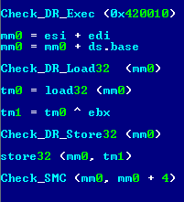
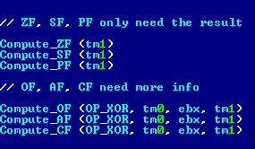
Back to our code…
.420010 (31 1C 3E) xor [esi+edi], ebx

Slide 19
First thoughts
For loops, keep the opcodes already decoded!
Memory model is usually flat…
We can catch accesses to DS, SS,…
Hardware debugging rarely used…
We can catch accesses to DRx
Trap Flag rarely used…
We can monitor accesses to EFlags
Notes:
-Specific instructions to access the segments, only MOV SEG, Register and POP SEG
-There is another way, of literally modifying the GDT/LDT, or by modifying the GDTR/LDTR registers. All these instructions can be monitored.
-0F 23 XX the only way of modifying DRx inside the emulator
-Of course, every time we encounter such instruction we will need to re-decode the instructions

Slide 20
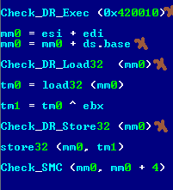
Back to our code…
.420010 (31 1C 3E) xor [esi+edi], ebx
Notes:
We can remove about half of the operations!
Of course, we can re-translate the code block and add these checks, if needed.

Slide 21
But we can do much more!
x86 - Very rich instruction set
One instruction – many basic operations
Different encodings, same result
Hard(er) to optimize…
Mike’s Intermediate Language Format
…apparently the acronym is taken ☺

Slide 22
IL Basics
Very RISC-like
Single-purpose micro-operations
Infinite number of virtual registers
Many info, useful for optimizations
Operation type, operands
Input / output variables (use-define)
Many info, useful for dynamic analysis
Memory access info
Notes:
What kind of memory does it access?
How often? What is the access pattern?
Is it part of a decryption loop?
Is the operation currently active, or maybe a part of an infinite loop ?

Slide 23
Parite.A decryption (1)
Decrypt:
.420010 xor [esi+edi], ebx
.420013 sub esi, 2
.420016 sub esi, 2
.420019 jnz Decrypt
Compute_ZF (tm1)
Compute_SF (tm1)
Compute_PF (tm1)
Compute_OF (OP_XOR, …)
Compute_AF (OP_XOR, …)
Compute_CF (OP_XOR, …)
mm0 = esi + edi
tm0 = load32 (mm0)
tm1 = tm0 ^ ebx
store32 (mm0, tm1)
Notes:
Defines MM0 virtual register, uses ESI and EDI
Defines TM0, uses MM0 and Memory (difficult to optimize)
Defines TM1, uses TM0 and EBX
Uses TM1 and Memory; Writes to memory (difficult to optimize)
Defines OSZAPC

Slide 24
Parite.A decryption (2)
Decrypt:
.420010 xor [esi+edi], ebx
.420013 sub esi, 2
.420016 sub esi, 2
.420019 jnz Decrypt
Compute_ZF (esi)
Compute_SF (esi)
Compute_PF (esi)
Compute_OF (OP_SUB, …)
Compute_AF (OP_SUB, …)
Compute_CF (OP_SUB, …)
tm0 = esi
esi = esi – 2
Notes:
Defines virtual register TM0, uses ESI
Uses ESI, defines ESI
Defines OSZAPC; Previous versions of OSZAPC are not used !

Slide 25
Parite.A decryption (3)
Decrypt:
.420010 xor [esi+edi], ebx
.420013 sub esi, 2
.420016 sub esi, 2
.420019 jnz Decrypt
Compute_ZF (esi)
Compute_SF (esi)
Compute_PF (esi)
Compute_OF (OP_SUB, …)
Compute_AF (OP_SUB, …)
Compute_CF (OP_SUB, …)
tm0 = esi
esi = esi – 2
Notes:
Defines virtual register TM0, uses ESI
Uses ESI, defines ESI
Defines OSZAPC; Previous versions of OSZAPC are not used!

Slide 26
Parite.A decryption (4)
We can follow the use-def chains and remove unnecessary micro-ops…
mm0 = esi + edi
tm0 = load32 (mm0)
tm1 = tm0 ^ ebx
store32 (mm0, tm1)
esi = esi – 2
tm0 = esi
esi = esi – 2
Compute_ZF (esi)
Compute_SF (esi)
Compute_PF (esi)
Compute_OF (OP_SUB, …)
Compute_AF (OP_SUB, …)
Compute_CF (OP_SUB, …)
Notes:
Already we have less than half of the operations (13/31) …

Slide 27
Parite.A decryption (5)
We can compute some values only if really needed…
mm0 = esi + edi
tm0 = load32 (mm0)
tm1 = tm0 ^ ebx
store32 (mm0, tm1)
esi = esi – 2
tm0 = esi
esi = esi – 2
Set_LazyFlags (OP_SUB, …)
Compute_ZF (esi)
Notes:
And we have removed more than 70% of the original code from a very simple loop…… but do you like this? ☺
2) We *KNOW* that esi = esi – 2; esi = esi-2 it’s the same as esi = esi - 4, but how can the optimizer know that ?
3) They are not inter-changeable, flags may be different, but it’s just for the sake of the argument.

Slide 28
Static single assignment
Sample code…
Three-address code..
int a, b, c;
a = 5;
b = 3;
c = a + b + 3;
b = c + 1;
int a, b, c;
a = 5;
b = 3;
c = a + b;
c = c + 3;
b = c + 1;

Slide 29
SSA (cont’d)
Three-address code…
SSA Form
a = 5;
b = 3;
c = a + b;
c = c + 3;
b = c + 1;
a[0] = cnst(5)
b[0] = cnst(3)
c[0] = a[0]+b[0]
c[1] = c[0]+cnst(3)
b[1] = c[1]+cnst(1)
Easy! Create a different version for every variable state!

Slide 30
SSA (cont’d)
SSA Form…
Graph!
a[0] = cnst(5)
b[0] = cnst(3)
c[0] = a[0]+b[0]
c[1] = c[0]+cnst(3)
b[1] = c[1]+cnst(1)
b[1]
+
/ \
c[1] cnst (1)
/
+
/ \
c[0] cnst (3)
+
/ \
a[0] b[0]

Slide 31
SSA (cont’d)
Very simple optimization framework
Constant folding
Constant propagation
Common sub-expression elimination
Dead code removal
Expensive, so it’s used only when needed…
b[1]
+
/ \
c[1] cnst (1)
/
+
/ \
c[0] cnst (3)
+
/ \
a[0] b[0]
Notes:
When dealing with a basic block that executes many times…

Slide 32
Memory!
0040517E 812B 84F1183C SUB DWORD PTR DS:[EBX],3C18F184
00405184 832B 96 SUB DWORD PTR DS:[EBX],-6A
00405187 013B ADD DWORD PTR DS:[EBX],EDI
00405189 D1CF ROR EDI,1
0040518D 832B DF SUB DWORD PTR DS:[EBX],-21
00405190 812B 69802E61 SUB DWORD PTR DS:[EBX],612E8069
00405196 29C9 SUB ECX,ECX
00405198 812B CD05B390 SUB DWORD PTR DS:[EBX],90B305CD
0040519E 832B 79 SUB DWORD PTR DS:[EBX],79
004051A3 87C1 XCHG ECX,EAX
004051A5 29D1 SUB ECX,EDX
004051A7 832B C9 SUB DWORD PTR DS:[EBX],-37
004051AE 2933 SUB DWORD PTR DS:[EBX],ESI
…
Win32.Harrier decryption loop (partial)
Notes:
This is just a small portion; the entire basic block is 164 bytes (HUGE)
All these instructions reference memory address pointed by EBX…
So we can treat [ebx] as a single variable, but there are some challenges!!!

Slide 33
Challenges
Memory locations = variables, but…
Hard to prove the addresses are valid…
Problems with pointer aliasing (including ESP!!)
A possible solution
Perform these optimizations only after we’ve gathered a set of run-time data…

Slide 34
Execution modes – 1
No code generation! ☺
Simply simulate the micro-ops
Advantages:
Very portable
Easy to profile
Easy to debug
Disadvantages:
Slow ☹

Slide 35
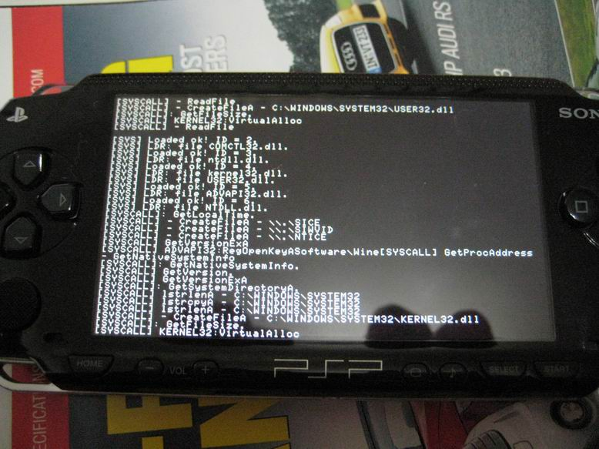
PSP ☺

Slide 36
Execution modes – 2
Trivial code generation…
Simply link the micro-functions that simulate the micro-ops
Most of them are 2-4 x86 instructions
Compiler generated, so they’re portable
Need a (very basic) platform-specific linker
Fast! ☺

Slide 37
Execution modes – 3
Generate code tailored for the target CPU!
Advantages
Fastest!
We can combine multiple micro-ops into a single CPU instruction
Special case: X86->X86
Disadvantages
Platform dependent
Notes:
For example computing the CPU flags; When working on X86 we can simply store the result from the operation itself (fetch the CPU’s own EFlags register)

Slide 38
Speed statistics

Slide 39
Exit conditions
We want to quit as early as possible when analyzing clean files
Too many GUI calls?
We want to quit in less than X seconds, no matter what…
Inject “time check” code…
We want to “chew” as much from the file as possible in those X seconds…
Notes:
Malware developers can do everything they want. A decryption loop that requires 5 seconds to finish? Quite possible. But in our best case scenario that would require almost 30 seconds, which is unacceptable, we have to finish our analysis in reasonable time.

Slide 40
What NOT to do…
For every basic block!!!
pushfd / pushad
call GetTickCount
sub eax, dword ptr [start_count]
xor edx, edx
mov ecx, 0x3e8
div ecx
cmp eax, dword ptr [max_seconds]
jg __out
popad / popfd
Notes:
Clearly unacceptable, because most basic blocks are smaller than this code!

Slide 41
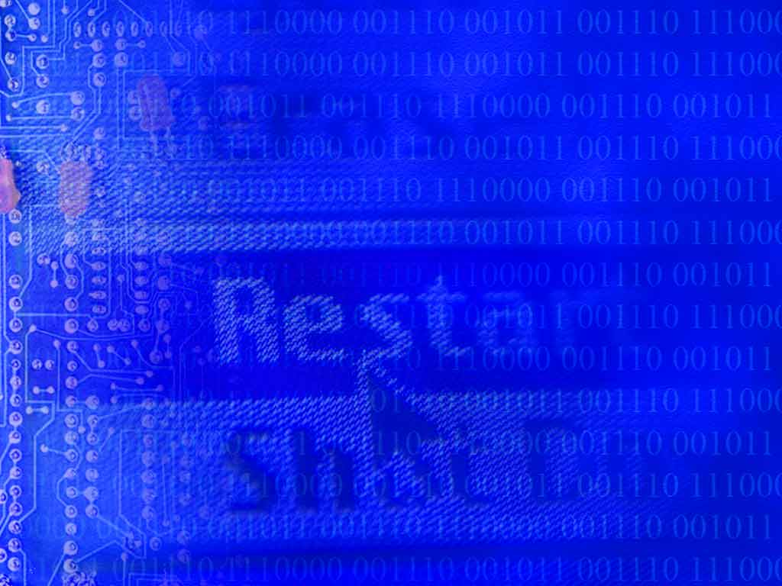
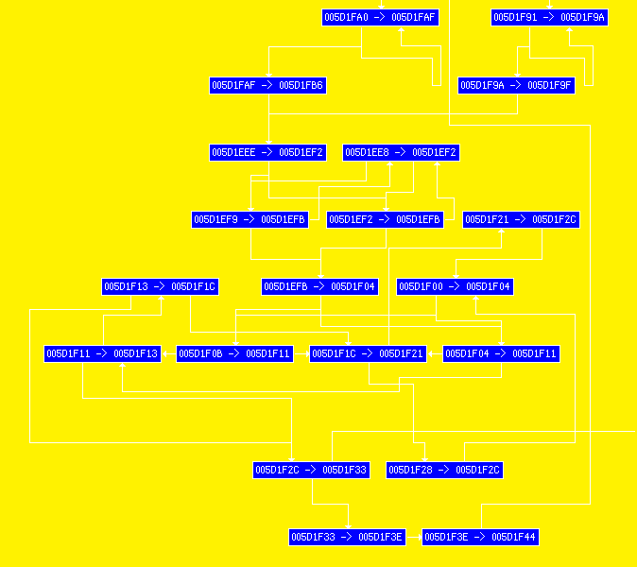
UPX CFG
Notes:
This is the control-flow graph for UPX … we notice there are a lot of “cycles”….
0x5D1FA0 – 0x5D1FAF, 0x5D1F91 – 0x5D1F9A are very tight loops, but we have more complex loops, so there’s no need to add code for every one of them…

Slide 42
An idea...
We have the control-flow-graph…
Why add “time check” code for every BB?
We can check only once / cycle in the CFG
Make sure there’s at least one “time check” per graph cycle
Easier way!
We can add “time check” code only for “backward” branches ☺

Slide 43
Scan conditions
Old(er) techniques
Specific APIs
Common startup code (CRT?)
New(er) techniques
Execution from a “dirty” page
Memory access patterns! (e.g. linear decryption loops)
Suspicious branches, purging of decryption code etc …
Notes:
From time to time we have to use signature scanning – we have to assume that at least some parts of the virus (if not all of it) have been decrypted, so we can use signatures.

Slide 44
Conclusions
CPU-intensive packers are here to stay…
…Ex: VMProtect requires 40 billion instructions…
Code optimization is a good way to reduce analysis time…
Compiler-like structures are good ways of solving other difficult AV problems ☺
Notes:
Many of VMProtect’s instructions are just garbage, can be optimized away.
Difficult problems : exit conditions, scan conditions etc.

Slide 45
Questions?
mchiriac@bitdefender.com

